Slide 1


RF & Microwave Industry Trends:
Design Skills You Need To Stay Relevant
How-Siang Yap

Slide 2

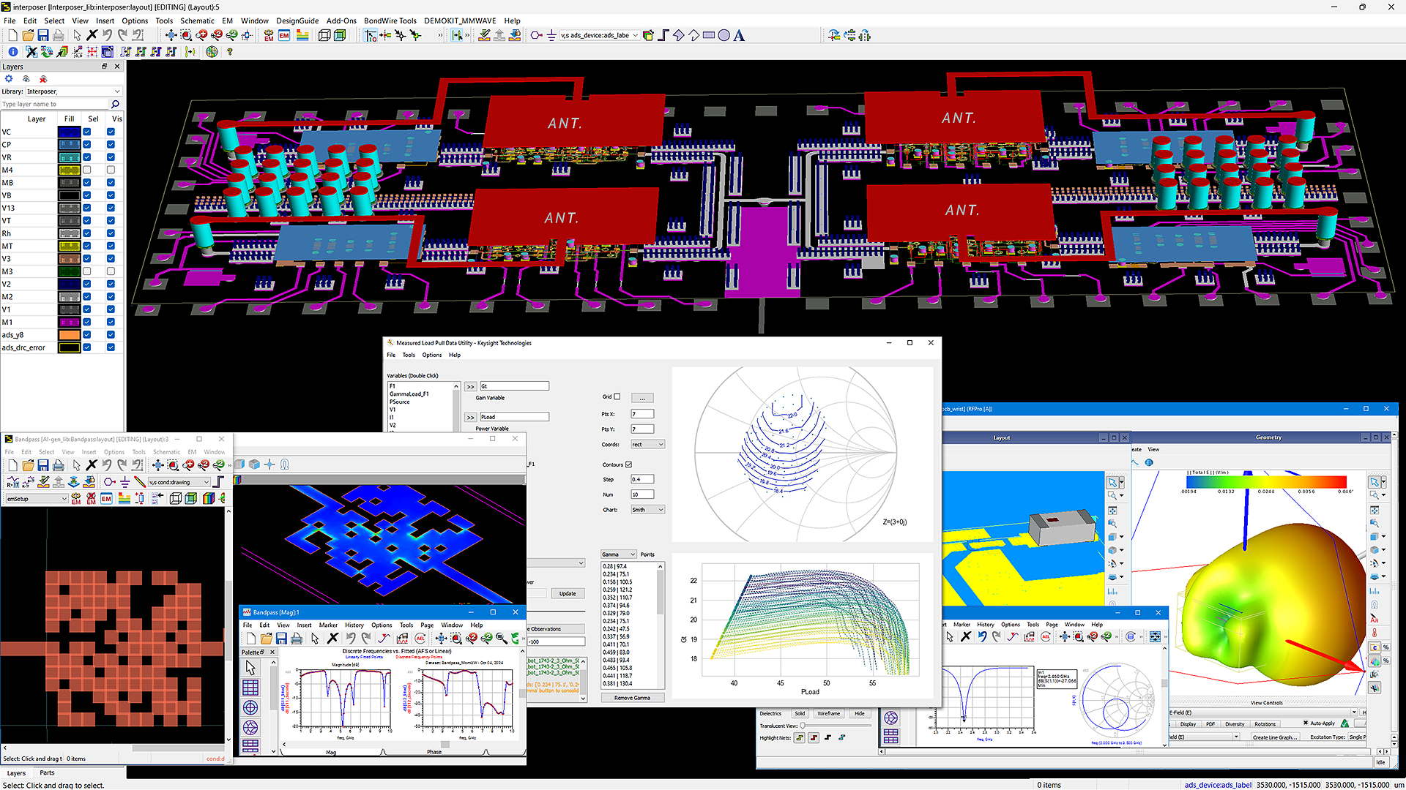
RF MW Industry Trends
What’s driving Keysight EDA development for RF/MW Design
6G Sub-THz 250 GHz Design
  Sub mm wavelength in substrate
Ai
Ai Machine Learning (ML)
  Automated data management
  Ai training
  Ai assisted design
ADS 2025 Screenshot
Notes:
2 major RF/MW industry trends are 6G and AI. 6G promises high-throughput, low-latency wireless data transport across land and satellite based networks. Consequently, 6G requires frequencies operating at sub-THz (up to 250GHz) which means the wavelengths in hardware substrates are sub-mm. This has significant implications on the design of RF/MW components for 6G.
AI deployment in RF/MW design is expected by companies to stay competitive in both innovation and productivity. This requires design platform automation for Ai training data generation and management, Ai training for Machine Learning (ML) and Ai assisted design.

Slide 3


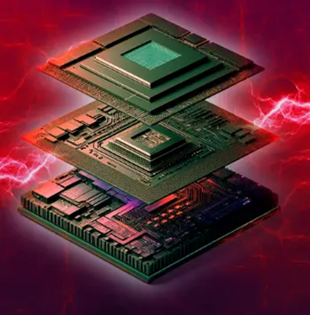
RF MW Industry Trends
What’s driving Keysight EDA development for RF/MW Design
6G Sub-THz 250 GHz Design
  Sub mm wavelength in substrate
  3DHI RF Chiplet Integration
  Wide BW digital RF modulation
  Multi-Domain Simulation/Optimization
6G sub mm wavelengths impacts physical design and simulation of RF/MW components for high throughput, low latency wireless data transport
Notes:
6G frequencies at reaching up to sub-THz of 250GHz. At these frequencies, the wavelengths in semiconductor, glass or ceramic substrates are all less than 1 mm. This means that RF/MW structures such as traditional interconnects such as traces bond wires will behave like antennas, causing unwanted coupling and feedback instability. Therefore tighter integration in the form of 3D Heterogenous Integration (3DHI) of RF chiplets (RFIC, MMIC, passive components, etc.) are required to implement 6G hardware.
6G is intended to carry high throughput, low latency wireless data and this must be accomplished through wide bandwidth digital RF modulation. Digital RF modulation has an important figure of merit called Error Vector Magnitude (EVM) which must be simulated and optimized at the circuit level during component design.
3DHI RF chiplets must work together to simultaneously satisfy system, circuit, electromagnetic, stability, electrothermal and statistical yield requirements. Traditional separate single tasking simulation and optimization techniques are no longer sufficient. That’s why the next generation multi-domain RF simulation and optimization flows are needed.

Slide 4


RF MW Industry Trends
Ai
What’s driving Keysight EDA development for RF/MW Design
AI & Machine Learning
Python Automation API
Chatbot Assistant
AI Training Data Generation
Neural Network Model Training
Advanced Optimization & Productivity
AI Assisted RF/MW Design
AI assisted IP Retrieval & Reuse
Python automation API enables AI to be incorporated into RF/MW design, modeling, simulation and optimization
Notes:
AI & Machine Learning (AI-ML) is permeating into every aspect of our lives, including RF/MW design. Automation of the design environment is prerequisite for enabling AI training data generation, ML training and deploying AI into design tasks. Python API is becoming the standard for enabling automation and Keysight ADS has enabled it for these tasks. Python code generation can also be Ai assisted in accelerating its adoption.

Slide 5

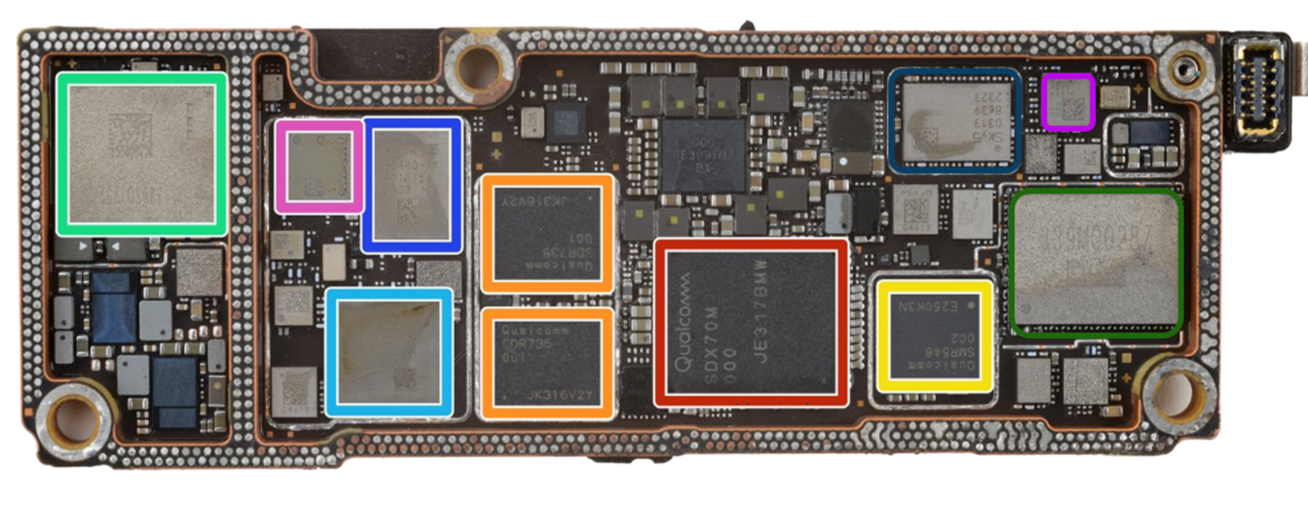
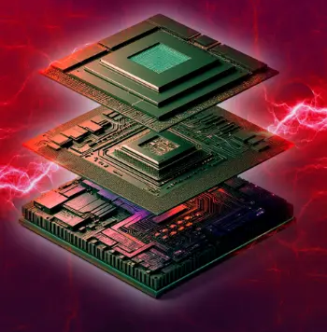
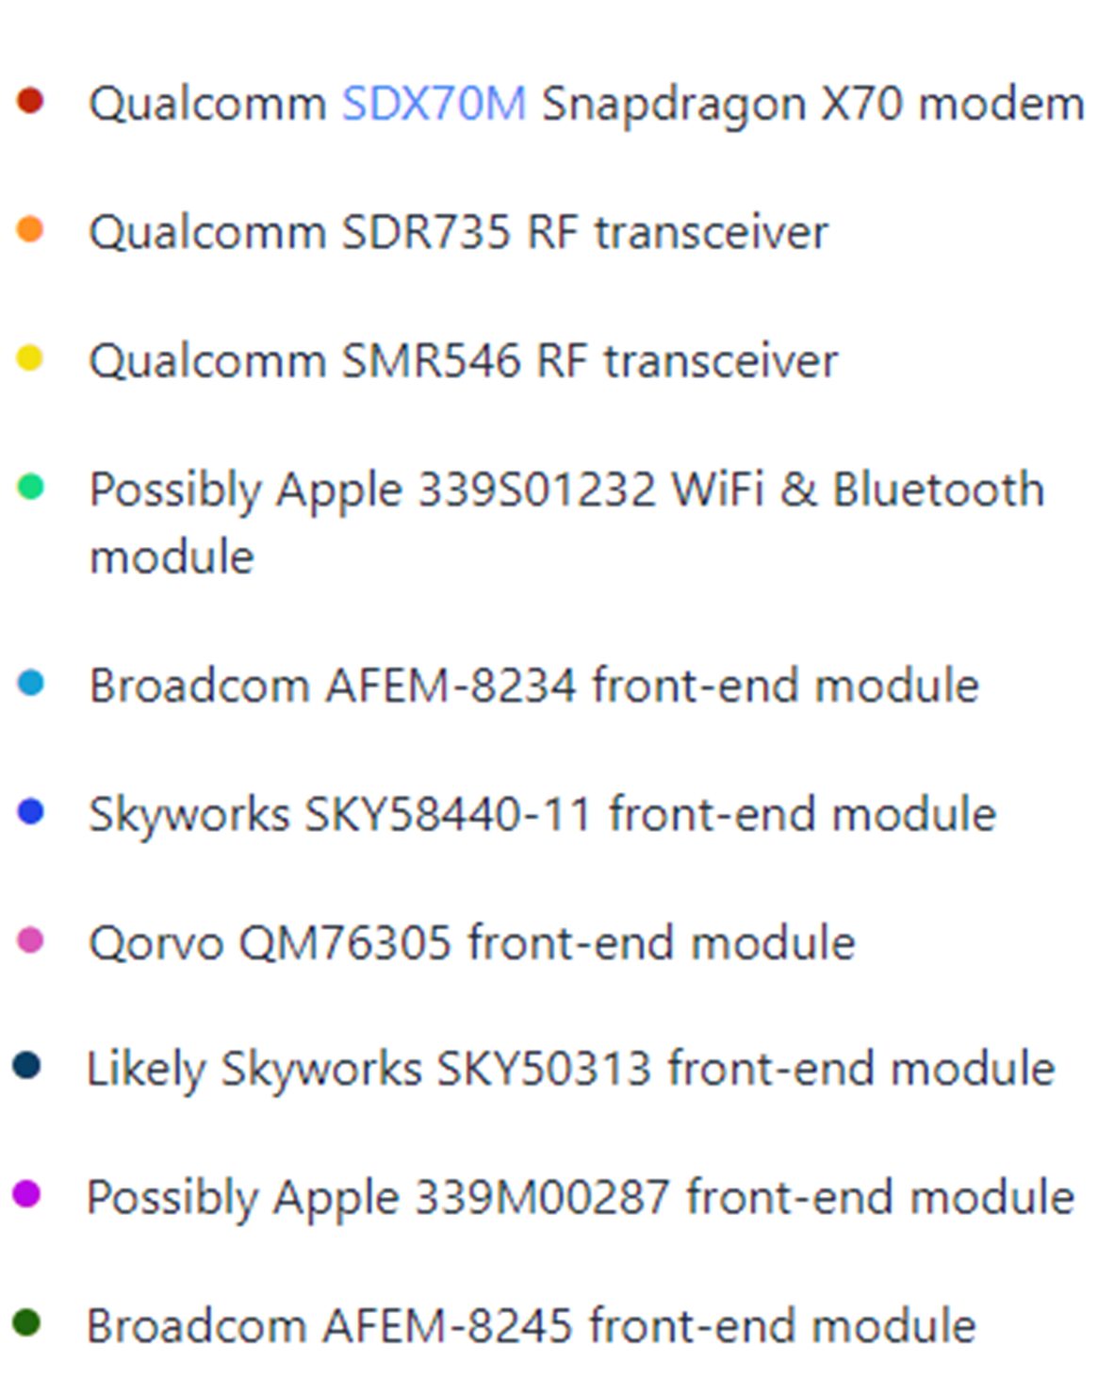
6G sub THz 250 GHz frequencies require 3DHI RF Chiplet Integration
Intertwined Si, III-V and Module design flow with multi-domain simulation and optimization
Source: iFixIt
5G iPhone 15 Pro Max RF Modules
III-V RFMW (ADS)
Silicon RFIC (Cadence/ Synopsys)
Silicon world
III-V world
Modules
(ADS)
Intertwined Design Flow- Multi-Domain Simulation

Slide 6
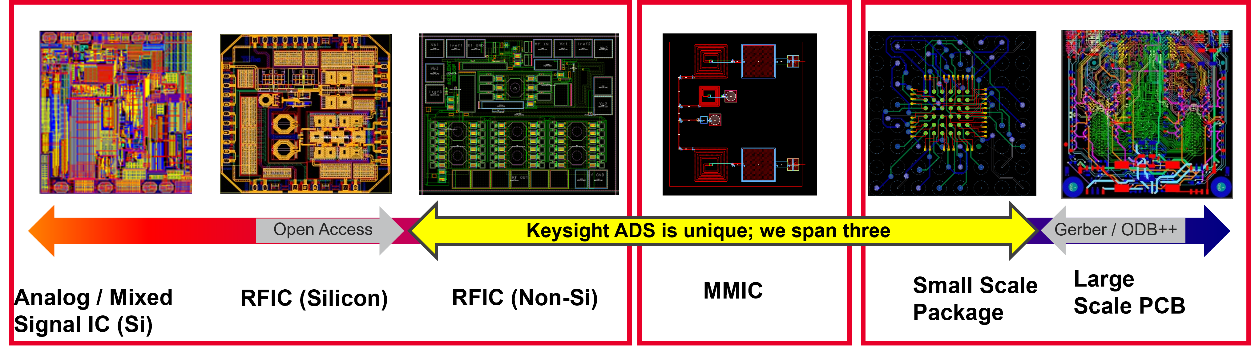
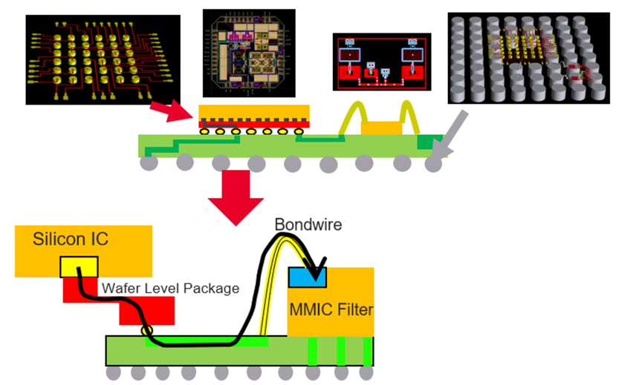
6G/5G RF Chiplet 3DHI Module Assembly & Simulation Platform
Keysight ADS streamlines 3DHI assembly by replacing 4 separate flows for RFIC, MMIC, packaging & PCB within a single platform
RFPro simulates RF paths across different technology boundaries with automated EM-Circuit analysis. No “cookie cutting” after assembly
Notes:
Example. of 4 separate disconnected flows from Cadence: 1. Virtuoso for Si RFIC; 2. AWR for III-V MMIC; 3. Adv Package Designer; 4. Allegro PCB. After assembly, any RF path crossing the 4 technology boundaries can be freely chosen for automated 3DEM-circuit cosimulation at will without traditional “cookie-cutting” of the design for EM simulation, followed by tedious manual stitching of the EM S-parameter ports to the correct circuit schematic nodes. Keysight ADS is unique in the industry to enable 3DHI RF Chiplet assembly because we also need to use in in designing our 6G test instrumentation.

Slide 7
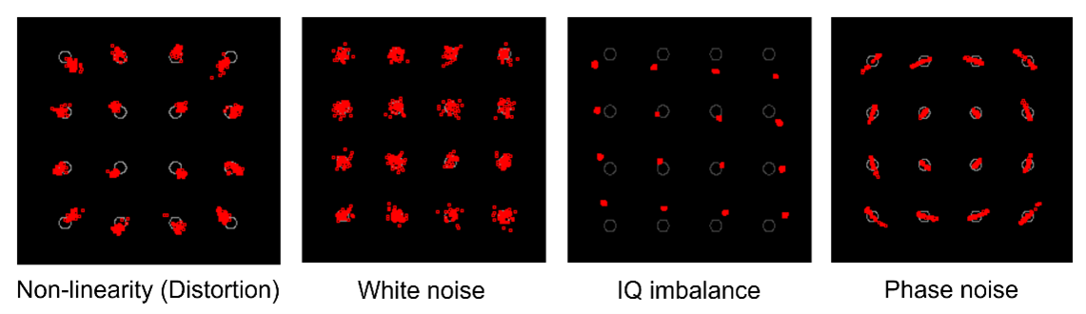
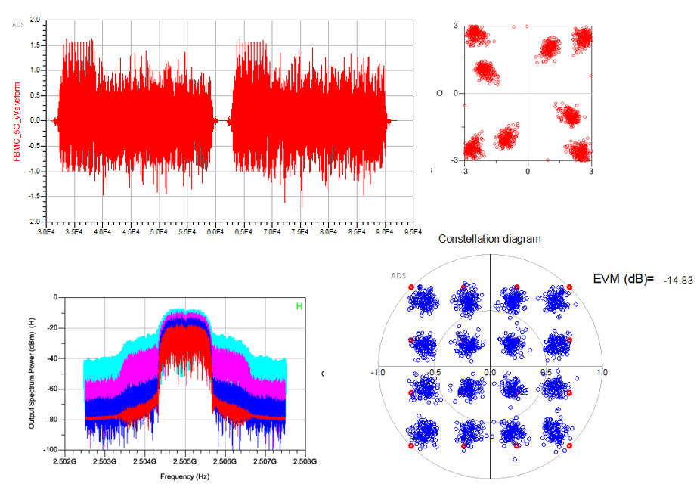
6G Wide BW Digital RF Modulation
Error Vector Magnitude (EVM) is the new RF/MW circuit performance spec
EVM measures the distortion of the RF digital modulation
EVM is degraded across the modulation BW by
  Amplitude-Phase nonlinearity
  IQ modulator imbalance
  White noise & phase noise
Keysight fast EVM simulation
  Proven in instrumentation compact signal generation and EVM analysis
  ADS enables breakthrough fast circuit level EVM simulation & optimization
  Unique in the industry to enable designing circuits to meet EVM specs directly
Notes:
6G or any current wireless applications such as automotive/aerospace radars and wireless networking require digital RF modulation for high-throughput, low-latency wireless data transport. Designing RF/MW components for digital wireless applications require a new figure of merit called Error Vector Magnitude (EVM) which measures the distortion the Error digital RF modulation. Keysight is unique in the industry in its compact signal generation and fast EVM measurement instrumentation techniques. These are also used in ADS during simulation to enable circuit designers to quickly simulate and optimize EVM at the circuit level.

Slide 8
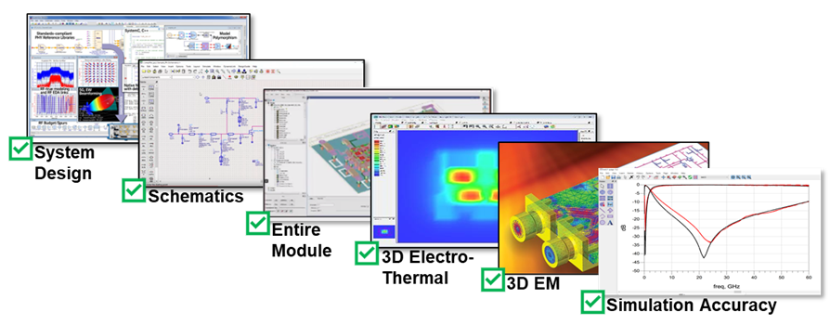
Next Gen Multi-Domain RF Simulator (Nexus)
Workflow automated RF simulation across multiple domains (System, Circuit, EM, ETH, Measurement, Statistics)
  Solve tough RF Design challenges faster
      Multi-domain integrated insights from multi-domain simulation workflow control
      Replaces serial task insights from individual access to specialized simulation tools for System, Circuit, EM, Electrothermal, Measurements & Statistics
  Streamline a whole workflow, not just a task
      Using low-code, graphical, or LLM interfaces for human RF users to script familiar applications and workflows
      Using Python, HPC, and Data Mgmt. to integrate highly automated AI/ML and digital transformation for the Enterprise
  Directly interoperable between platforms
      Avoid wasting design time on translators, setups, and specialized domain knowledge
      Interoperable in Keysight ADS, Cadence, & Synopsys platforms
  Scalable, cost-effective token pool licensing
      Enables instant access to all combinations of multi-domain simulation and optimization (Envelope, HB, Transient-Convolution, Electrothermal, Stability, EVM, Linear )
Notes:
To make 3DHI RF Chiplet integration work, we not only need to assemble and verify the integrity of the physical with the electrical designs, we need to also simulate the critical RF paths through the 3DHI module. These RF paths cross physical technology boundaries (e.g., RFIC- MMIC- ceramic passives - packaging – PCB - antennas). Multi-domain simulation workflow is needed because multiple design goals and tradeoffs (e.g. gain, linearity, EVM, efficiency, bandwidth, stability, etc.) must be analyzed iteratively during design. This automated workflow based multi-domain simulation replaces manual serial single task based individual specialized simulations for dramatic improvement in design insights and productivity.
Physical dimensional uncertainty in sub-THz sub-mm wavelengths during measurements turns into electrical variations, How do you design HW you can’t measure. Use EM simulation tools to augment your measurements as part of multi-domain simulation and digital twining.
Cost of simulation licenses is minimized through token pool licensing where tokens are taken during simulation and returned when done.

Slide 9
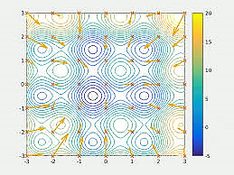
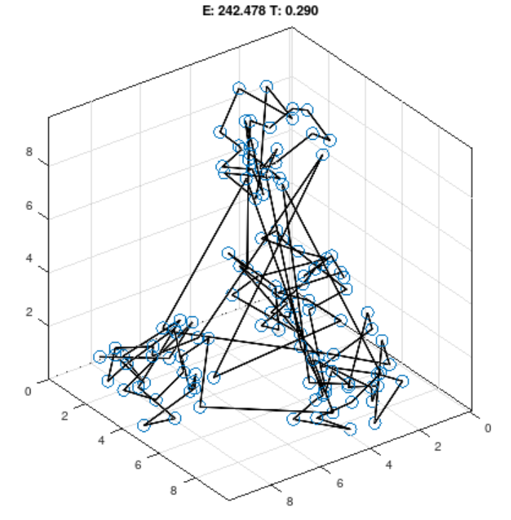
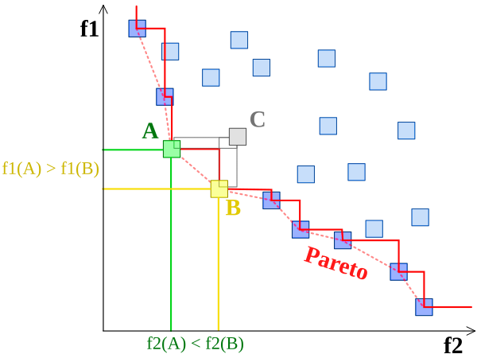
Next Gen Multi-Domain RF Simulator & Optimizer (Nexus)
Optimize RF designs across domains and hierarchy with high dimensional multi-objective goals
Graphics credit: Wikipedia
Particle Swarm
Corana Simulated Annealing
Non Dominated Sorted Genetic Algorithm II (NSGA-II)
  New generation optimizers and flexible flow control
      Multi-objective optimization with large number of variables
      Optimize complex designs across simulation domains and hierarchy
      Intuitive and flexible optimization setup and control
Notes:
Traditional optimization of multi-objective goals combines all goals into single error function with weights assigned to each objective based on human assumption of their relative importance. These assumptions are made before the optimization begins and does not produce the optimal combinations of multi-objective goals called the Pareto front which shows the trade offs amongst the competing goals. These new optimization techniques address these limitations to enable multi-objectives (e.g., EVM, Stability, Efficiency, Temperature and Size) goals with large number of input variables (i.e., high dimensional search space) to be optimized across simulation domains and design hierarchies.

Slide 10
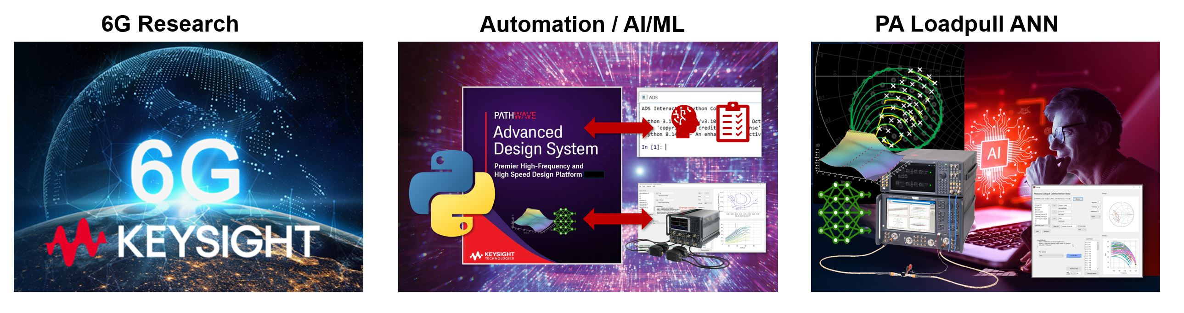
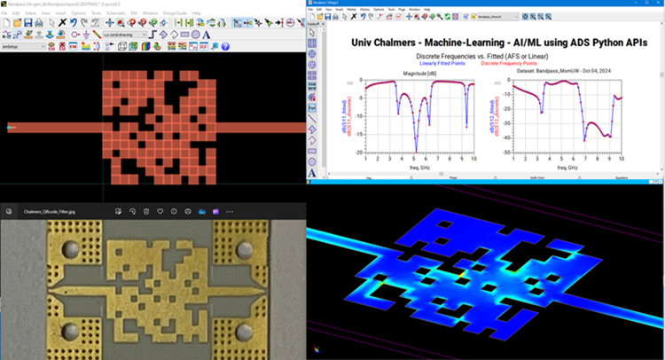
AI- Machine Learning enabled by Python Automation API
Ai
ADS Python API enables programmatic control of simulation, schematic, layout, data processing and display
Automate data processing, formatting and management
  Harness measured, simulated and graphical data
  Artificial Neural Network ANN model training and creation
  AI training data generation
ADS Python API
  Enables external capabilities (AI models, Optimizers, Synthesis, etc.) to be added
  Create innovative designs
  Automate workflow for personal productivity
  Enterprise level workflow optimization with AI to win against competitors
Research & Innovation
Notes:
AI is permeating every aspect of our daily lives and RF design with EDA is no exception. AI in ADS is enabled through its Python API which enables programmatic control of virtually all of its capability such as simulation, schematic, layout, data processing and display. This allows automated generation of AI training data and formatting of measured data, which are then used to train Artificial Neural Networks (ANN) in Machine Learning to produce simulation digital twin models. The ANN models can then be used in design simulation or synthesis as shown in the QR code filters by Chalmers University in Sweden.

Slide 11

Summary
  AI & Machine Learning
      ADS Python API
      Python Data
      AI Training Data Generation
      Neural Network Model Training
      AI Assisted RF/MW Design
      Automation Productivity
      AI assisted IP Retrieval & Reuse
      Chatbot Assistant
Keysight EDA Solutions
Ai
6G sub-THz 250 GHz Design
    3DHI RF Chiplets Integration
        ADS SmartMount 3DHI assembly
        RFPro automated EM-Circuit cosimulation
    Wide BW digital RF modulation
      Keysight instrument compact test signals
      ADS circuit level fast EVM analysis
    Multi-Domain Simulation/Optimization
      RF Circuit Professional (NEXUS)
      Scalable cost-effective token-pool licensing
      Envelope, EVM, HB, Transient-Convolution, Electrothermal, Stability, Linear
ADS 2025 Screenshot
Notes:
In the following session, please pay attention and learn new design skills to keep pace with the 6G and AI trends that is shaping the RF/MW industry. Make sure you ask for free trials of the powerful design tools you see today to stay relevant with the industry.

