Slide 1


5G NTN and 6G Satellite Link Design
Sassan Ahmadi
Murthy Upmaka
Keysight Technologies

Slide 2
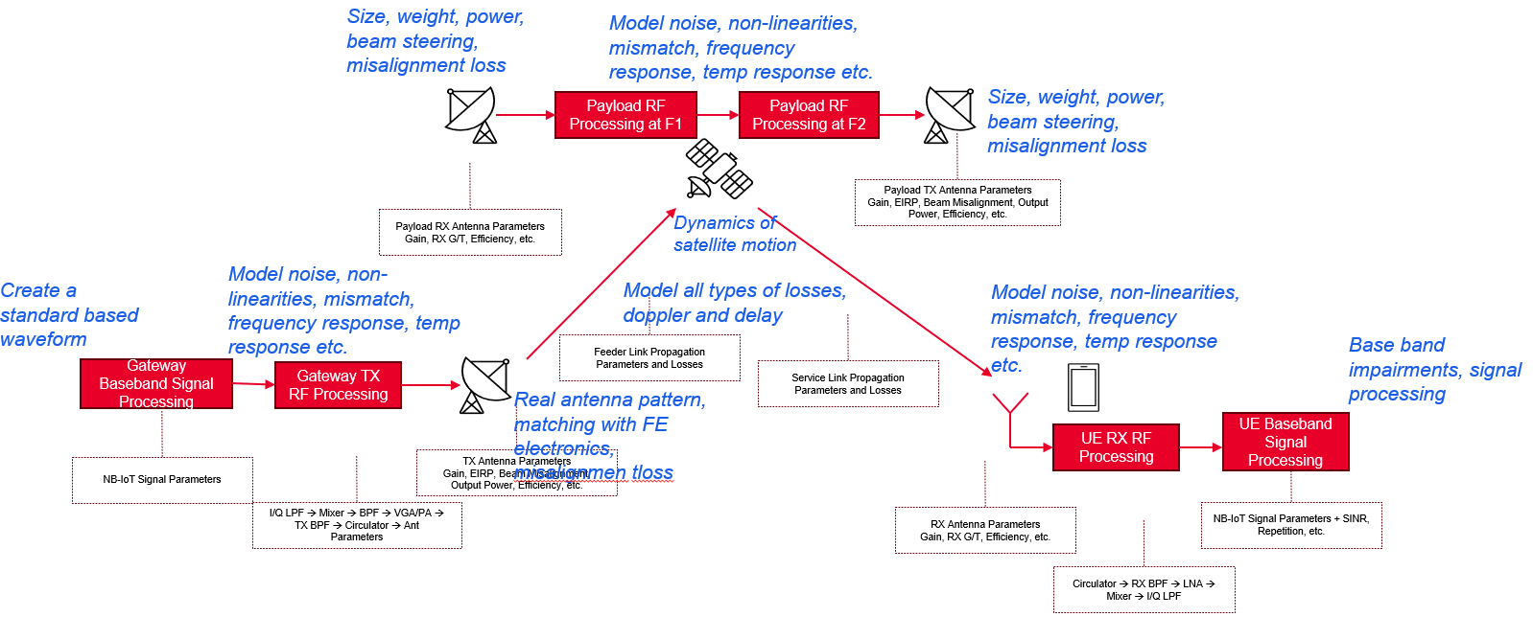
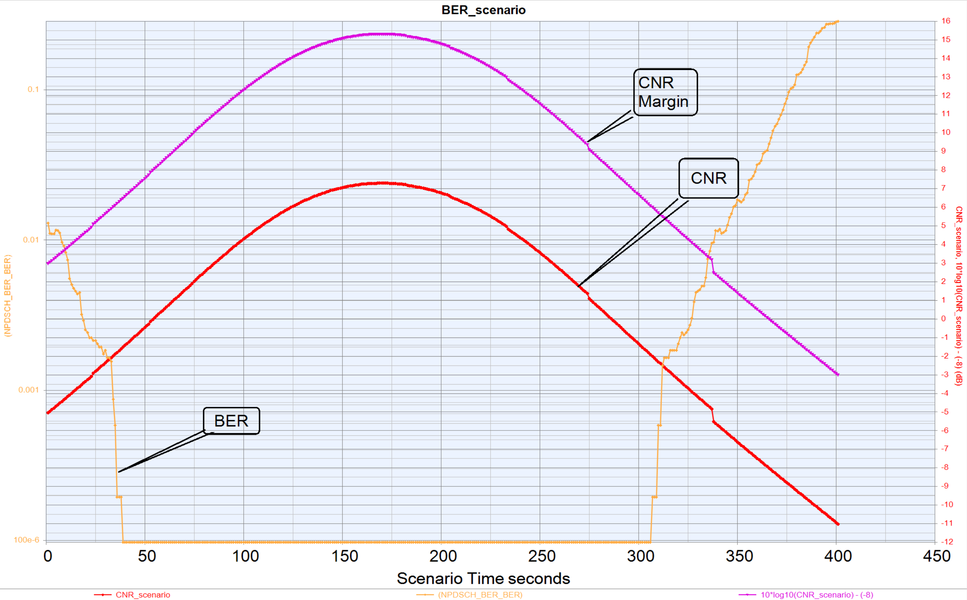
5G NTN and 6G Satellite Link Design
You will learn:
Overview of NTN
Challenges in designing an NTN link
The methodology to design an NTN link
SystemVue software that helps designing the NTN link
A case study of a link budget analysis

Slide 3

5G/6G NTN Technologies
Agenda
Overview of NTN and use cases
5G/6G NTN technologies and vendor/operator challenges
3GPP NTN roadmap and 6G NTN outlook
NTN architectures and characteristics
NTN link budget analysis
System design challenges and solutions
A case study
Summary

Slide 4
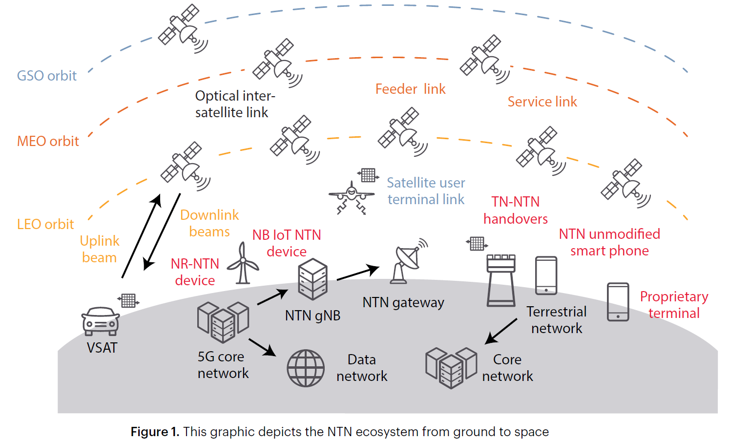
5G/6G NTN Technologies
NTN: Non-Terrestrial Network
enhancing connectivity and transforming current capabilities
The Definitive Guide to Non-Terrestrial Networks - ebook
Ubiquitous Service
Notes:
The space and satellite industry is experiencing rapid evolution driven by new companies, research efforts, and investment.
80% population has wireless access
40% of the globe has wireless coverage
Although we think primarily of satellites in NTNs, other components can consist of low-altitude platforms / drones (LAP), high-altitude pseudo satellites / drones / balloons (HAPS), satellites across the various orbits, and combinations of these.
GEO: geosynchronous equatorial orbit
MEO:medium Earth orbit
LEO:low Earth orbit

Slide 5
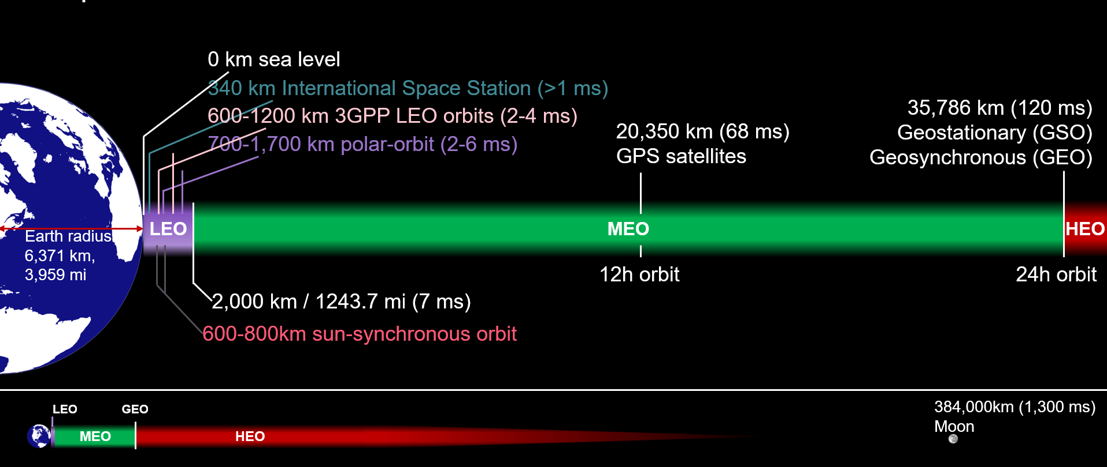
Satellite Orbits

Slide 6
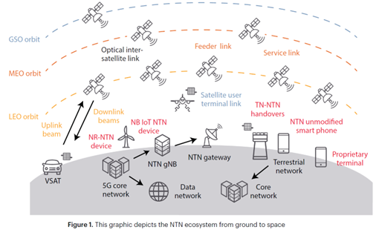
5G/6G NTN Technologies: use cases
NTN: Non-Terrestrial Network
Mainly to augment the TN (terrestrial network)
Urban : helps offloading, network resiliency, fixed wireless, emergency
Rural : Fixed wireless, network resiliency, emergency, Public protection and disaster relief
Remote: Network resiliency, PPDR, emergency, backhaul, wide area connectivity
Isolated: Aeronautical, Maritime, PPDR and emergency
Notes:
The space and satellite industry is experiencing rapid evolution driven by new companies, research efforts, and investment.
80% population has wireless access
40% of the globe has wireless coverage
Although we think primarily of satellites in NTNs, other components can consist of low-altitude platforms / drones (LAP), high-altitude pseudo satellites / drones / balloons (HAPS), satellites across the various orbits, and combinations of these.
GEO: geosynchronous equatorial orbit
MEO:medium Earth orbit
LEO:low Earth orbit

Slide 7
5G/6G NTN Technologies: use case examples
NTN: Non-Terrestrial Network
Each use case might require a different technology.
Examples:
1. Continuous communication, high data rates such as satellite internet
Huge dish communicating to GEO satellite
2. Hand phone in a remote area sending an SOS signal to satellite.
Lower Path Loss requiring communicating with LEO satellite
3. In a stadium 10s of thousands communicating
Set up a drone-based network
Notes:
The space and satellite industry is experiencing rapid evolution driven by new companies, research efforts, and investment.
80% population has wireless access
40% of the globe has wireless coverage
Although we think primarily of satellites in NTNs, other components can consist of low-altitude platforms / drones (LAP), high-altitude pseudo satellites / drones / balloons (HAPS), satellites across the various orbits, and combinations of these.
GEO: geosynchronous equatorial orbit
MEO:medium Earth orbit
LEO:low Earth orbit

Slide 8
5G/6G NTN Technologies: use case examples
NTN: Non-Terrestrial Network
GEO satellite : Higher path loss and large delay. Higher cost of satellite deployment
LEO satellite : Path loss, moderate delay, doppler, requiring handoff for continuous comms
drone-based network: Higher multipath fading, interference
We need to design the links with different technologies to meet the challenges
Notes:
The space and satellite industry is experiencing rapid evolution driven by new companies, research efforts, and investment.
80% population has wireless access
40% of the globe has wireless coverage
Although we think primarily of satellites in NTNs, other components can consist of low-altitude platforms / drones (LAP), high-altitude pseudo satellites / drones / balloons (HAPS), satellites across the various orbits, and combinations of these.
GEO: geosynchronous equatorial orbit
MEO:medium Earth orbit
LEO:low Earth orbit

Slide 9
5G/6G NTN Technologies
Agenda:
Overview of NTN and use cases
5G/6G NTN technologies and vendor/operator challenges
3GPP NTN roadmap and 6G NTN outlook
NTN architectures and characteristics
NTN link budget analysis
System design challenges and solutions
A case study
Summary

Slide 10
5G/6G NTN Technologies: Customer Challenges
NTN started in Rel-17 and continues to evolve in Rel -18 and 19 in 5G advanced
Marching to be integral part of 6G
The main considerations are
Selection of the best NTN technologies
Modeling RF and propagation channel realistically
Optimize the TN with minimum impact from NTN
Create digital twins that give a clear idea of ROI

Slide 11
5G/6G NTN Technologies
Agenda:
Overview of NTN and use cases
5G/6G NTN technologies and vendor/operator challenges
3GPP NTN roadmap and 6G NTN outlook
NTN architectures and characteristics
NTN link budget analysis
System design challenges and solutions
A case study
Summary

Slide 12
3GPP NTN Roadmap
Source: 3GPP and “The path to 5G-Advanced and 6G Non-Terrestrial Network systems” by Alessandro Guidotti et al.

Slide 13





6G NTN: Integrated Non-Terrestrial Networks
Seamless NTN-TN Integration: Requires thorough interference modeling and spectrum sharing strategies.
Advanced Antenna and RF Design: Large antenna arrays, beamforming, and energy-efficient RF circuitry are essential in the gateway, satellite and the terminals.
Digital Twin and Realistic Modeling: Critical for design, testing, and adoption of NTN technologies.
Optical vs. Microwave Inter-Satellite Links: Requires careful interference and performance analysis.
Testing & Verification Methodologies: Fundamental to ensure trust, reliability, and deployment feasibility.
Transparent/Regenerative NTN Payload with Phased-Array Antenna
(DU + RU) or RU
Optical/mmWave Links
Transparent/Regenerative NTN Payload with Phased-Array Antenna
(DU + RU) or RU
Edge Cloud (CU)
Core Cloud (5GC/vEPC)
UE
[UE to UE via Satellite]
NTN Gateway with Parabolic or Phased-Array Antenna (RU)
UE
UE
Source:2022 11th Advanced Satellite Multimedia Systems Conference and the 17th Signal Processing for Space Communications Workshop (ASMS/SPSC)
3GPP and “The path to 5G-Advanced and 6G Non-Terrestrial Network systems” by Alessandro Guidotti et al.

Slide 14
5G/6G NTN Technologies
Agenda:
Overview of NTN and use cases
5G/6G NTN technologies and vendor/operator challenges
3GPP NTN roadmap and 6G NTN outlook
NTN architectures and characteristics
NTN link budget analysis
System design challenges and solutions
A case study
Summary

Slide 15
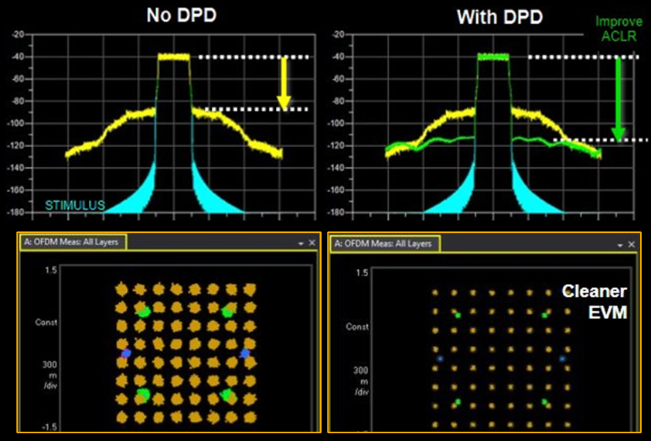
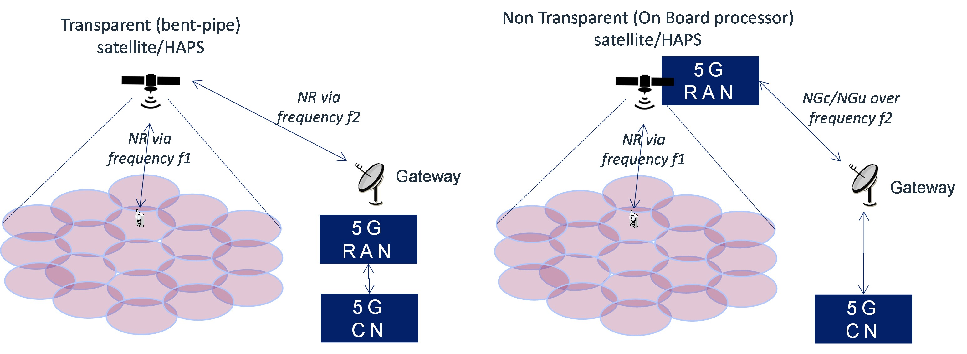
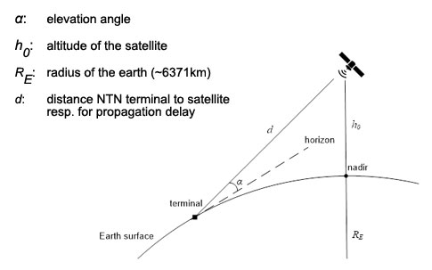
Modeling Non-Terrestrial Networks
Large-scale Fading Effects: LOS probability, Path loss and shadow fading, O2I penetration loss, atmospheric absorption (above 10GHz), rain and cloud attenuation (above 6 GHz), Ionospheric (below 10GHz) and Tropospheric (above10GHz) scintillation, Faraday [polarization] rotation (3dB polarization loss)
Small-scale Fading Effects: Flat and frequency-selective fading, Coherence [Time/Bandwidth/Distance] vs [Doppler/Delay/Angle] spread
NTN experiences higher carrier frequency offset (CFO) and sampling time offset (STO) effects, Doppler shift due to satellite movement depends on the satellite orbit, elevation angle, and carrier frequency, PA nonlinearity, co-channel/adjacent channel interference, I/Q imbalance, link budget, antenna arrays, beamforming, noise and distortion, impedance mismatch, intermodulation and harmonic distortion, etc.

Slide 16
5G/6G NTN Frequency Bands
NR Operating Band | Uplink | Downlink | Bandwidth (MHz) | Duplex Mode
n253 | 1668 MHz – 1675 MHz | 1518 MHz –1525 MHz | 5,10,15,20,30 | FDD
n254 | 1610 MHz – 1626.5 MHz | 2483.5 MHz – 2500 MHz | 5,10,15,20,30 | FDD
n255 | 1626.5 MHz – 1660.5 MHz | 1525 MHz – 1559 MHz | 5,10,15,20,30 | FDD
n256 | 1980 MHz – 2010 MHz | 2170 MHz – 2200 MHz | 5,10,15,20,30 | FDD
n510 | 27.5 GHz – 28.35 GHz | 17.7 GHz – 20.2 GHz | 50,100,200,400 | FDD
n511 | 28.35 GHz – 30.0 GHz | 17.7 GHz – 20.2 GHz | 50,100,200,400 | FDD
n512 | 27.5 GHz – 30.0 GHz | 17.7 GHz – 20.2 GHz | 50,100,200,400 | FDD
n23 | 2000 MHz – 2020 MHz | 2180 MHz – 2200 MHz |  | FDD
5G NTN and NTN IoT Band Considerations
Low-power IoT devices require L/S-band for extended coverage and battery life.
High-data rate applications (e.g., VSATs, cell phones) may use Ku/Ka-band for faster and wider bandwidth transmission.
Regulatory & standardization efforts (e.g., 3GPP Rel-17 & Rel-18) are defining NTN IoT spectrum allocation.

Slide 17
5G/6G NTN Technologies
Agenda:
Overview of NTN and use cases
5G/6G NTN technologies and vendor/operator challenges
3GPP NTN roadmap and 6G NTN outlook
NTN architectures and characteristics
NTN link budget analysis
System design challenges and solutions
A case study
Summary

Slide 18


Link Budget Analysis
Background Information
The Reference Sensitivity is a range of values that can be calculated as $P_{ref}=10\log\left(kT_{0}B\right)+NF+SINR+L_{m}$ where $kT_{0}B$is the thermal noise power in dBm, $B$is the noise equivalent bandwidth, $NF$is the maximum receiver noise figure, $SINR$is the minimum SINR for the chosen MCS, $L_{m}$is the implementation margin.
The noise floor for any receiver is defined as $Noise_Floor=$ $10\log\left(kT_{0}B\right)+NF$, where $NF={SNR}_{in}−{SNR}_{out}$ (in dB) is a measure of SINR degradation by the components in the RF signal path including the RF filters and low-noise amplifier. The thermal noise power density is measured at typical room temperature.
Interference Power
Signal Power
$$CINR=\frac{P_{C_{j}}}{P_{N}+\sum_{k≠j}{P_{I_{k}}}}$$
Noise Power

Slide 19
Link Budget Analysis
Background Information
Link budget shows how different components and propagation processes influence the available SNR at the receiver. It can be used to compute the required transmit power, dynamic range of a system, or the required receiver sensitivity.
Link budget is a commonly used metric to evaluate the coverage of a cellular system in the downlink or uplink.
$$Received Power \left(dBm\right) = Transmitted Power \left(dBm\right) + Gains \left(dB\right) − Losses \left(dB\right)$$
$$\underset{mean path loss}{\underbrace{{\bar{L}}_{p}(d)=L_{s}(d_{0})+10n\log{(}\frac{d}{d_{0}})}} \left(\text{dB}\right); \underset{path loss}{\underbrace{L_{p}(d)}}=\underset{mean path loss}{\underbrace{L_{s}(d_{0})+10n\log{(}\frac{d}{d_{0}})}}+\underset{shadowing}{\underbrace{X}} \left(\text{dB}\right); X\sim ℕ(0,σ^{2})$$
EIRP is Effective Isotropic Radiated Power. The EIRP can be related to the transmit power (P_{TX}), the cable losses (and possibly including antenna mismatch) L, and the antenna gain (G) by
EIRP=P_{TX}-L+G
Free Space Path Loss

Slide 20
5G NTN-IoT Link Budget Analysis (Example)
From effective coding rate Compute Reference CNR
Set NB-IoT Channel Parameters
Set Satellite Payload Characteristics
Set UE Payload Characteristics
Set Link Characteristics
Link budget analysis is an essential step in the design of radio and satellite communication systems for calculating the performance of the system and type of services offered by the system by accounting for power gains and losses across the transmission and propagation paths.
Compute Link Budget
Compute Link Margin and NB-IoT Repetitions

Slide 21
NTN-IoT Link Budget Analysis (Example)
Satellite orbit |  | GEO | LEO-1200 | LEO-600
Satellite altitude |  | 35786 km | 1200 km | 600 km
Payload characteristics for DL transmissions
Equivalent Satellite Antenna Aperture | S-band (i.e. 2 GHz) | 22 m | 2 m | 2 m
Satellite EIRP Density |  | 59 dBW/MHz | 40 dBW/MHz | 34 dBW/MHz
Satellite Tx Max Gain |  | 51 dBi | 30 dBi | 30 dBi
3db Beamwidth |  | 0.4011 deg | 4.4127 deg | 4.4127 deg
Satellite Beam Diameter |  | 250 km | 90 km | 50 km
Equivalent Satellite Antenna Aperture | Ka-band (i.e. 20 GHz for DL) | 5 m | 0.5 m | 0.5 m
Satellite EIRP Density |  | 40 dBW/MHz | 10 dBW/MHz | 4 dBW/MHz
Satellite Tx Max Gain |  | 58.5 dBi | 38.5 dBi | 38.5 dBi
3db Beamwidth |  | 0.1765 deg | 1.7647 deg | 1.7647 deg
Satellite Beam Diameter |  | 110 km | 40 km | 20 km
Payload Characteristics For UL Transmissions
Equivalent Satellite Antenna Aperture | S-band (i.e. 2 GHz) | 22 m | 2 m | 2 m
G/T |  | 19 dB K⁻¹ | 1.1 dB K⁻¹ | 1.1 dB K⁻¹
Satellite Rx Max Gain |  | 51 dBi | 30 dBi | 30 dBi
Equivalent Satellite Antenna Aperture | Ka-band (i.e. 30 GHz for UL) | 3.33 m | 0.33 m | 0.33 m
G/T |  | 28 dB K⁻¹ | 13 dB K⁻¹ | 13 dB K⁻¹
Satellite Rx Max Gain |  | 58.5 dBi | 38.5 dBi | 38.5 dBi
Parameters | Values
Carrier Frequency | 2 GHz for DL and UL (S-band)
System Bandwidth | 30 MHz (S-band), 400 MHz (Ka-band)
Channel Bandwidth | Downlink: 180 kHz Uplink: 3.75, 15, 45, 90, or 180 kHz
Satellite Altitude | 35786 km (GEO)
Target Elevation Angle | 10.95°, 20°
Atmospheric Loss | 0.2 dB
Shadowing Margin | 3 dB
Scintillation Loss | Ionospheric loss: = 2.2 dB Tropospheric loss: ITU-R P618
Additional Loss | 0 dB
Frequency Reuse Factor | 1, 2, 3
Satellite Antenna Polarization | Circular polarization
Terminal Type | Ka-band: VSAT S band: (M, N, P) = (1,1,2)
Free Space Path Loss
Terminal RF Parameters | Tx Power = 23 dBm, Tx/Rx Antenna Gain = 0 dBi, Rx Noise Figure = 7 dB Rx Antenna Temperature = 290º K
Polarization Loss | 3 dB

Slide 22
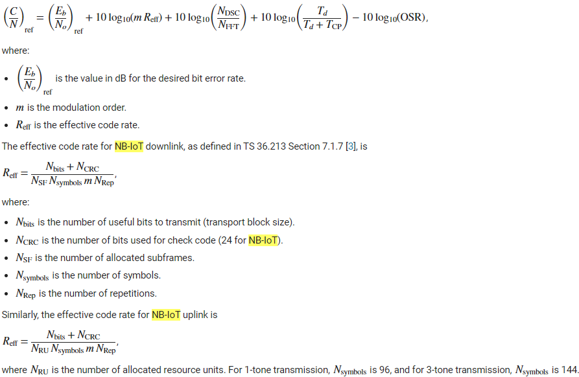
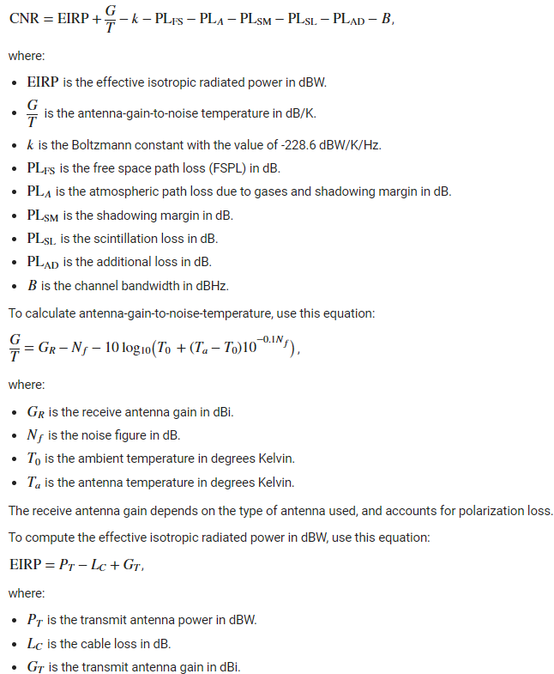

NTN-IoT Link Budget Analysis
Metrics
Calculate Effective Code Rate
Calculate Required CNR for the Selected MCS
Calculate Receiver (GW,SAT,UE) Antenna G/T
Calculate the Actual CNR
Calculate Link Margin
Calculate the Number of Repetitions to Achieve the Required CNR

Slide 23
5G/6G NTN Technologies
Agenda:
Overview of NTN and use cases
5G/6G NTN technologies and vendor/operator challenges
3GPP NTN roadmap and 6G NTN outlook
NTN architectures and characteristics
NTN link budget analysis
System design challenges and solutions
A case study
Summary

Slide 24
5G/6G NTN Technologies: System Challenges
Size, weight, power, beam steering, misalignment loss
Model noise, non-linearities, mismatch, frequency response, temp response etc.
Payload RF Processing at F1
Payload RF Processing at F2
Size, weight, power, beam steering, misalignment loss
Payload TX Antenna Parameters
Gain, EIRP, Beam Misalignment, Output Power, Efficiency, etc.
Payload RX Antenna Parameters
Gain, RX G/T, Efficiency, etc.
Dynamics of satellite motion
Create a standard based waveform
Model noise, non-linearities, mismatch, frequency response, temp response etc.
Model all types of losses, doppler and delay
Model noise, non-linearities, mismatch, frequency response, temp response etc.
Feeder Link Propagation Parameters and Losses
Base band impairments, signal processing
Gateway Baseband Signal Processing
Gateway TX RF Processing
Service Link Propagation Parameters and Losses
Real antenna pattern, matching with FE electronics, misalignmen tloss
UE RX RF Processing
UE Baseband Signal Processing
NB-IoT Signal Parameters
TX Antenna Parameters
Gain, EIRP, Beam Misalignment, Output Power, Efficiency, etc.
I/Q LPF → Mixer → BPF → VGA/PA → TX BPF → Circulator → Ant
Parameters
RX Antenna Parameters
Gain, RX G/T, Efficiency, etc.
NB-IoT Signal Parameters + SINR, Repetition, etc.
Circulator → RX BPF → LNA → Mixer → I/Q LPF

Slide 25
5G/6G NTN Technologies: System Challenges – the solutions
Need to integrate across physical, numerical, time and frequency domains.
We need sophisticated tools

Slide 26


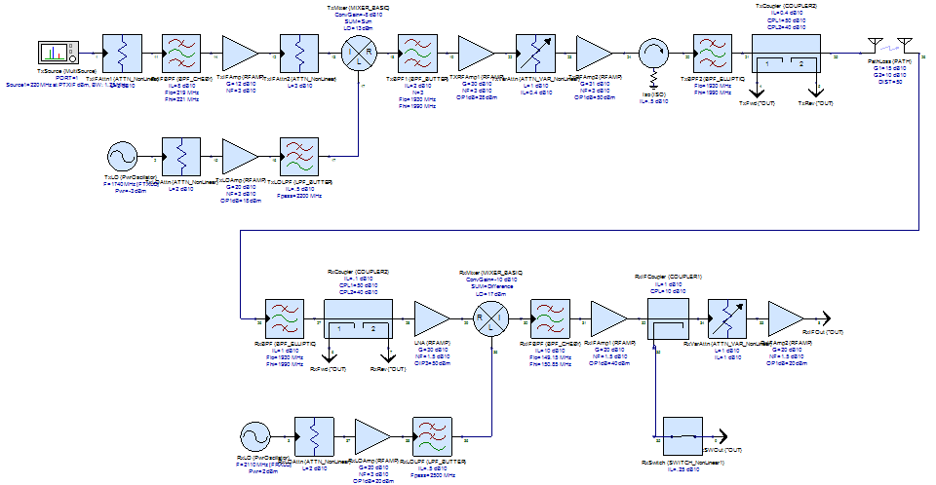
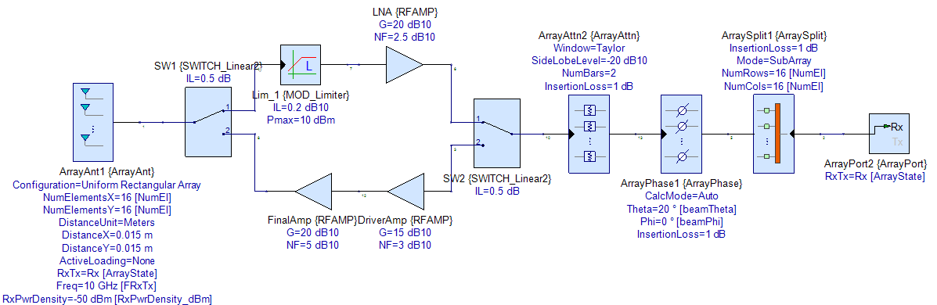
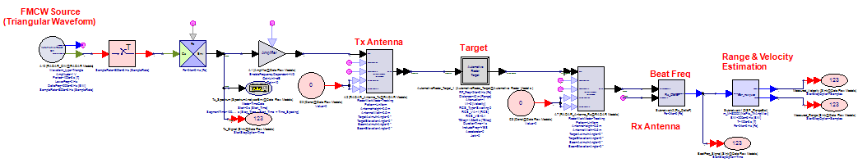
SystemVue at a Glance
Transmitter
Model
Signal, BB & RF
Tx
Channel
Model / Fading
Receiver
Model
Antenna Array
Antenna Array
Multi-dimensional accurate RF part modeling
Frequency domain RF line up analysis
Phased array antenna design
5G waveform generation
NTN channel modeling
5G base band receiver
End-to-end simulation of BER/FER/Throughput
Spectrasys
Phased Array Analysis
Signal processing

Slide 27
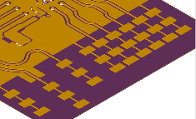
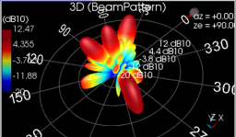
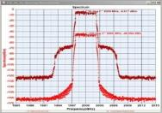
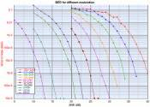
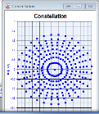
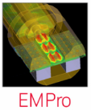
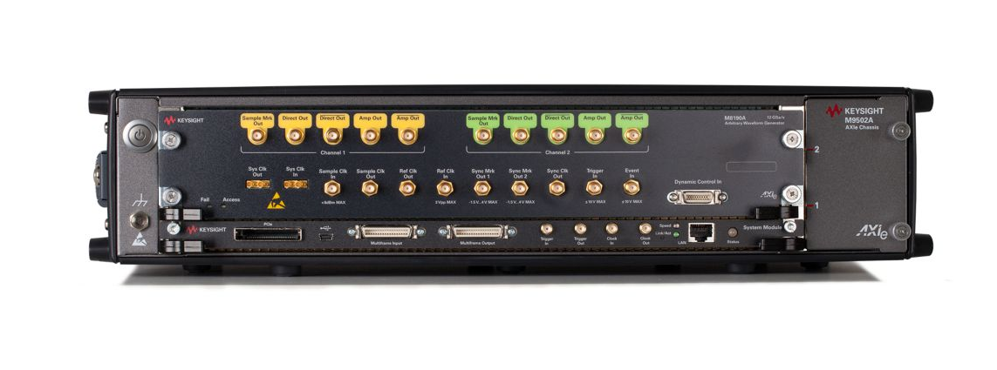
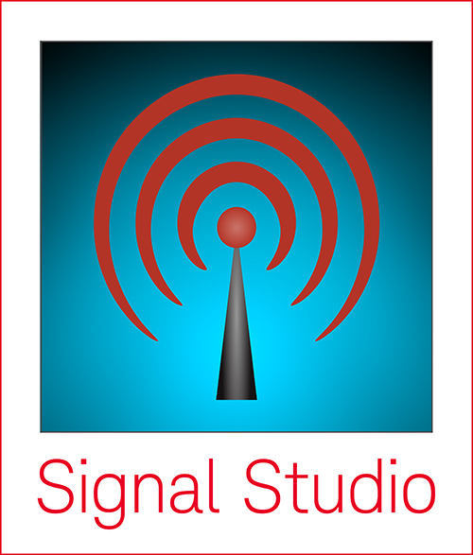

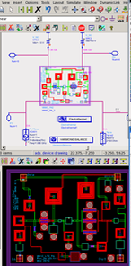


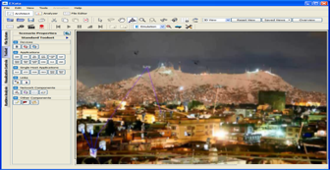



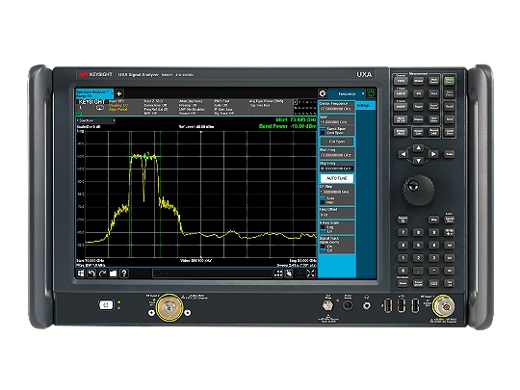
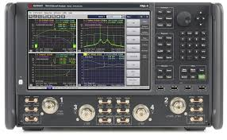
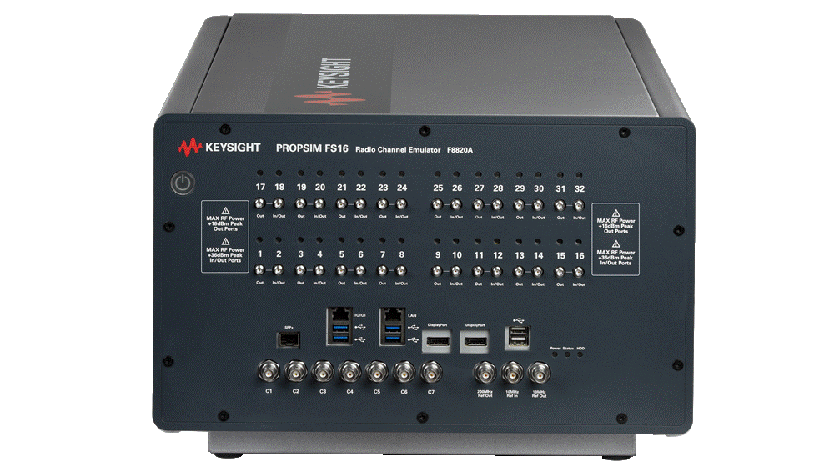
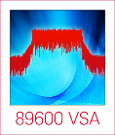

SystemVue in your workflow
Antennas
EIRP
System-level Performance
Rx Power, EVM,
IMD, ACPR
PAPR, etc.
Transmitter
Model
Signal, BB & RF
Tx
Channel
Model / Fading
Receiver
Model
Antenna Array
Antenna Array
Atmospheric,
Terrain, Doppler,
Delay, Orbit
C++
RF/µW Circuits and Layout
Keysight
Sources,
Analyzers,
Software
HDL Python
EXata
PNA-X
Measured
X and S
Parameters
PropSim Channel
Emulator
5G NTN

Slide 28
5G/6G NTN Technologies
Agenda:
Overview of NTN and use cases
5G/6G NTN technologies and vendor/operator challenges
3GPP NTN roadmap and 6G NTN outlook
NTN architectures and characteristics
NTN link budget analysis
System design challenges and solutions
A case study
Summary

Slide 29
Case Study – NTN link budget analysis
Payload RF Processing at F1
Payload RF Processing at F2
Feeder
Channel
Service
Channel
Gateway Baseband Signal Processing
Gateway TX RF Processing
UE RX RF Processing
UE Baseband Signal Processing

Slide 30
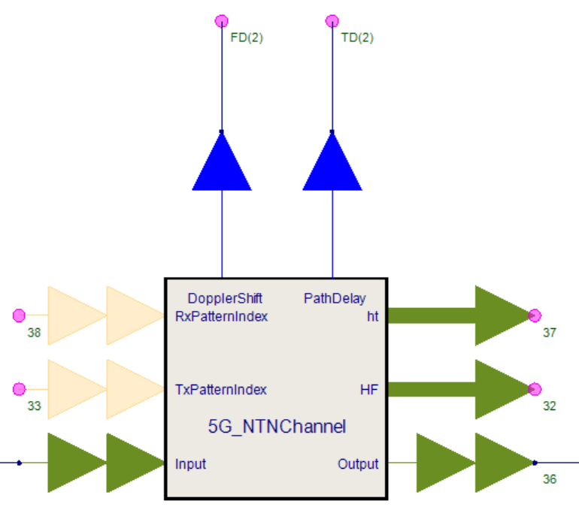
5G/6G NTN Technologies: System design
Allows modeling of Satellite link
Animation for to visualize scenario
Models various loss mechanisms
  Pathloss
  Scintillation
  Polarization
  Faraday rotation
  Shadowing etc.
Computes doppler
Computes delay

Slide 31
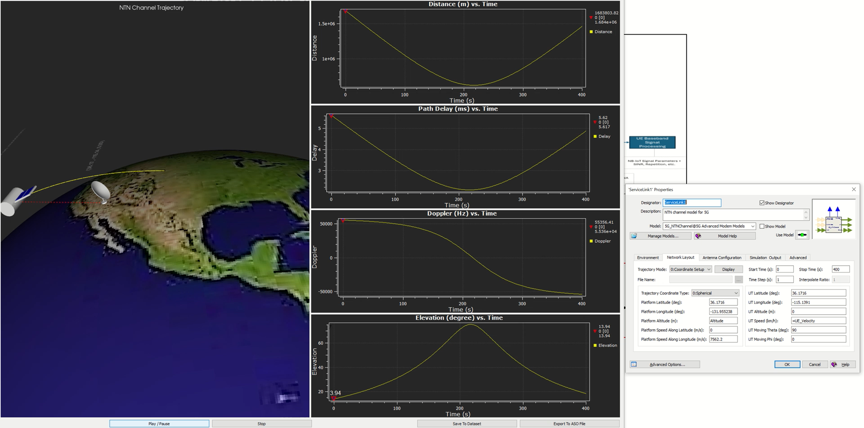
5G/6G NTN Technologies: System design

Slide 32
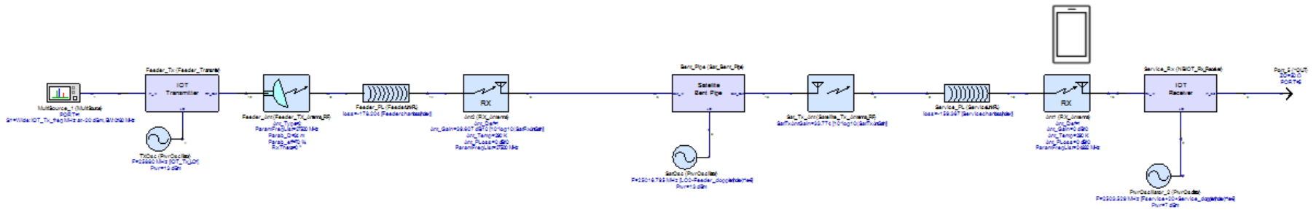
5G/6G NTN Technologies: System design - frequency domain
Channel
Feeder
Service
Tx
Bent Pipe
Rx
Antennas
Integrate RF subsystems, Antennas and channel accurately and simulate quickly

Slide 33
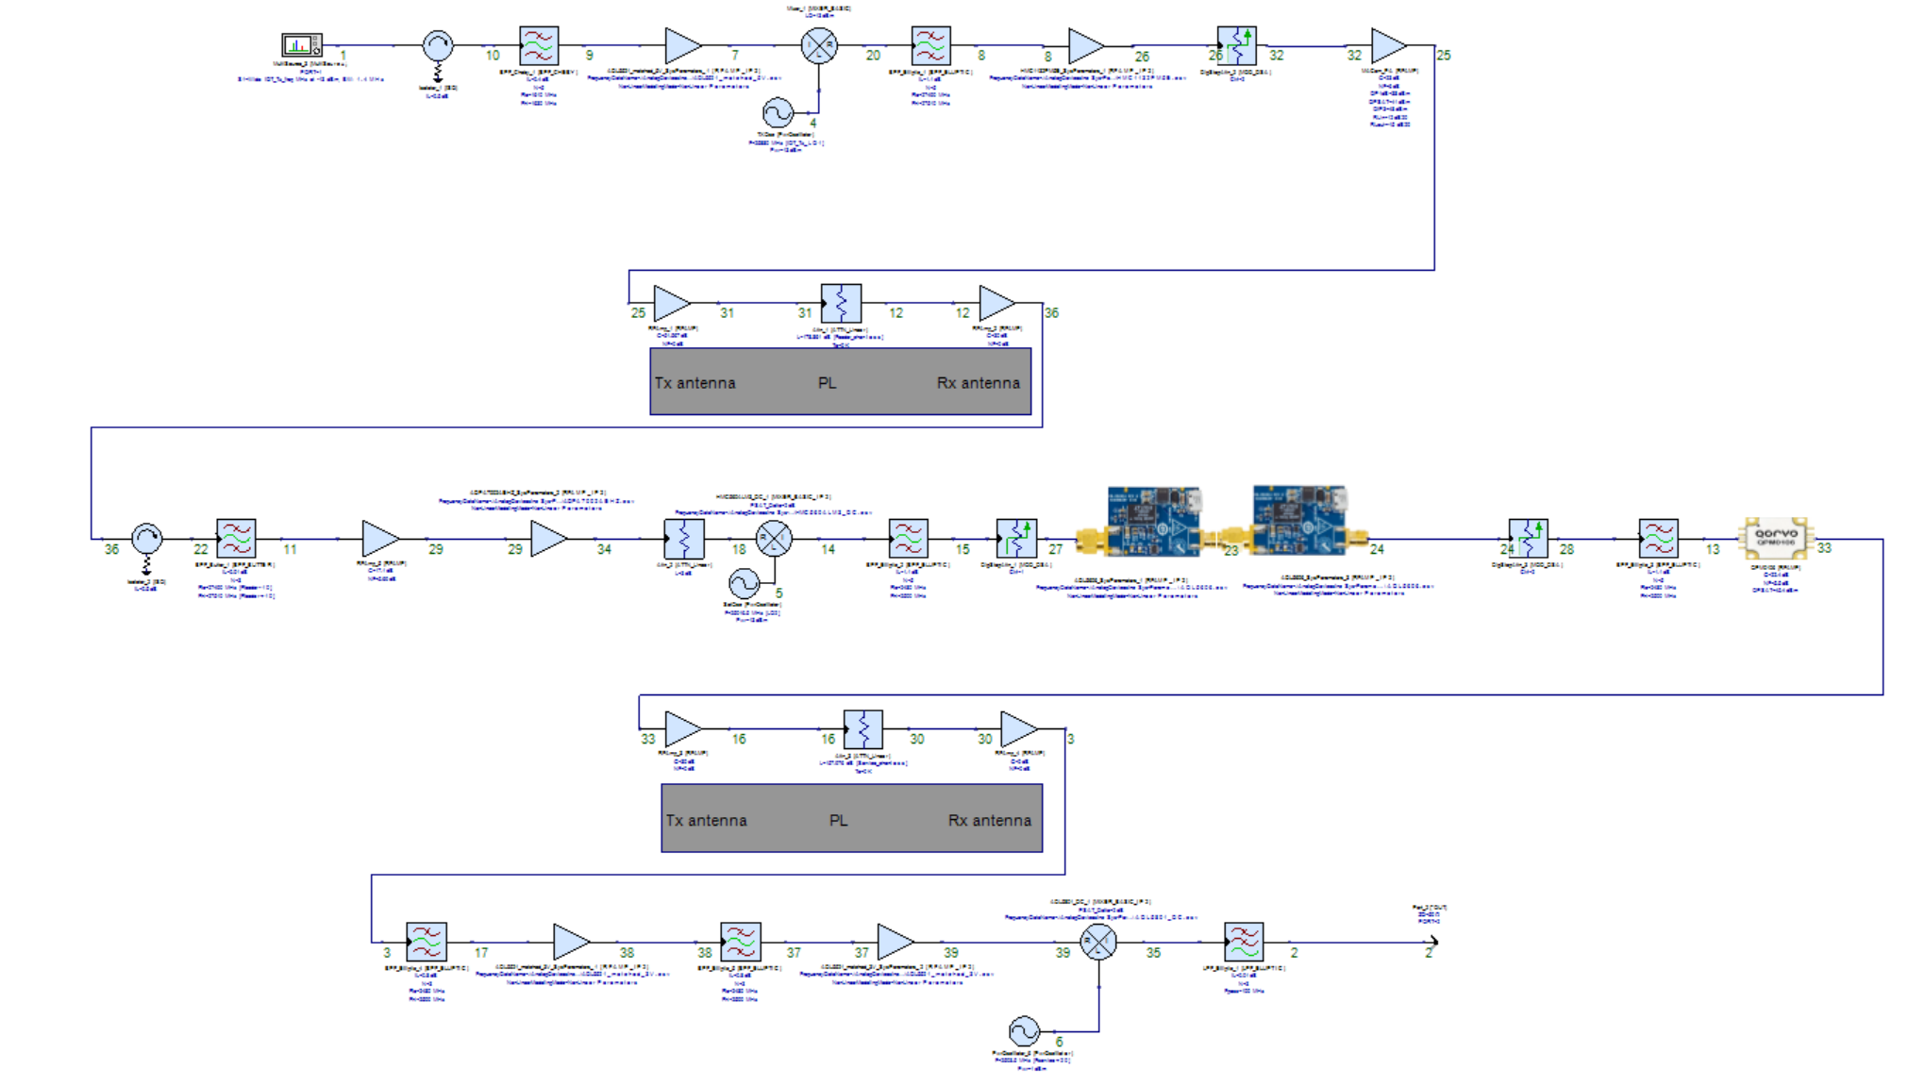
5G/6G NTN Technologies: System design – frequency domain
Gateway Tx
Bent Pipe
UE Rx

Slide 34
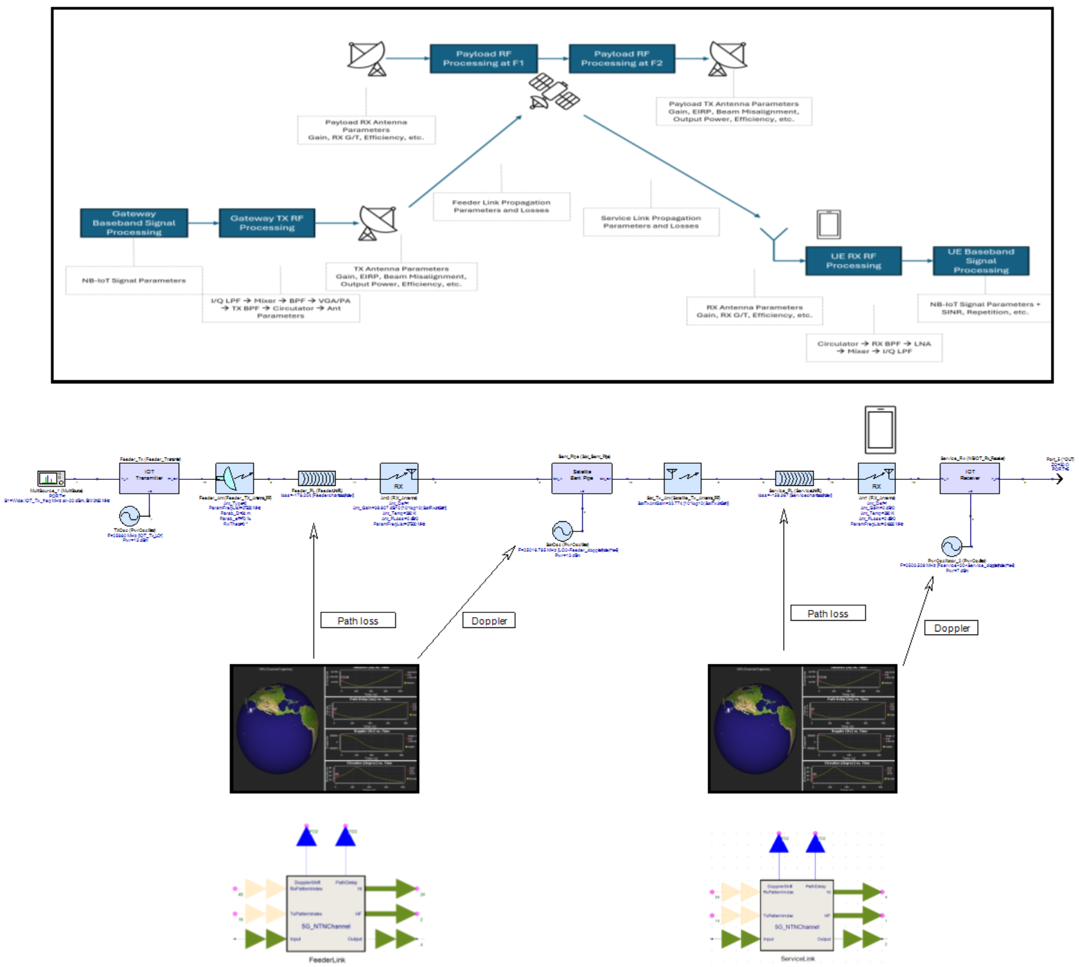
5G/6G NTN Technologies: System design – frequency domain
Simulates in seconds!
Integrate RF subsystems, Antennas and channel accurately and simulate quickly

Slide 35
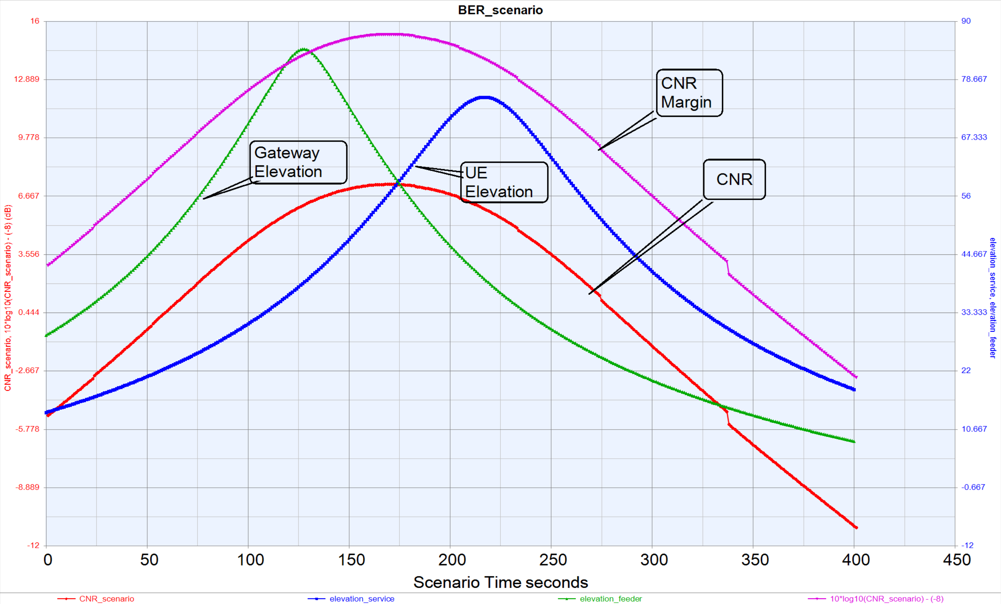
5G/6G NTN Technologies: System design

Slide 36
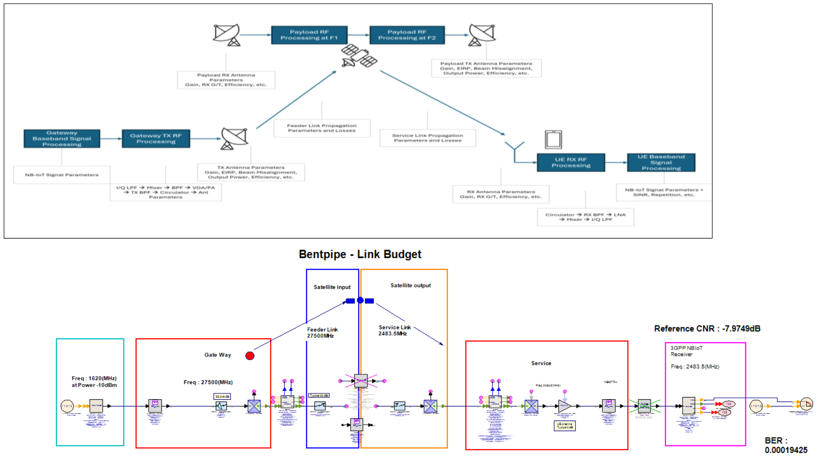
5G/6G NTN Technologies: System design – time domain

Slide 37
5G/6G NTN Technologies: System design

Slide 38
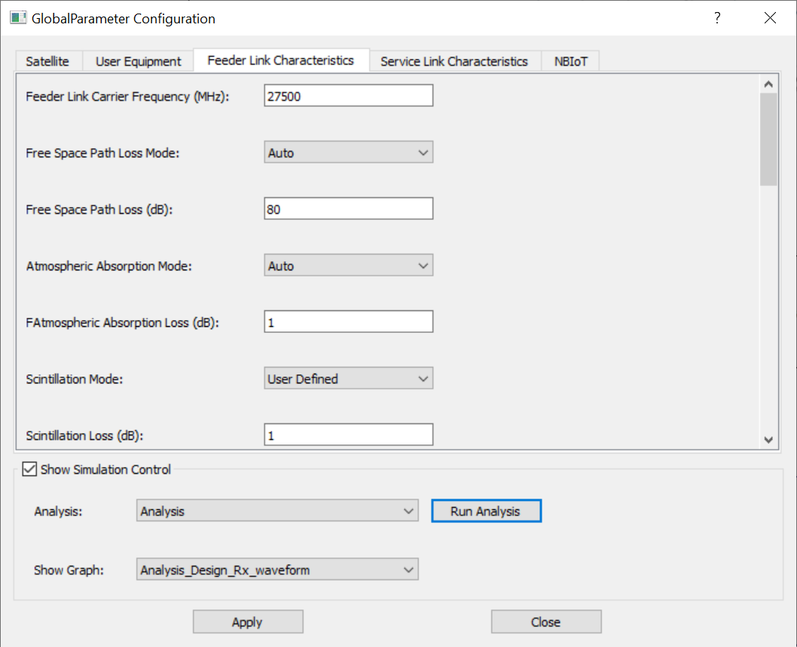
5G/6G NTN Technologies: System design
It is fast and accurate, agreed.
What about user experience and integrating into a workflow?
User definable GUI ☺

Slide 39
5G/6G NTN Technologies
Agenda:
Overview of NTN and use cases
5G/6G NTN technologies and vendor/operator challenges
3GPP NTN roadmap and 6G NTN outlook
NTN architectures and characteristics
NTN link budget analysis
System design challenges and solutions
A case study
Summary

Slide 40
Summary
Simulating an end-to-end NTN transmission path
NTN link budget analysis is hard
Keysight’s SystemVue is a comprehensive tool perform NTN link budget analysis
SystemVue is conducive to be integrated into diverse workflows.
NTN is here to stay and progressing to be an integral part of 6G.

Slide 41
Learn More
Keysight W4516E PathWave 5G NR NTN Channel Model Kit
Keysight W4503E PathWave Phased Array Simulation
Keysight W4540E PathWave DPD Explorer in PathWave ADS | Keysight
Keysight W4522E PathWave 5G And Cellular Library

Slide 42
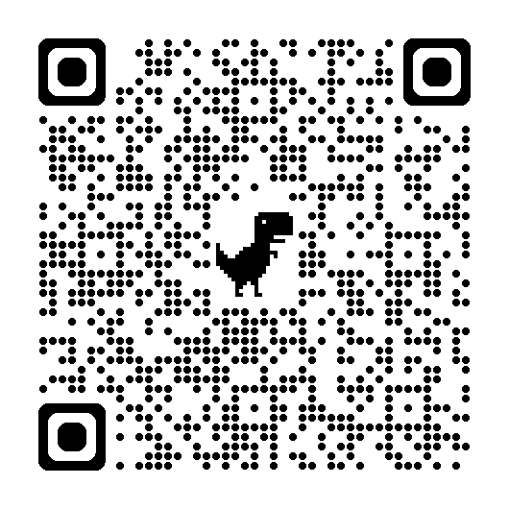

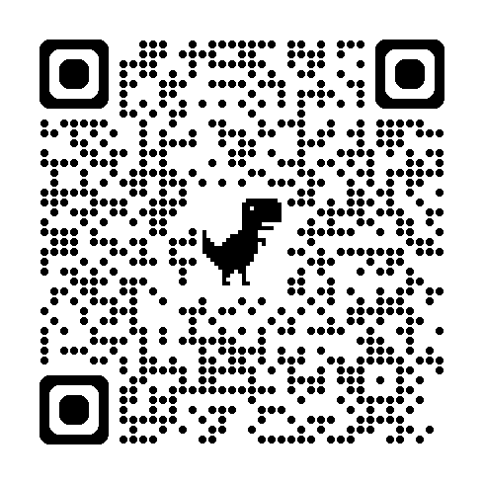
Resources
Website: SystemVue: System-level Design and Simulation Software
W4804B SystemVue Core, RF, Comms/DSP, Phased Array Bundle
SystemVue Bundles

Slide 44
Back up slides

Slide 45
5G Non-Terrestrial Networks
Use Cases
Satellite communication [broadcast satellite services (BSS), fixed satellite services (FSS), and mobile satellite services (MSS)] has existed for a few decades; however, new 3GPP standards are meant to complement and integrate space coverage with terrestrial networks.
Source: Rohde & Schwarz

Slide 46
Downlink
Scenario: LEO Satellite at 600 km Altitude
See Table 6.2-4 of TR 36.763 for the payload transmission parameters
NTN Payload with Phased-Array Antenna
Feeder Link
(Proprietary Link for TTC and 3GPP LTE/NR for NTN Typically using Ka band)
Service Link
Specified by 3GPP (LTE/NR)
See Table 6.2-1and 6.2-2 of TR 36.763 for propagation parameters (LEO 600 km)
NB-IoT Downlink Signal Generation and RF Processing
NB-IoT Downlink Signal Reception and RF Processing
Ground Station (NTN Gateway) with Parabolic Antenna or Phased-Array Antenna
UE or IoT Device
UE power class (PC5=20 dBm)
- UE Noise Figure (NF=9 dB)
Channel Bandwidth for NB-IoT: NB-IoT 180 kHz (DL), Up to 180 kHz with all permissible smaller resource allocations 12*15 kHz, 6*15 kHz, 3*15 kHz, 1*15 kHz, 1*3.75 kHz (UL)
UL/DL Frequency: Band 254 (see Table 5.1.1-1 of TR 36.764
Reference sensitivity for UE category NB1 and NB2: -108.2dBm (see TR 36.784 Table 6.2.2.1-4)
SV Gateway Model:
https://pmc.ncbi.nlm.nih.gov/articles/PMC9740709/
 | Uplink Antenna |  |  |  | Downlink Antenna
Satellite | SpaceX | Telesat | OneWeb | Amazon | SpaceX | Telesat | OneWeb | Amazon
Diameter (m) | 1.5 | 1.5 | 3.5 | 2.4 | 1.5 | 1.5 | 3.5 | 2.4
Above ground level (m) | 1.95 | 3.2 | 4.55 | - | 1.95 | 3.2 | 4.55 | -
EIRP (dBW) | 68.4 | 75.9 | 63.2 | 62.3 | 39.44 | 38 | 30.6–39 | 36
Max Gain (dBi) | 41 | 31.8 | - | 53.1 | 46.9 | 45.5 | 51.5 | 50.2
Elevation (deg) | 25 | 10 | 15 | 20 | 25 | 10 | 15 | 20
Path distance (km) | 2439 | 1504 | 1684 | 590 | 2439 | 1504 | 1684 | 590

Slide 47
Uplink
Scenario: LEO Satellite at 600 km Altitude
See Tables 6.1 and 6.2-2 of TR 36.763 for transmission parameters
Feeder Link
(Proprietary Link for TTC and 3GPP LTE/NR for NTN Typically using Ka band)
Service Link
Specified by 3GPP
See Table 6.2-1of TR 36.763 for propagation parameters
NB-IoT Uplink Signal Reception and RF Processing
NB-IoT Uplink Signal Generation and RF Processing
Ground Station with Directive Parabolic Antenna or Phased-Array
UE or IoT Device
UE power class (PC5=20 dBm)
- UE Noise Figure (NF=9 dB)
Channel Bandwidth for NB-IoT: NB-IoT 180 kHz (DL), Up to 180 kHz with all permissible smaller resource allocations 12*15 kHz, 6*15 kHz, 3*15 kHz, 1*15 kHz, 1*3.75 kHz (UL)
UL/DL Frequency: Band 253 (see Table 5.1.1-1 of TR 36.764
SV Gateway Model:
https://pmc.ncbi.nlm.nih.gov/articles/PMC9740709/
 | Uplink Antenna |  |  |  | Downlink Antenna
Satellite | SpaceX | Telesat | OneWeb | Amazon | SpaceX | Telesat | OneWeb | Amazon
Diameter (m) | 1.5 | 1.5 | 3.5 | 2.4 | 1.5 | 1.5 | 3.5 | 2.4
Above ground level (m) | 1.95 | 3.2 | 4.55 | - | 1.95 | 3.2 | 4.55 | -
EIRP (dBW) | 68.4 | 75.9 | 63.2 | 62.3 | 39.44 | 38 | 30.6–39 | 36
Max Gain (dBi) | 41 | 31.8 | - | 53.1 | 46.9 | 45.5 | 51.5 | 50.2
Elevation (deg) | 25 | 10 | 15 | 20 | 25 | 10 | 15 | 20
Path distance (km) | 2439 | 1504 | 1684 | 590 | 2439 | 1504 | 1684 | 590

Slide 48
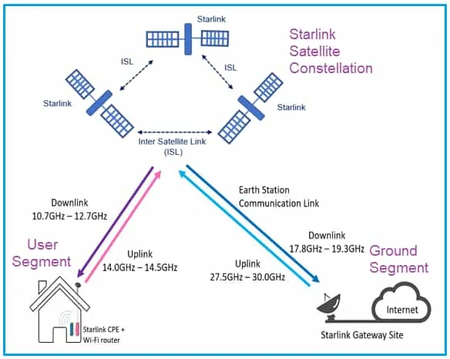
Starlink Example
Non-3GPP Compliant Service Link

Slide 49
SystemVue Value Proposition for 6G
SystemVue provides
  An intuitive software tool for system-level modeling with exceptional accuracy and fidelity.
  Customizable levels of realism for system components and impairments, ensuring precise simulations.
It can help users to develop accurate system-level Digital Twins of 5G/6G NTN technologies; simulate and benchmark performance using realistic baseband, RF and antenna models.
  Users can
    Generate the Desired Waveforms (e.g., 4G LTE/5G NR, NB-IoT, and more)
    Process the Waveforms through Realistic RF Transceiver and Antenna Models
    Generate AI/ML Model Training Data with SystemVue and Use Trained Model Parameters in SystemVue to Assess the Performance Gains
    Derive Real-World Device Models and Use their Parameters in SystemVue
    Use Realistic Propagation and Channel Models (e.g., 3D and Ray Tracing, and more)

Slide 50
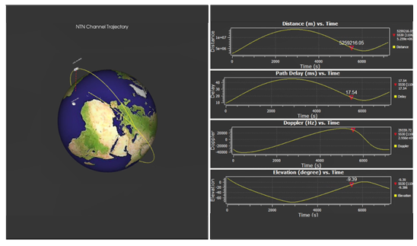
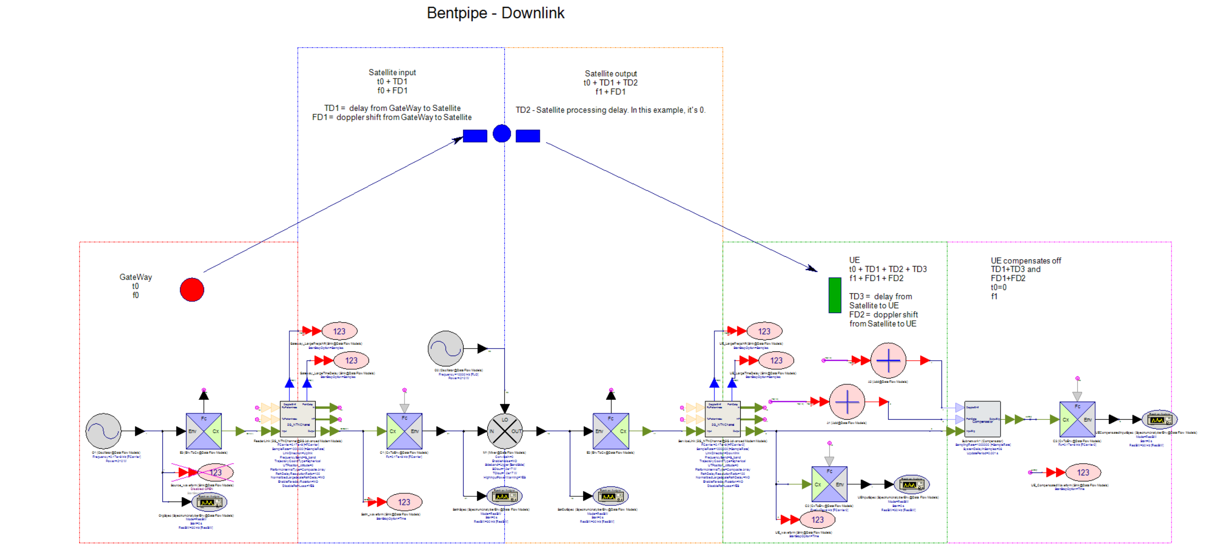
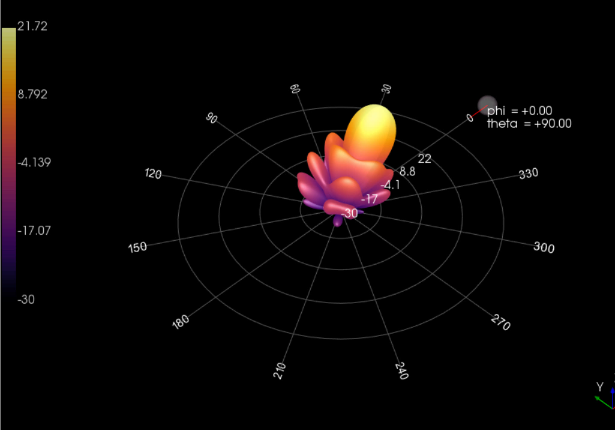

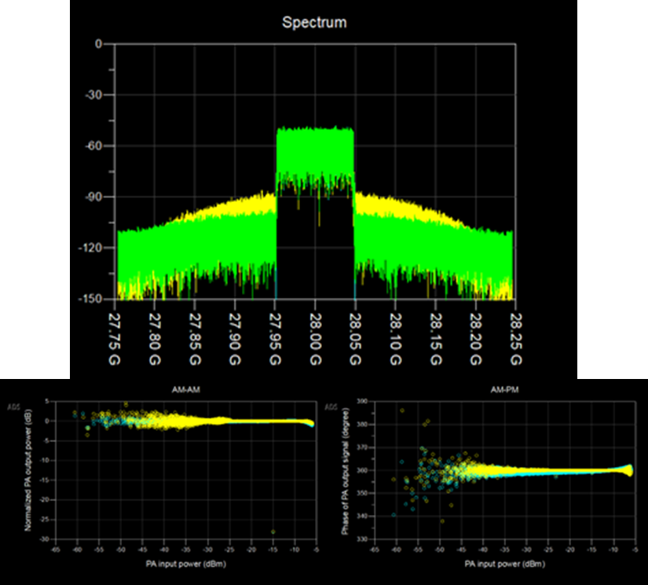

Non-Terrestrial Networks Modeling
Gateway, Payload and UE Antenna Array Modeling
Nonlinearity Modeling
PA and DPD Performance Modeling

