Slide 1

Enabling Next Generation Heterogeneous Integrated Module Design in ADS
Matthew Ozalas, Jack Sifri, Dan Schwarz

Slide 2
Agenda Outline
Introduction: What is Heterogeneous Integration (HI), and what’s driving it?
Smart Mount: The backbone of HI Module Assembly
Examples: Multi-Technology and HI module Assembly
Co-simulation: RFPro and EM / Circuit Co-Simulation
Circuit Excitation: Introduction to Circuit Excitation and EM simulation with Near/Far Field plots
Summary
Demo: Putting everything together in a demo

Slide 3
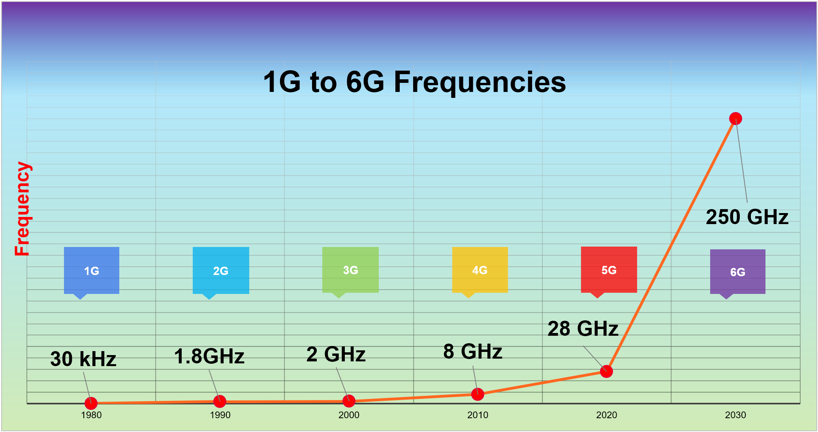
Technology Trends
Greater integration of complex RFICs and MMICs, filters, passives, & packages at higher frequencies
    Co-simulation of circuit, EM and electro-thermal technologies
    EM simulation moving to more usable technology for all circuit designers
Higher frequencies
  5G (24 - 28 GHz)
  6G (>100 GHz – sub-THz range)
  Automotive Radars (77 - 81 GHz)
  WiGig (57 – 66 GHz)
“We used to consider packages as a painful way to go from our IC to the PCB. With millimeter-waves, it is now an integral part of our design cycle, and it opens possibilities we dreamt of years ago.”
- 5G Design Manager -
Notes:
The industry trend in RF and microwave Design is driven by consumer demand for more and greater functionality, smaller size, and increasingly higher application frequency bands with broadband modulated RF signals. This directly translates into denser and denser integration of complex modules with RFICs, MMICs Passives, Packages, and antennas at higher frequencies. This also means that the design of these components and integrated modules are now becoming more challenging, because circuit simulation must definitely be combined with 3D EM simulation to account for parasitic effects of the complex multi-technology integrated structures. So, we are now at 5G with an operation frequency in the 28 gigahertz millimeter wave band ad moving up in frequency in the sub-THz (Terahertz) frequency range for 6G.
So, you can see the work for RF and microwave circuit designers are not getting any easier.
The integration of circuit and 3D EM simulation in ADS facilitates first-pass design success, making it an ideal platform for next-generation heterogeneous integrated module design.

Slide 4
Technology Trends
Complex multi-technology 3DHI Modules at higher frequencies
Heterogeneous Integration
Higher Frequency, Complex Systems
Wafer level packaging
2.5D,3D
Thin Film / Interposer
Chiplets
MCM
TSV / uBump
PoP
Data and Connectivity
mmW to THz
Standards & waveforms
Low Loss / Low latency
Arrays & Beamforming
SWaP-C
Infrastructure
Autonomous Vehicles
EW
Satcomm
Consumer Electronics
HPC (driven by AI/ML)
Notes:
The demand for Data and Connectivity drives higher frequency, complex systems.
Heterogeneous Integration offers a way to achieve those requirements efficiently in terms of SWaP-C (size, weight, power, cost).

Slide 5
What is Heterogeneous Integration ?
Heterogeneous Integration refers to the integration of separately manufactured components into a higher-level assembly that, in the aggregate, provides enhanced functionality and improved operating characteristics. (Source: IEEE Electronics Packaging Society)
    2D Heterogeneous Integration places chips/components side-by-side in a single substrate.
    2.5D Heterogeneous Integration: components are placed side by side on an interposer
    3D Heterogeneous Integration: Chips and packages are stacked vertically
Type of customers moving to 2.5D or 3DHI
    Aerospace and Defense customers 2.5/3D (mmW), and research in the THz region
    Automotive customers 3DHI (mmW), particularly WLP and AIP (Antenna-in-Package)
    Traditional 2D Module and package customers 2-2.5D mmW (5G), 3D? (6G)
  A quote from a Radar Customer: “Our packaging technology now costs more than our chip runs so its imperative that we can simulate the chip and package together and verify performance before we tape the package out”
pHEMT Switch
GaAs PA
Patch Antenna Package
Patch Antenna
GaAs PA Array
Multi Layer Laminate
GaAs PA
pHEMT phase shifter
pHEMT phase shifter
PC3
Interposer
Interposer
Notes:
Heterogeneous Integration refers to the integration of separately manufactured components into a higher-level assembly that, in the aggregate, provides enhanced functionality and improved operating characteristics. (Source: IEEE Electronics Packaging Society)
3D Heterogeneous Integration (3DHI) is an advanced packaging technology.
It involves stacking and integrating separately manufactured components, such as chips or wafers, within a single package.
It allows for the combination of different materials, devices, and circuits, enhancing the functionality and performance of microelectronics
3DHI is gaining traction due to its potential to improve performance, reduce costs, and offer more flexible form factors for complex systems

Slide 6
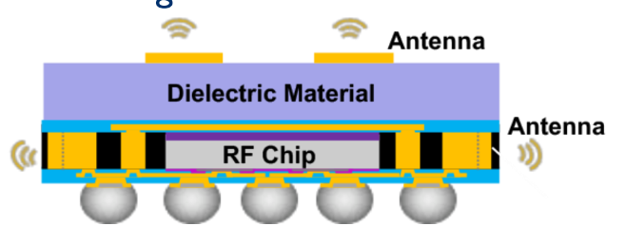
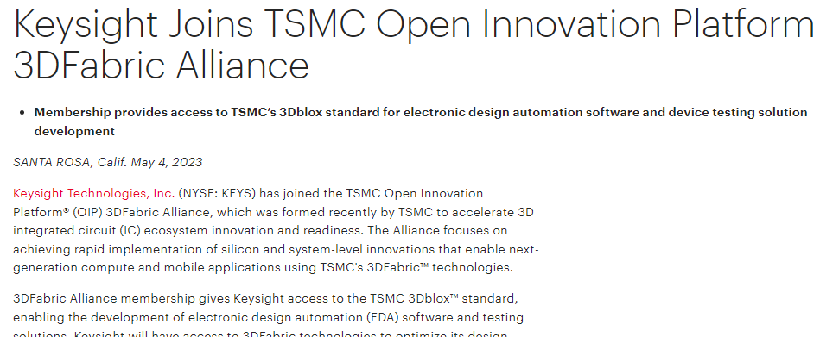
Current Industry State: Processor Tech Dominates, even towards mmW
Keysight, Synopsys, Ansys and TSMC Announce Collaboration on TSMC’s 3DFabric
Processor techniques work even at mmW ! Keysight active, primarily through partnerships.
TSMC 3D Fabric + similar work ongoing at Samsung, Intel and others
Keysight joins TSMC 3DFabric alliance
TSMC qualified 12mm x 12mm x 0.9mm package with 2 RDLs
Source: 5G Packaging Trends for Smartphones, Yole, 2023
Notes:
When building a heterogeneous workflow, would you prefer to use vendors with open, interoperable toolsets OR would you prefer a sealed, self-contained ecosystem entirely managed by a single EDA company? A vast majority of our customers prefer EDA vendors who work together and partner, because this type of open approach and partnership leads to innovation. It also allows our customers to pick the best tool for the job – whether that tool comes from Keysight or someone else. That’s why Keysight have chosen to partner with Synopsys and Ansys as part of the TSMC 3D Fabric Alliance, which is TSMC’s Heterogeneous Integration environment. We expect these types of partnerships to continue and expand going forward.

Slide 7
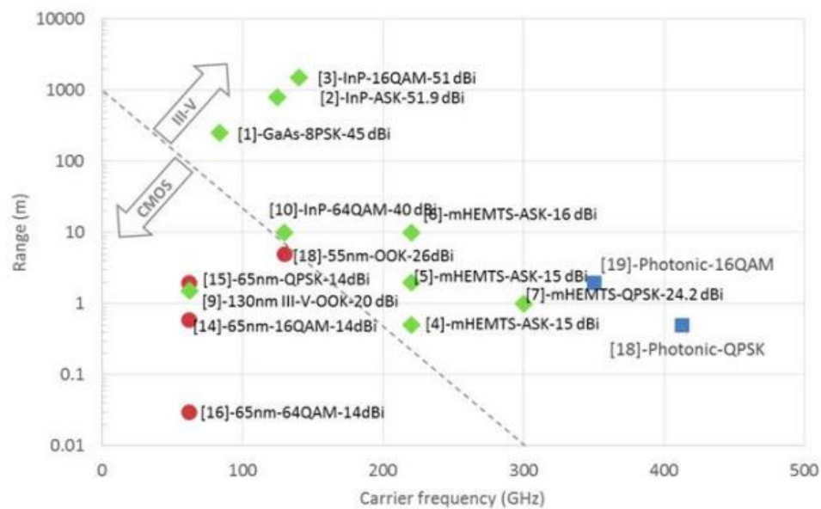
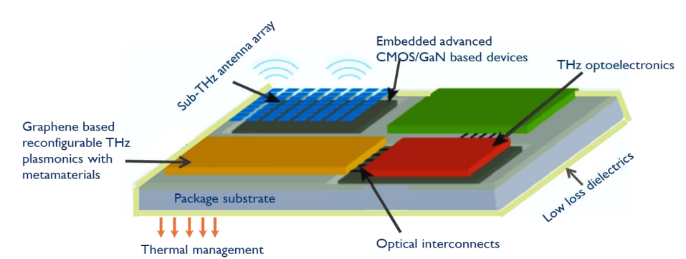
Future Industry State: sub-THz and III-V Chiplets
Expect more diverse technologies and packages to enable next gen wireless design
Still in research stage, primary interest from A/D customers and emerging 6G.
Very likely to feature III-V technologies as opposed to Si-based packaging.
3DHI challenges include Thermal management; Manufacturing Complexity; Interconnect Density & Reliability; Design & Simulation Tools; Cost; and Standardization
Link: 6G Wireless Market, Keysight Library
Notes:
Which types of customers are moving to 2.5D or 3DHI?
Aerospace and Defense customers: 2.5/3D (mmW), Research: THz
Automotive customers 3DHI (mmW), particularly WLP and AIP (Antenna-in-Package)
Traditional 2D Module and package customers 2-2.5D mmW (5G), 3D? (6G)
A quote from a Radar Customer:
“Our packaging technology now costs more than our chip runs so its imperative that we can simulate the chip and package together and verify performance before we tape the package out”

Slide 8
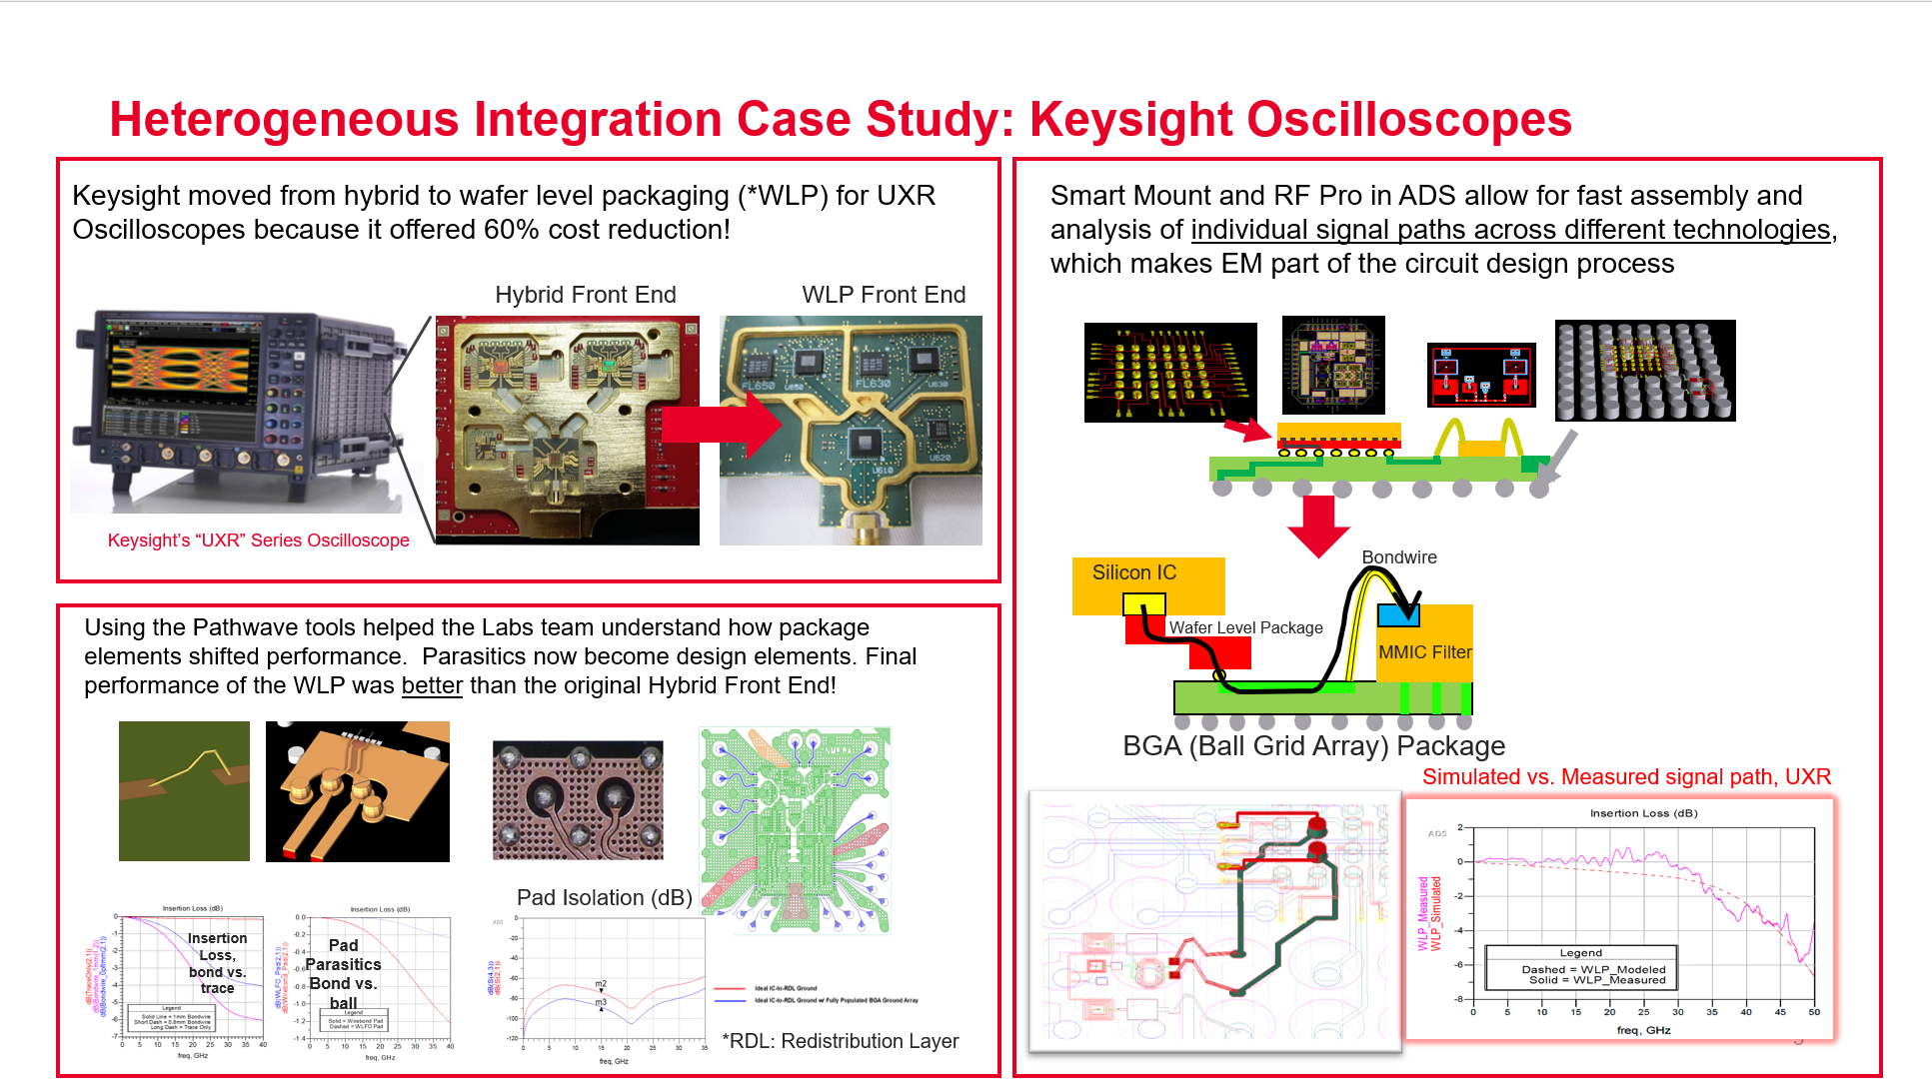
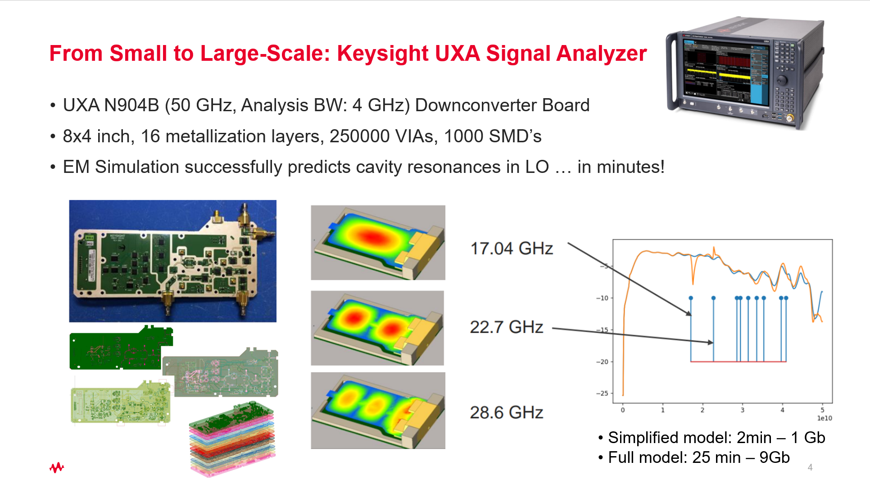
Keysight Develops High-Frequency Hardware for Instruments
Keysight is the ONLY EDA Company that makes hardware
Keysight is building 2.5D and 3DHI modules in instruments using ADS.
  Access to hardware groups and tech gives product insights that other EDA companies do not have.
  Example: A/D vendors almost never share IP with EDA partners. We can access our own HW IP.
Software R&D teams at Keysight work closely with Keysight hardware teams to build our toolset.
Keysight have firsthand experience with the relevant workflows in this space
Notes:
At Keysight, we face these same challenges as our customers do because we develop high frequency hardware for instruments. For example, the front ends in our UXR scope recently migrated to wafer level packaging. This was a big task for the design team in Keysight labs – they had to move away from a super flexible technology mix with bond wires and shims into these very compact wafer level packages. And the challenge is you can’t tune these things – the package is what it is. But despite this, the team was successful in not only reducing the cost by 60%, but also achieving better performance with the wafer level package. How did they do it? It came down to how they viewed the package – traditionally, we think of packages as parasitic elements – but they viewed it more like a critical part of the design. And that change of mindset enabled them to be successful.
But they also needed tools to allow this – and that’s how we produced Smart Mount and RF Pro. ADS is an open platform, so you can bring in designs from anywhere. Smart Mount allows you to assemble these technologies and RF Pro allows you to analyze the signals paths, even if they traverse multiple technologies. We’ll talk about that more in the slides that follow.

Slide 9
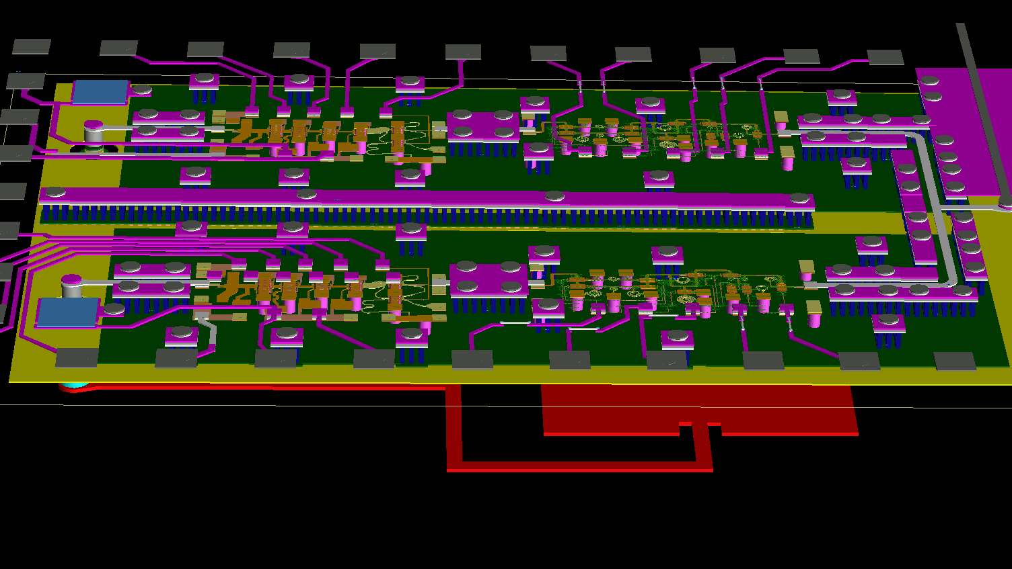
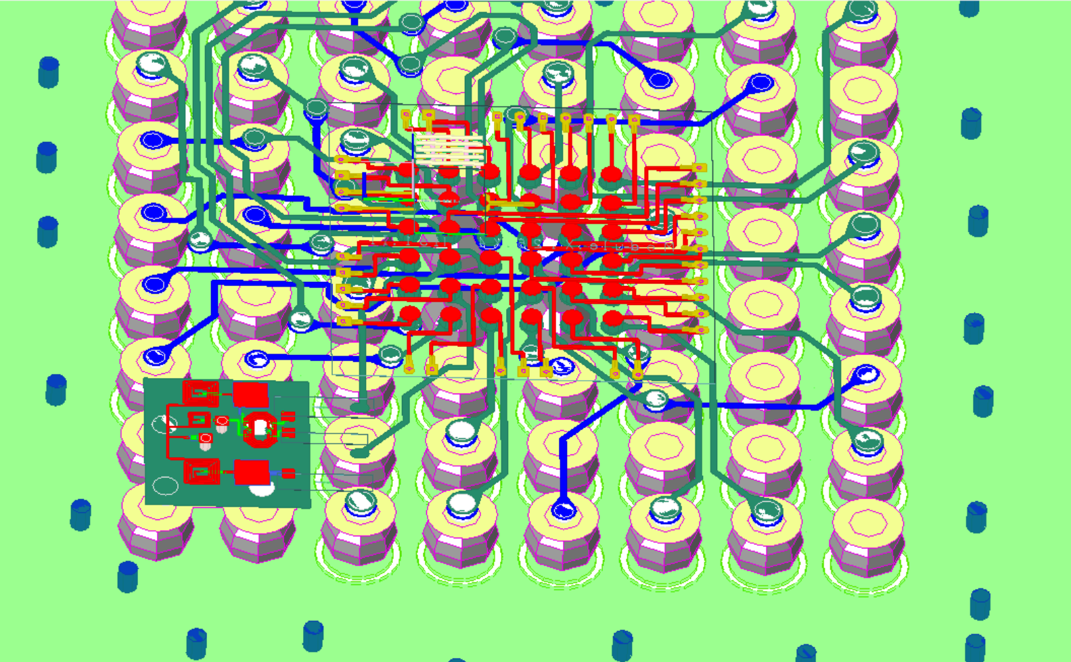
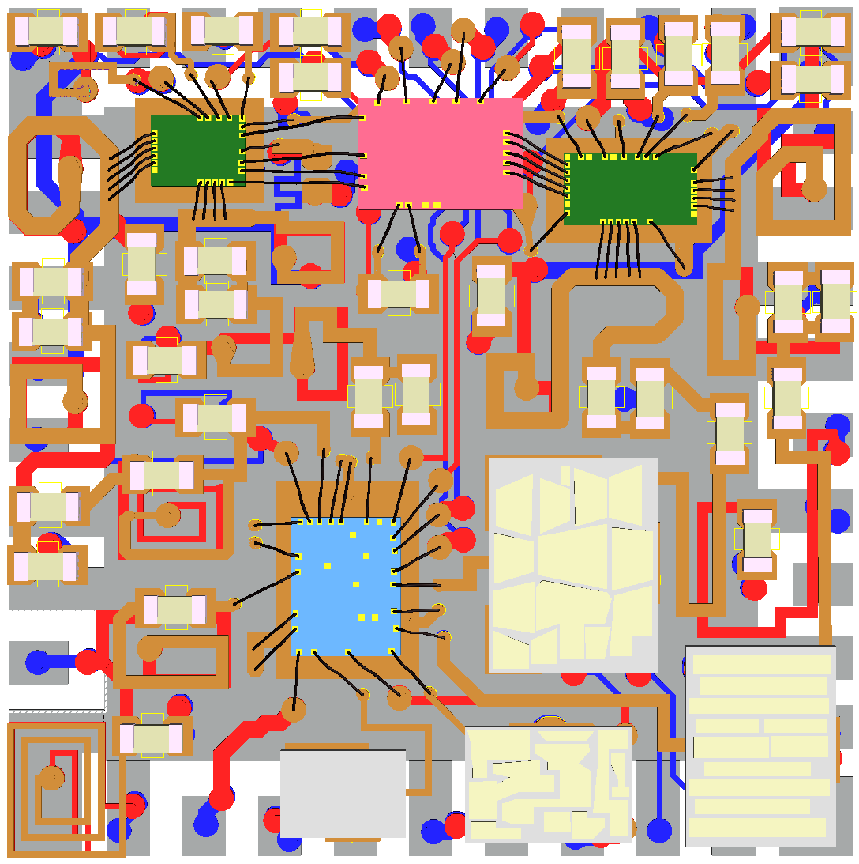
Simple, monolithic workflows don’t work for complex products…
Traditional, Monolithic Workflow
Technology Set →Tool selection →Design process
Tool 1
Tool 2
Tool 3
Too rigid, siloed
No co-design
Different analysis tools won’t agree
Technology assembly requires automation across multiple different design tools.
Not easy to fix problems after the pieces have been designed.
Model/PDK
Model/PDK
Model/PDK
Physical
Design
Physical
Design
Physical
Design
?
Circuit Sim,
EM + ETH
Circuit Sim,
EM + ETH
Circuit Sim,
EM + ETH
Assembly/
Verification
Test, Analyze
Flow is sequential:
when things break, you don’t find out until the end!
Notes:
Heterogenous integration pulls separately manufactured components into a higher-level assembly that provides enhanced functionality and improved operating characteristics. The challenge with building heterogeneous products is they are very complex. It’s not easy to integrate technology together at high frequencies and get functioning products; this becomes almost impossible as you move into mmW and THz. One major challenge lies in the design flow: most legacy flows are monolithic – meaning they were built for one technology. The fixed technology set drives the tool selection which then dictates the design process.
The graphic on the right shows an attempt to apply a monolithic workflow to a heterogenous product by paralleling the one technology flow for each additional technology. It doesn’t make sense to use a single tool to design a product which pulls together multiple different technologies into one package. It is not a good fit for the reasons described on the right of the slide. The biggest issue is that integration does not happen until the end of the design process. Also, integrating at the end requires a huge amount of automation. This approach only works if you know beforehand that all the parts will work well together (for example, a Front-End Module for a mature cellular standard would work with this approach).

Slide 10

Heterogeneous Workflows are needed … but potentially too difficult!
Heterogeneous products →
Next-Gen Heterogeneous Workflow
Design Process → Tool Selection → Technology Set
Deployment / Orchestration
Reusable and Reconfigurable
Co-design is implicit
Apply analysis tools where they make sense
Assembly happens early and often
Integration problems addressed in design phase
Hard to pull off in practice, esp. if there are many tools
DATA
Verification
Measurement, Statistics, Reports
Physical
Drawings, Documentation,
Machine Assembly
System
Antenna Pattern, Waveforms
Package
Ckt Sim, EM, Thermal
Chip
Verification: LVS/EM
Circuit
Design: Ckt, Thermal
Outside
IP
Models
In-house
External
Fab
Notes:
A Heterogeneous workflow utilizes multiple tools integrated together to design a product. The graphic on the right shows an example of a heterogeneous workflow. In contrast with the Monolithic workflow in the last slide, the Design process drives the technology set. This is important because there may be no clear “right” technology at the beginning of the cycle – the design teams must figure out which technology mix to use on a case-by-case basis.
Each function in the workflow might be one tool, but it could just as easily be realized with different tools. A key feature of a heterogeneous workflow is that it is flexible; it can easily be reconfigured for example to incorporate a new technology or package type. A heterogeneous workflow also allows integration to happen much earlier in the design process. A key enabler for this is the data transfer – in a monolithic workflow, data tends to flow one way ; in a heterogeneous workflow, data can move bidirectionally up and down. For example, data from the integrated design could be back annotated into the individual test benches automatically, allowing the IC designers to access and understand the shifts in performance caused by integration – while they are still designing!
Intuitively, it makes sense to design a heterogeneous product with a heterogeneous workflow. The advantages are summarized on the right-hand side of the slide. However, there is also one key challenge that prevents most companies from adopting this type of workflow: it is very difficult to achieve such a tight integration between many tools with different design kits, engines, use models, and data structures. Theoretically, there are advantages to using as many tools as possible in a workflow like this but practically, too many different tools cause the complexity of the workflow to become overwhelming and overly complex.

Slide 11

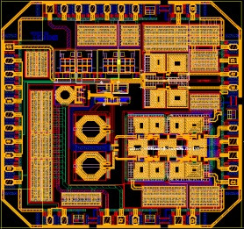
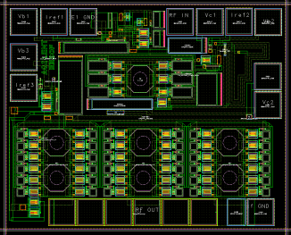
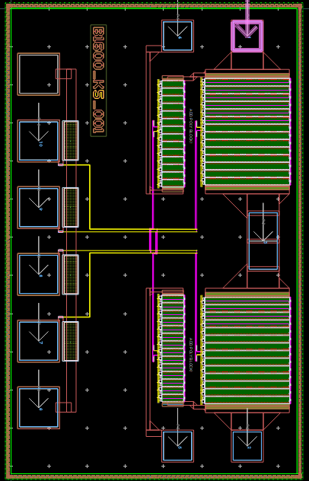
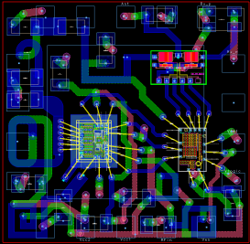
ADS: A Great Platform for Heterogeneous Design
PDKs, Models, Libraries, Automation, Design and Data Management
Silicon RFIC
Interoperable, OA-based designs
Layout, Verification
Front To Back Platform
GaAs/GaN/MMIC
Technology Assembly
EM,
Thermal
Native IC and package designs
Multi-Physics
Silicon IC
Pkg or board
Simulation, Analysis
Simulation engines
and data analysis
Imported designs
Notes:
If you’re going to build a heterogeneous workflow, ADS is a great tool to start with because the platform acts as a glue to hold the rest of your flow together. Designs from different tools and technologies can easily be brought in, combined with native design, and assembled. From there, you gain access to our simulation tools, our multi-physics tools, and our layout / verification tools.

Slide 12
Agenda Outline
Introduction: What is Heterogeneous Integration (HI), and what’s driving it?
Smart Mount: The backbone of HI Module Assembly
Examples: Multi-Technology and HI module Assembly
Co-simulation: RFPro and EM / Circuit Co-Simulation
Circuit Excitation: Introduction to Circuit Excitation and EM simulation with Near/Far Field plots
Summary
Demo: Putting everything together in a demo

Slide 13
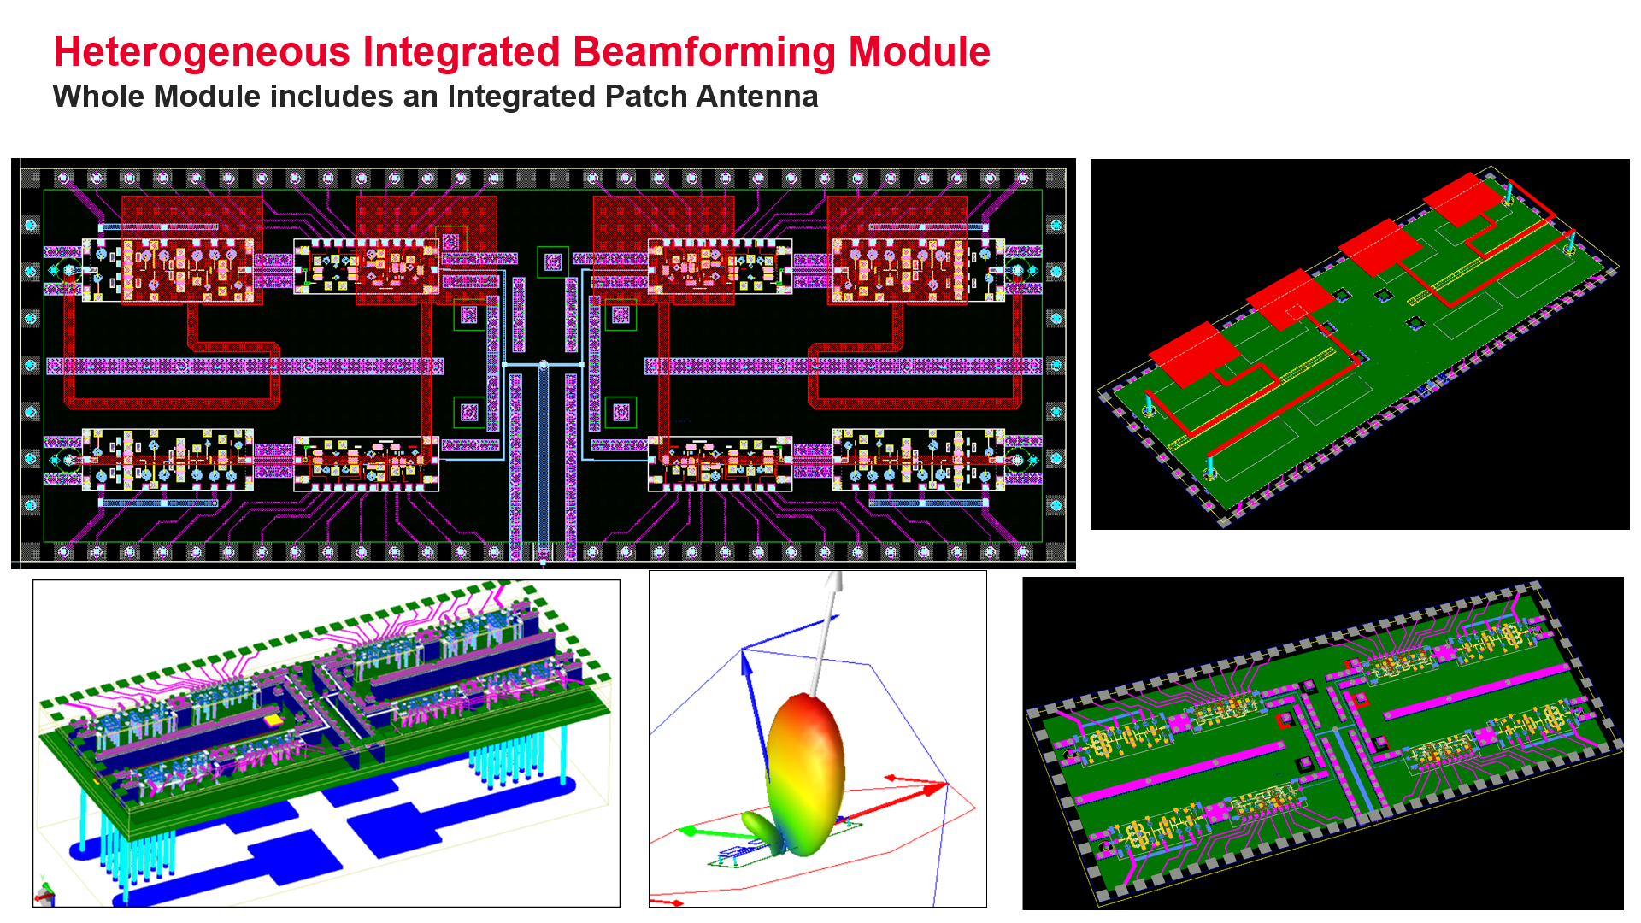
Assemble any set of technologies with Smart Mount
Notes:
Assembling technologies into one layout is challenging. One big issue is that the databases and the designs are coming from different sources, and they need to be stacked and assembled, while maintaining traceability. An assembly tool needs to be flexible – sometimes an IC metal should stack onto a board, other times it should embed into the board. Finally, assembly must be simple enough to fit into the circuit design process without a lot of tedious steps.
Smart Mount assembly in ADS addresses all these issues, making technology assembly as easy as instantiating a cell into layout. Its easy to use, there is no complex layer mapping, no substrate modification, and it also is configurable at the library level. At the same time, its quite powerful and versatile – the video in the next slide will illustrate that. And finally, its scalable: both in the sense that it works well for very large assemblies with lots of chips or stacked technology, and it also supports physical scaling as encountered in nm Silicon processes.

Slide 14
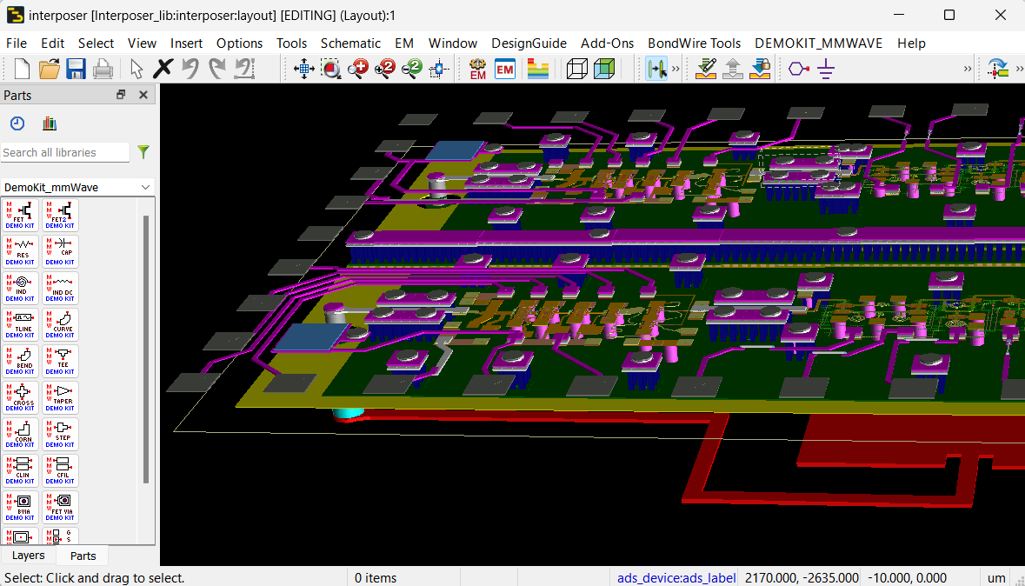
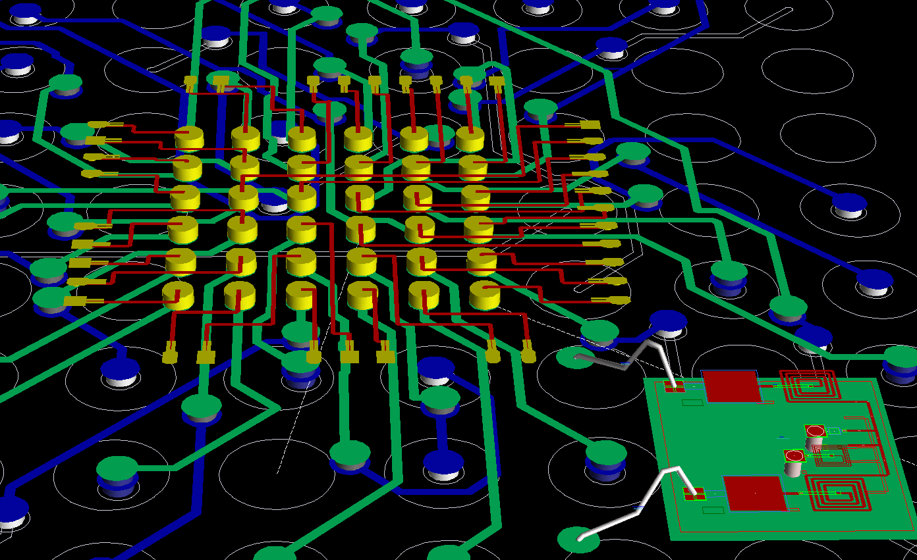
Assemble any set of technologies with Smart Mount
Simple: No complex layer mapping, no substrate modification, applies to all designs in the library
Powerful: Stack or map technology interfaces
Versatile: Can generate artwork on the fly upon instantiation, works for interoperable libraries
Scalable: Supports physical scaling (nm processes), and stacks through hierarchy
YouTube video
Fan-Out Wafer-Level Packaging (FOWLP) Module Design and Analysis in ADS
Si Tranceiver
Filter Chip
Patch Antenna Package
Redist (Fan in)
GaAs PA
pHEMT phase shifter
Fanout Package
Interposer
Notes:
Assembling technologies into one layout is challenging. One big issue is that the databases and the designs are coming from different sources, and they need to be stacked and assembled, while maintaining traceability. An assembly tool needs to be flexible – sometimes an IC metal should stack onto a board, other times it should embed into the board. Finally, assembly must be simple enough to fit into the circuit design process without a lot of tedious steps.
Smart Mount assembly in ADS addresses all these issues, making technology assembly as easy as instantiating a cell into layout. Its easy to use, there is no complex layer mapping, no substrate modification, and it also is configurable at the library level. At the same time, its quite powerful and versatile – the video in the next slide will illustrate that. And finally, its scalable: both in the sense that it works well for very large assemblies with lots of chips or stacked technology, and it also supports physical scaling as encountered in nm Silicon processes.
Smart Mount allows a component designed in one technology to be used in a design with a different technology. When a smart mount component (Chip) is placed in a top-level design (Module), ADS layout will automatically provide the mapping of the Chip technology onto the Module technology,
Smart Mount allows ADS to automatically provide the mapping of the Chips technology onto the Module technology. It is all done automatically.

Slide 15
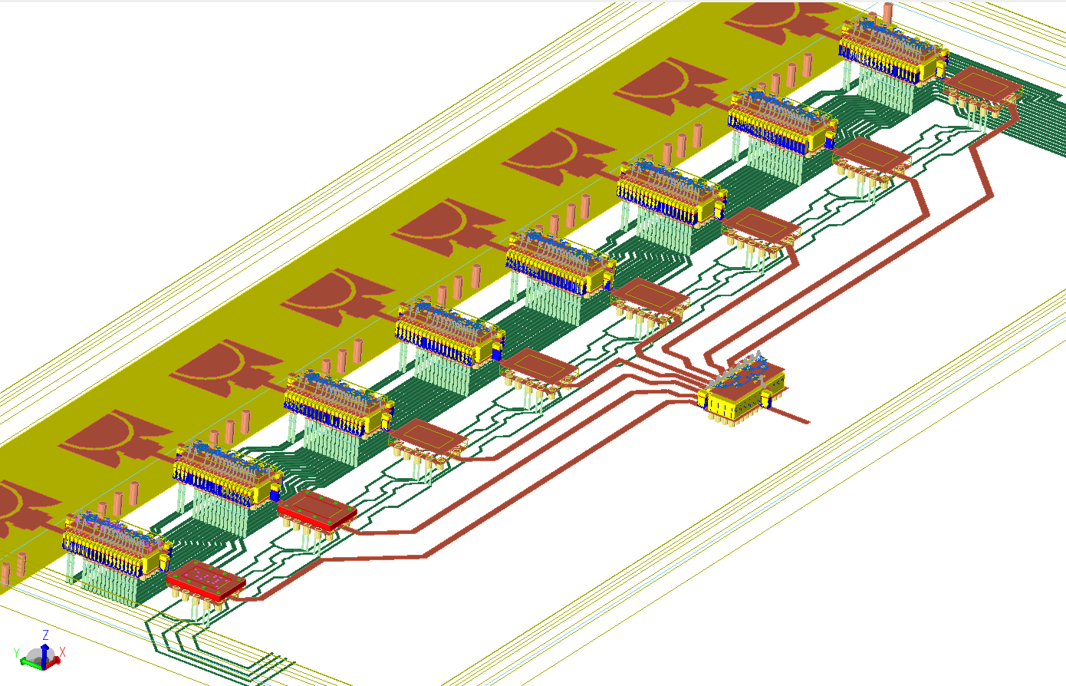
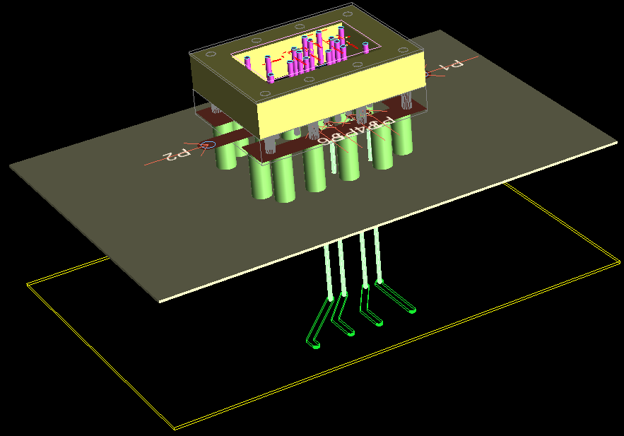
Physical Integration and Simulation of 28 GHz 5G Beamformer Module
Integration and Assembly of Mobile-Phone Board
Physical Integration of a 28 GHz 5G Beamformer Module in ADS
https://youtu.be/VLQ4_QGHpro
8-Patch Antenna (Integrated on Board)
RF & DC interconnect lines
8 MMIC Phase Shifter / PA’s Modules (QFN)
YouTube video link
mm-Wave MMIC
Amplifier
RF Input
MMIC
1:8 Splitter (QFN)
PCB Ground Plane
PCB Power Plane
8 MMIC Amps
(flip chip in QFN)
DC Bias Lines
Notes:
Problem statement:
Putting all the multi-technology pieces together (RFICs, MMICs, 3D packaging, interconnects and routing) is not trivial especially when the resulting RF module structure must also be correctly simulated before prototyping.
Preparing the RF module assembly with proper assignment of ports, ground reference, material stack-ups, active/passive component partition, etc., can take longer than the actual simulation itself.
The solution:
Fortunately, with Smart Mount and RFPro, this process is now automated for RF circuit designers to invoke EM simulation as easily as circuit analysis.

Slide 16
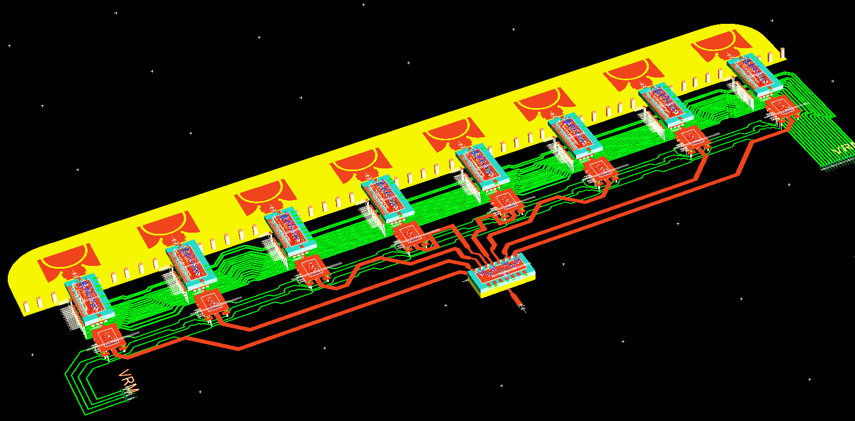
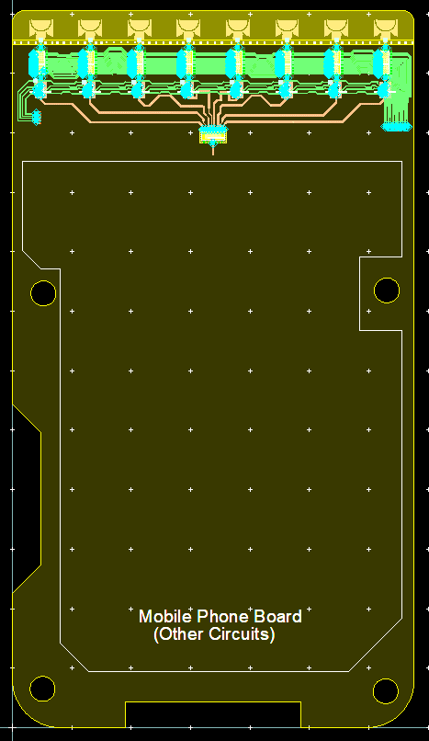
HI Beamforming Module with Integrated Antenna
Watch the YouTube video:
https://youtu.be/VLQ4_QGHpro

Slide 17
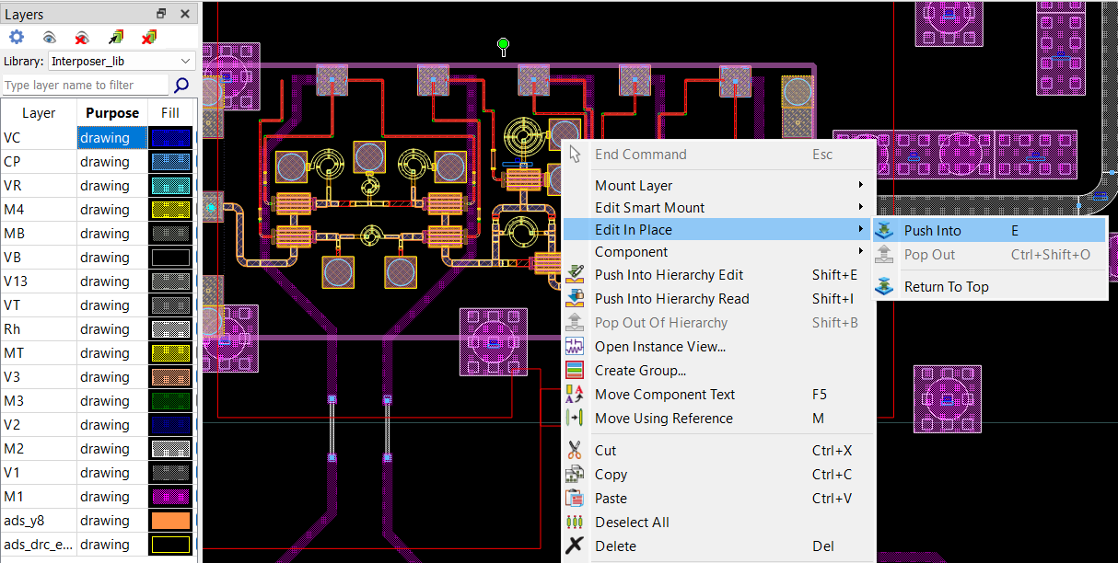
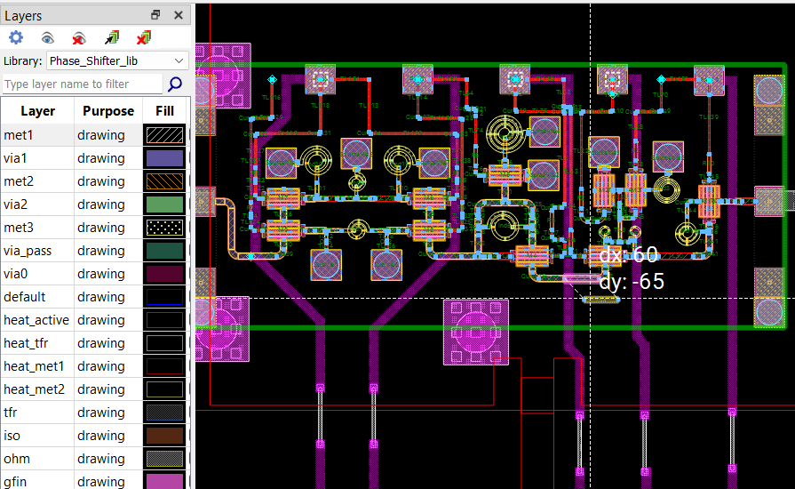
Smart Mount Edit in Place offers industry first
Co-Design across assembled technology with one button press
Edit in place is a common feature used in hierarchal IC flows.
Starting in ADS 2025 Update 1, Edit in place also works with Smart Mount Cells
  Layers and libraries update automatically when doing Edit in Place across technology
Notes:
Starting in ADS 2025 Update 1, Edit in place also works with Smart Mount Cells
Layers and libraries update automatically when doing Edit in Place across technology

Slide 18
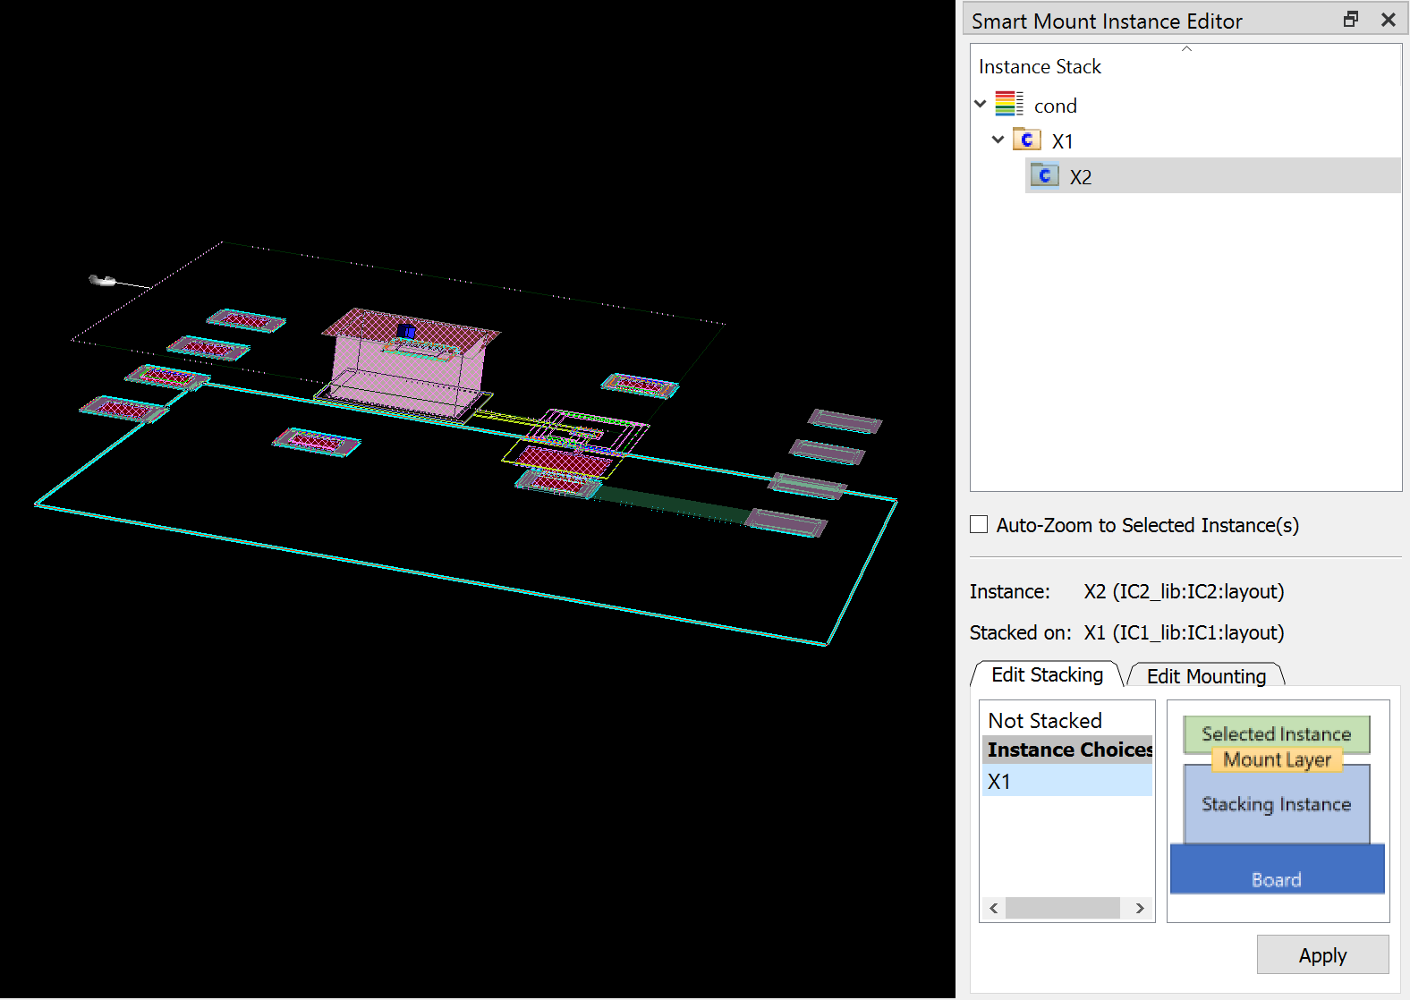
Focus: Smart Mount Technology Stacking for 3DHI
Assemble technology at the top design, just like physical processes
Traditional Smart Mount uses hierarchy to assemble
cell 1
cell 2
cell 3
cell 4=
cell 1 +
cell 2
cell 5=
cell 3 +
cell 4
Creates extra cells / complexity in design
Technology scale factors can inadvertently multiply
New Smart Mount Stacking enables single level assembly
cell 1
cell 2
cell 3
IC2
cell 4=
cell 1 +
cell 2 +
cell 3
IC1
Multiple technologies can be stacked on one level
Scale factors and cells directly accessible
Notes:
Previously, if you wanted to stack multiple technologies on top of one another using Smart Mount, it was necessary to utilize hierarchy. The graphic on the top shows that approach. While this works very well in some cases, there are times when it causes problems. One issue is you can end up with lots of extra cells in your database. Another problem may occur when utilizing technology scale factors – when these are applied through hierarchy, they can cascade and result in a top design which is not representative of the physical reality.
ADS 2024 introduces a new Smart Mount “Stacking” feature. Using a “Smart Mount Instance Editor” docking window in layout, you can now stack technologies on top of one another at the top level, so no need for extra cells and hierarchy. Simply select the instance you want to stack, specify the instance you want to stack it on, and the offset is handled automatically! This is exactly how physical assembly works in the real world.

Slide 19
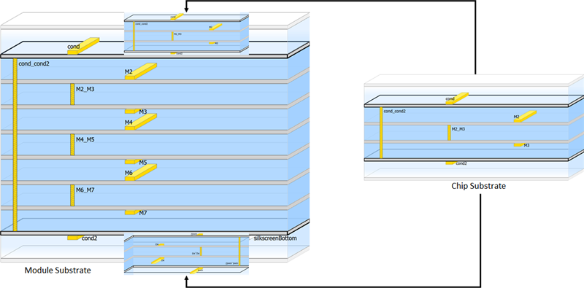
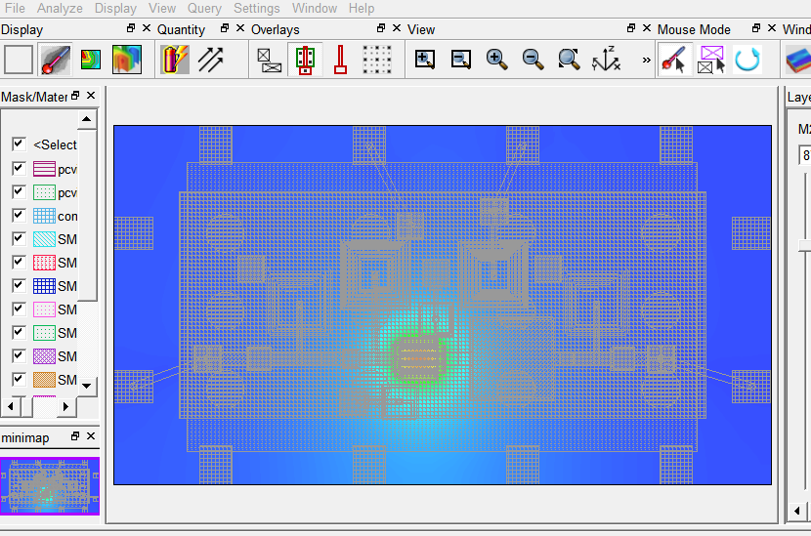
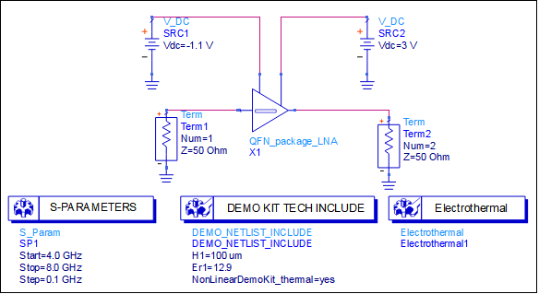
Simulate Smart Mount multi-tech designs in Electro-Thermal
SmartMount setup
Notes:
Electrothermal simulation now works with all Smart Mount Heterogeneous Integrated modules

Slide 20
Agenda Outline
Introduction: What is Heterogeneous Integration (HI), and what’s driving it?
Smart Mount: The backbone of HI Module Assembly
Examples: Multi-Technology and HI module Assembly
Co-simulation: RFPro and EM / Circuit Co-Simulation
Circuit Excitation: Introduction to Circuit Excitation and EM simulation with Near/Far Field plots
Summary
Demo: Putting everything together in a demo

Slide 21
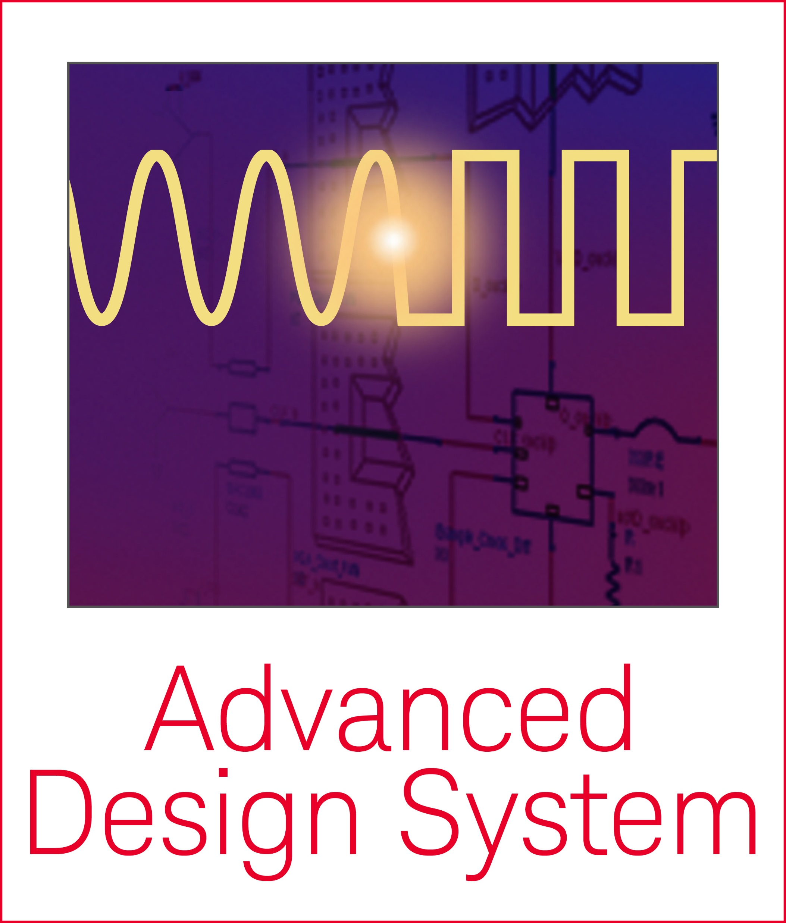
EM-Circuit Simulation - What we heard over 10 years
ADS
Tech file
RF Layout + Circuit
Strip Ckt Components & Erase non-simulateable structures from layout
START
Add Pins to replace stripped ckt components from Layout
Duplicate layer
information]
Import GDS file
into other 3rd party EM tools
EM
Tech file
Export GDS file
Export port locations to a .MSK file
Re-Assign material information
REPEAT
Run custom program to create script file to auto-generate ports in 3rd party EM tools
Set up geometry & ports for simulation
Auto-generate Ports
(For complex designs)
Run EM simulation for S-parameters
EM-Circuit
Co-sim
Reconnect
Ckt to EM
S-parameters in ADS
Import S-parameters from EM tool into ADS
FINISHED
Notes:
In the past (and , 3D EM simulation was performed as a separate task, disconnected from the design flow. For example, and most of you might have experienced this flow. First the design is exported to some EM simulation tool. All SMD components and active devices are stripped off and removed from the layout and the remaining portion to be simulated must be cookie-cut out to be analyzed by the EM simulator.
Now, pins are placed at every disconnected node, and the layout is then exported as a GDS file. EM simulation is run, and a large, multi-port S-parameter matrix is created to represent the EM solution without the active devices and the SMD components. This multi-port S-parameter file must then be reconnected back to the circuit with the SMD components and the active devices for the EM and circuit co-simulation in order to understand the EM circuit interaction. This reconnection process is manual, and tedious, and error prone, especially when hundreds of ports are involved.
Just imagine if by error you happen to manually connect the wrong component at the wrong node, and perhaps the results were reasonably acceptable, but it is the wrong results due to this error; then the hardware will fail, and it would take at least another three months to troubleshoot and rebuild. Whatever the situation is, delay to market always result in significant financial loss, and repeated hardware failures can cause the company to lose design wins repeatedly, leading to eventual closure.

Slide 22
Integrated EM-Circuit Co-Simulation in ADS
ADS
Tech file
RF Layout + Circuit
Strip Ckt Components & Erase non-simulateable structures from layout
START
Add Pins to replace stripped ckt components from Layout
Duplicate layer
information]
Import GDS file
into other 3rd party EM tools
EM
Tech file
Export GDS file
Export port locations to a .MSK file
Re-Assign material information
RFPro in ADS
Integrated
EM / Circuit
Co-Simulation
Run custom program to create script file to auto-generate ports in 3rd party EM tools
Set up geometry & ports for simulation
Auto-generate Ports
(For complex designs)
Run EM simulation for S-parameters
EM-Circuit
Co-sim
Reconnect
Ckt to EM
S-parameters in ADS
Import S-parameters from EM tool into ADS
FINISHED
Notes:
So, having an "Integrated 3D EM/Circuit Co-Simulation For First-Pass Design Win", is represented by this new flow shown on the left side only. The whole process from circuit simulation to EM analysis and EM circuit co-simulation is all integrated together and automated that designers no longer have to perform the tedious tasks in order to run EM simulation.
In this new process, there is no layout modification whatsoever, and there is no manual reconnection of SMD components and active devices. The whole process and the EM setup are totally integrated, and automated, and error free.

Slide 23

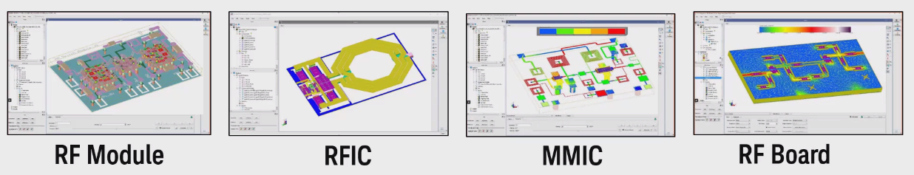
RF/MW Circuit Designers Need Easy 3D-EM/Circuit Co-Simulation
RFPro in ADS Removes EM Setup Complexity
Integration
  Integrated EM and Circuit Co-Simulation
  3D view
  Solution for RF PCB, RFIC, MMIC and RF Modules
  Same user interface for ADS and Cadence Virtuoso
  Same environment for FEM and Momentum
Layout
  No Cookie cutting
  No exporting
  No removing active devices and placing pins & ports
  No reconnecting schematics to s-parameter files
Solver
  No expert setup
  Be confident in the setup of the simulation and accuracy of the results
  Better automated defeaturing (via merging/dummy removal/hatched planes…)
RFPro
Notes:
Here I present to you this new design environment by introducing RFPro.
RFPro is an EM circuit co-simulation environment, tightly integrated in ADS to enable easy access to EM analysis by RF and microwave circuit designers, whenever they need it during design.
RFPro addresses three common requests:
1) No layout modification or cookie cutting to do EM analysis. You no longer need to strip off and remove components. All this is automatically done by RFPro.
2) Automatic and correct setup of EM analysis to produce results that can be trusted with confidence. Yes, RFPro has intelligence to automatically create for you correct EM setup.
3) Tight integration with circuit design simulators in ADS and Cadence Virtuoso with the same environment to access FEM or Momentum EM solvers.

Slide 24
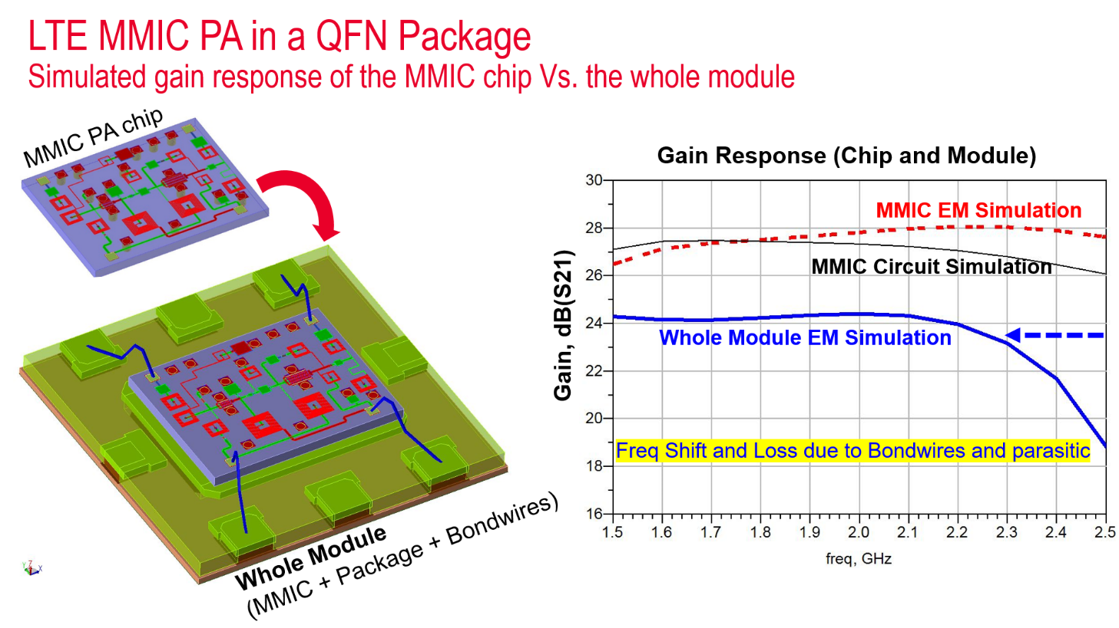
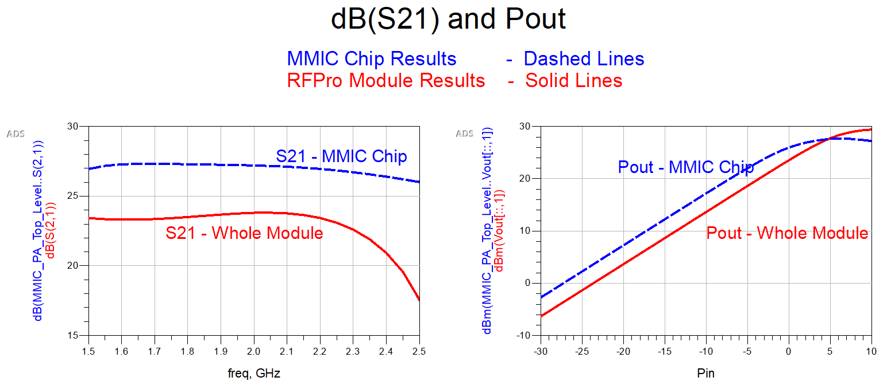
Keysight Pathwave MMIC Solutions
Multi-Technology Smart-Mount assembly and EM simulation
Documentation
MMIC Power Amplifier - Keysight EEsof Applications
Simulation results predict the effect of Bond wires, package, and substrate.
Loss
Freq Shift
Notes:
Multi-Technology / Smart Mount Assembly and EM Simulation with RFPro
Here I present to you how to conveniently assemble a multi-technology module (IC, Package, and Bond wires) using the drag and drop Smart Mount capability in ADS and simulate it using RFPro 3D FEM simulator.
You can quickly set up and run an EM-circuit co-simulation without any manual reconnection errors.
RFPro is an EM circuit co-simulation environment, tightly integrated in ADS to enable easy access to EM analysis by RF and microwave circuit designers, whenever they need it during design. The EM setup and EM simulation is automatic and very easy for everyone to use

Slide 25
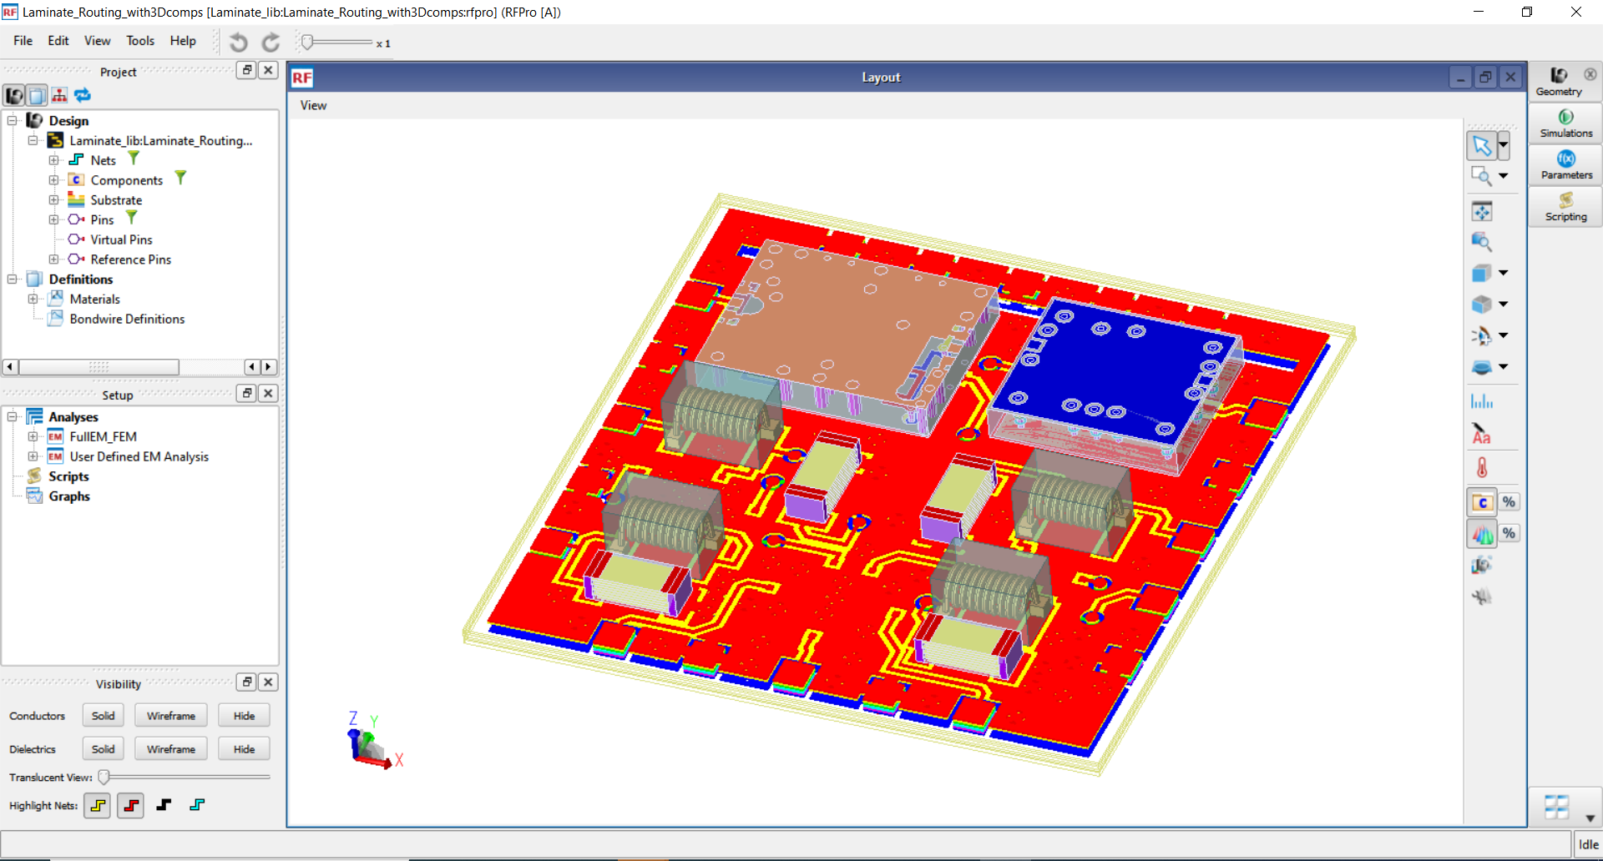
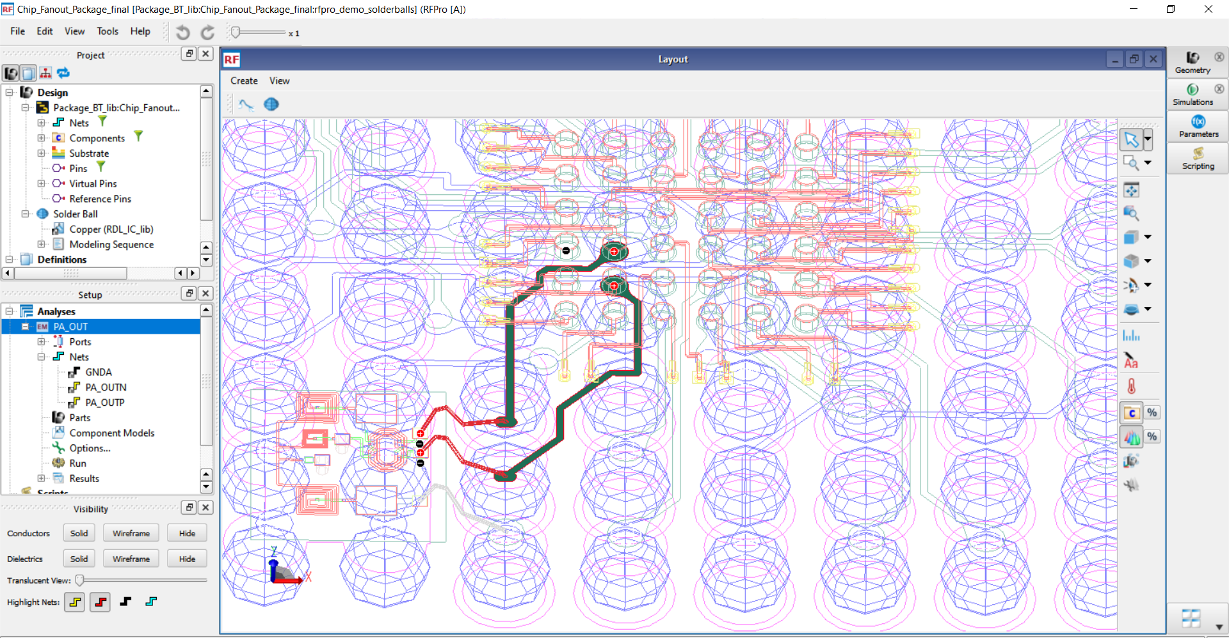
RFPro Makes EM Easy For Heterogeneous Packaging Design
Simplifies EM setup and analysis for modules and packages
Key Benefits
Instant EM access during design
Automatic EM expert settings guarantee confidence in EM results for novice and expert users
Enhanced FEM engine to handle heterogeneous form factors of the assembled technologies
Interactive EM and EM-circuit co-simulation to analyze coupling effects between technologies
Recombine in 1-click SMD components, active devices and the EM simulation for further circuit simulation analysis
Assess manufacturing impairments without any parameterization effort
Net-Extract and analyze any part of the design without having to cookie cut the Layout.
Notes:
As described earlier, higher frequencies are a big challenge in the industry today. The thing that happens when you go up in frequency is that the small interconnects start to really matter in the design. So these must transform from being parasitics, which you want to minimize and manage, to being critical elements in the design. In other words, at high frequencies, a solder ball is just as important as a capacitor on your IC. So, the EM tools need to change too. They need to go from being verification tools to design tools. In other words, instead of combining everything together an running a giant full product EM simulation, you need to do EM on just one interconnect – but that interconnect may run through several technologies. That’s not easy to pull off.
RF Pro enables circuit design engineers who are not experts in EM theory to run fast and accurate analysis as part of their design.

Slide 26
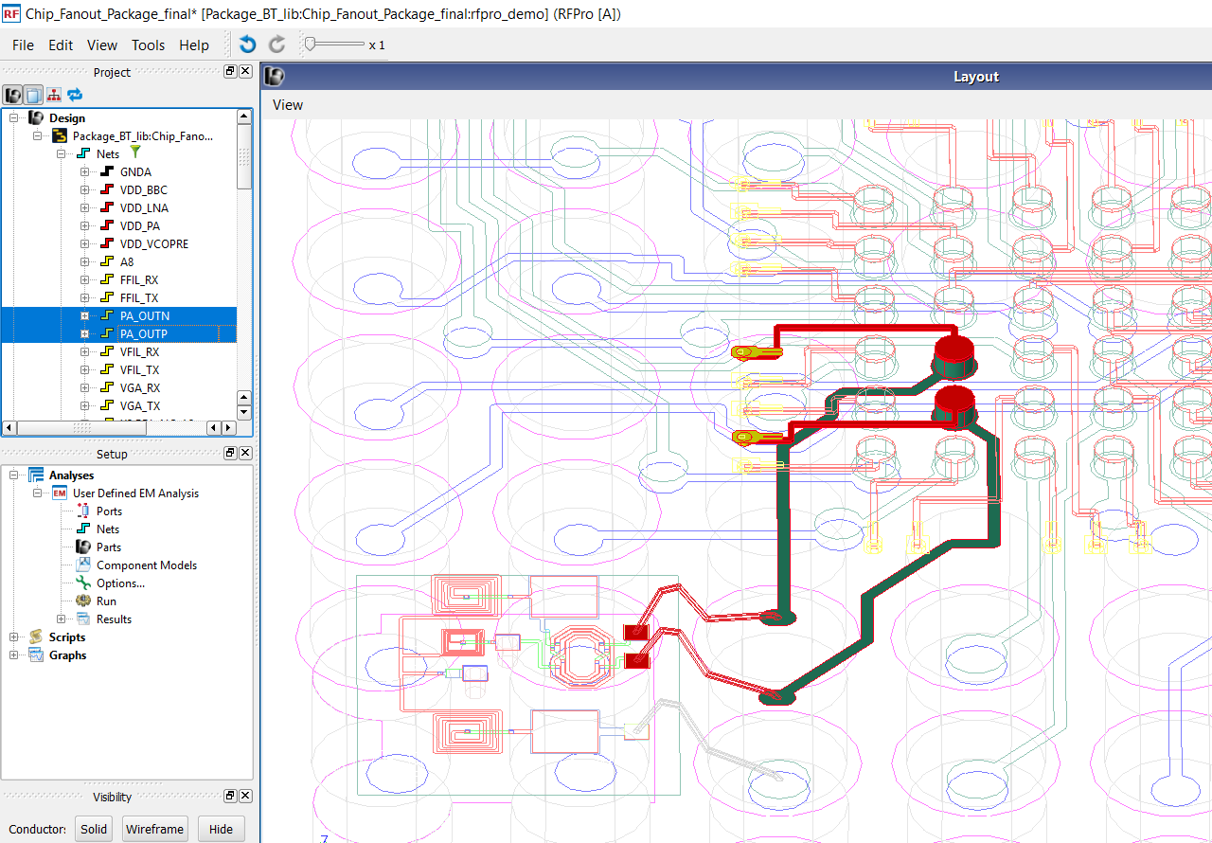
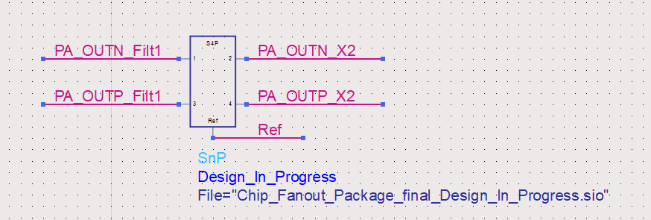
Multi-Technology Smart Mount Assembly and Net Extraction Simulation in RFPro
Design Engineers need to analyze signal paths, even if they traverse through multiple technologies
Bondwire
Signal path is traced from Si Pad to
GaAs Pad, traversing through several
technologies along the way
Si Substrate
GaAs IC Pad
Si IC Pad
RDL metal / bump
Package routing interconnect
YouTube video
Fan-Out Wafer-Level Packaging (FOWLP) Module Design and Analysis in ADS
Documentation
Schematic instantiation of interconnect results
RF Module Fan-Out Wafer Level (FOWL) Packaging - Keysight EEsof Applications
Notes:
Assembling technologies into one layout is challenging. One big issue is that the databases and the designs are coming from different sources, and they need to be stacked and assembled, while maintaining traceability. An assembly tool needs to be flexible – sometimes an IC metal should stack onto a board, other times it should embed into the board.
Net Extraction with RFPro allows to extract any critical paths or Nets in your design and have RFPro quickly and efficiently analyze them with EM-circuit co-simulation and without having to do any layout modification or cookie cutting.
Finally, assembly must be simple enough to fit into the circuit design process without a lot of tedious steps.
Check out the video demo

Slide 27
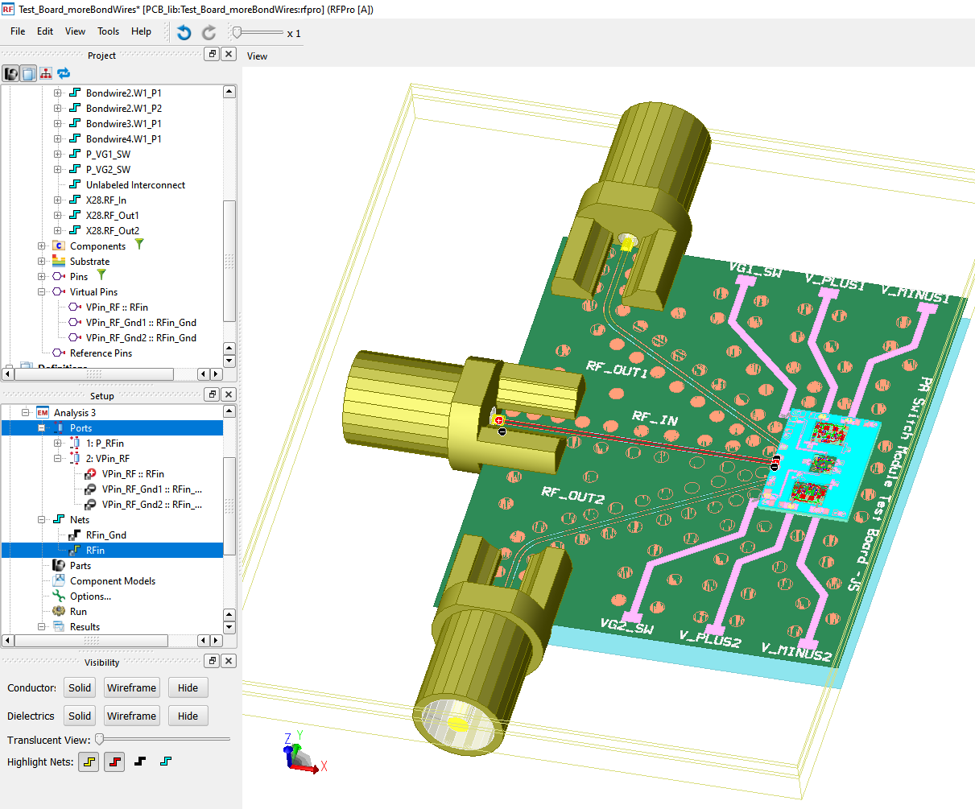
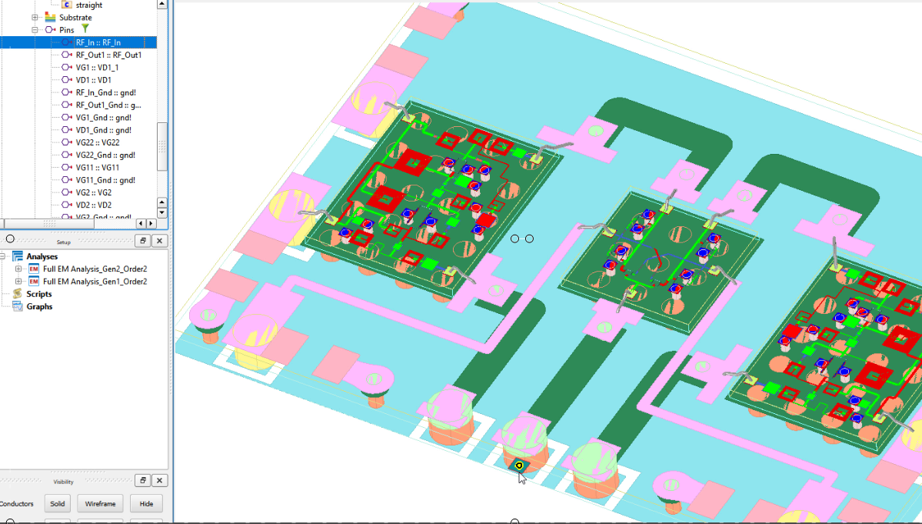
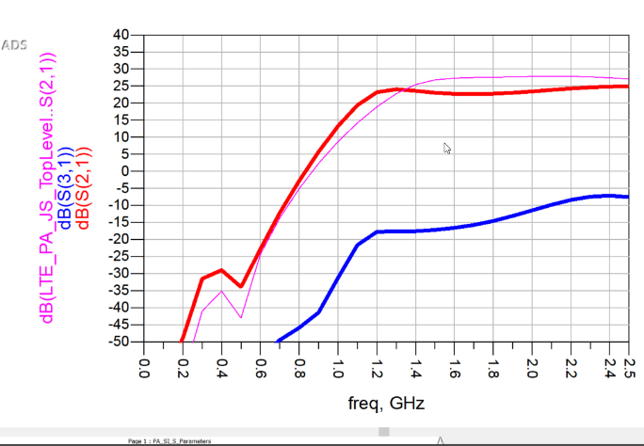
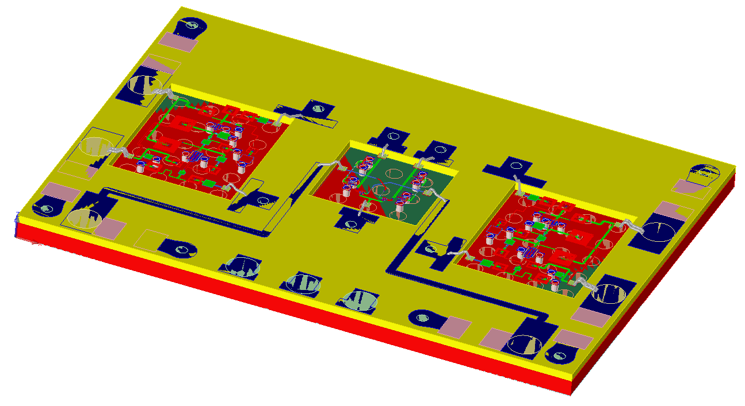
RFPro Makes EM Easy For MMIC / Module Designers
Simplifies EM Setup and Analysis for MMIC and RF PCB
Key Benefits
Instant EM access during design
Automatic EM expert settings guarantee confidence in EM results for novice and expert users
Fast & correct analysis setup, regardless of problem size for quick, interactive EM and EM-circuit co-simulation on demand
Enhanced Momentum and FEM simulator performances
PA/Switch Module on Laminate Board
Notes:
RFPro is an EM circuit co-simulation environment, tightly integrated in ADS and enables easy access to EM analysis by RF and microwave circuit designers, whenever they need it during design.
RFPro addresses three common requests:
No layout modification or cookie cutting to do EM analysis. You no longer need to strip off and remove components. All this is automatically done by RFPro.
Automatic and correct setup of EM analysis to produce results that can be trusted with confidence. Yes, RFPro has intelligence to automatically create for you correct EM setup.
Tightly integrated with circuit design simulators in ADS and Cadence Virtuoso with the same environment to access FEM or Momentum EM solvers.
The assembly & simulation of Complex RF Modules Using Smart-Mount & RFPro EM Flow in ADS:
We have seen how RFPro in ADS is used in both, single technology and Multi-technologies. Here, we expand further and share with you how Smart-Mount and RFPro EM Environment in ADS are used to build and simulate a PA/Switch module with three IC’s on a Laminate Board, sitting on another PCB Board with 3D SMA connectors, Solder bumps, and bond wires.
All of these mixed-technologies components are easily and automatically assembled together using Smart Mount and Co-simulated (Circuit and EM together) with RFPro in ADS without having to touch or modify any layouts. It is all automated.

Slide 28
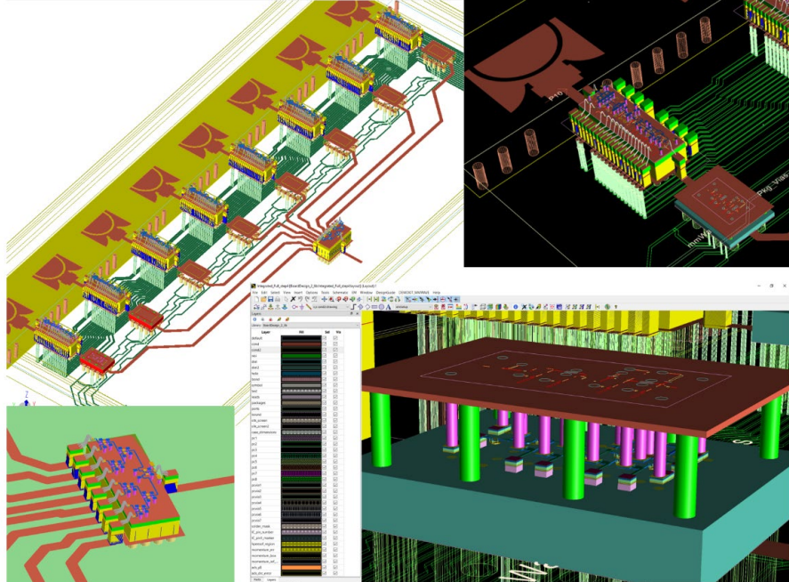
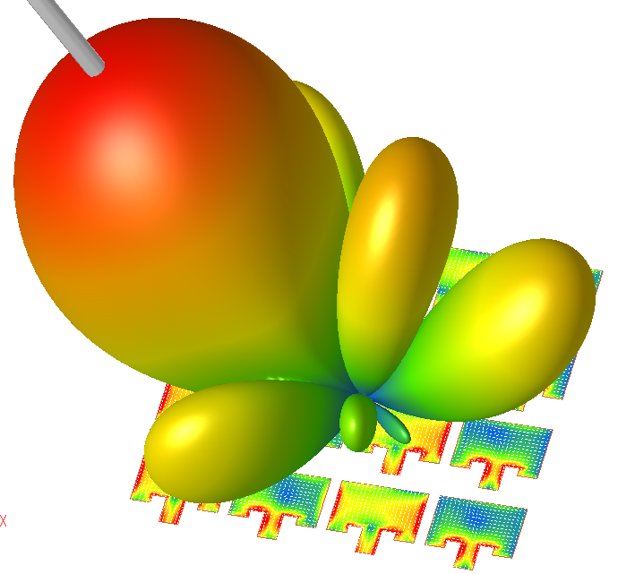
Physical Integration and EM Simulation are Easy with Smart Mount and RFPro
Physical Integration of 28 GHz 5G Beamformer Module in ADS
Challenges
Traditionally, putting all multi-technology pieces together (RFICs, MMICs, 3D packaging, interconnects and routing) is not trivial especially when the resulting RF module structure must also be correctly simulated before prototyping.
Traditionally, preparing the RF module assembly with proper assignment of ports, ground reference, material stack-ups, active/passive component partition, etc., can take longer than the actual simulation itself.
Solution:
Fortunately, with Smart Mount and RFPro, the whole process is automated for RF circuit designers to assemble, integrate, and invoke EM simulation quickly and easily, all in one single tool and database.
Complex RF Module Assembly
Watch the YouTube video:
https://youtu.be/VLQ4_QGHpro
Notes:
Problem statement:
Putting all the multi-technology pieces together (RFICs, MMICs, 3D packaging, interconnects and routing) is not trivial especially when the resulting RF module structure must also be correctly simulated before prototyping.
Preparing the RF module assembly with proper assignment of ports, ground reference, material stack-ups, active/passive component partition, etc., can take longer than the actual simulation itself.
The solution:
Fortunately, with Smart Mount and RFPro, this process is now automated for RF circuit designers to invoke EM simulation as easily as circuit analysis.

Slide 29
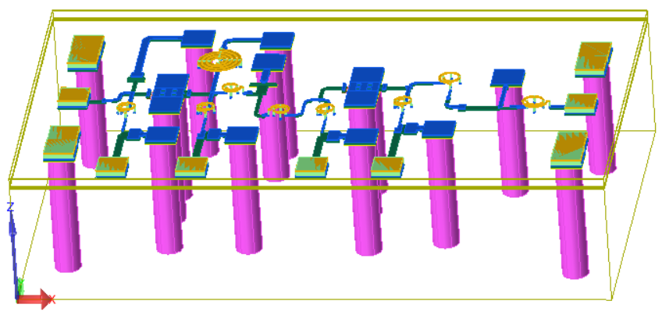
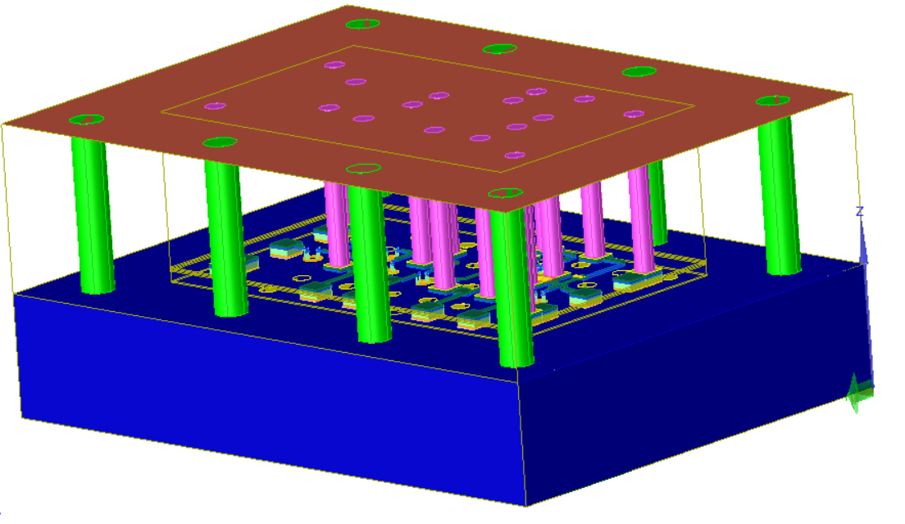
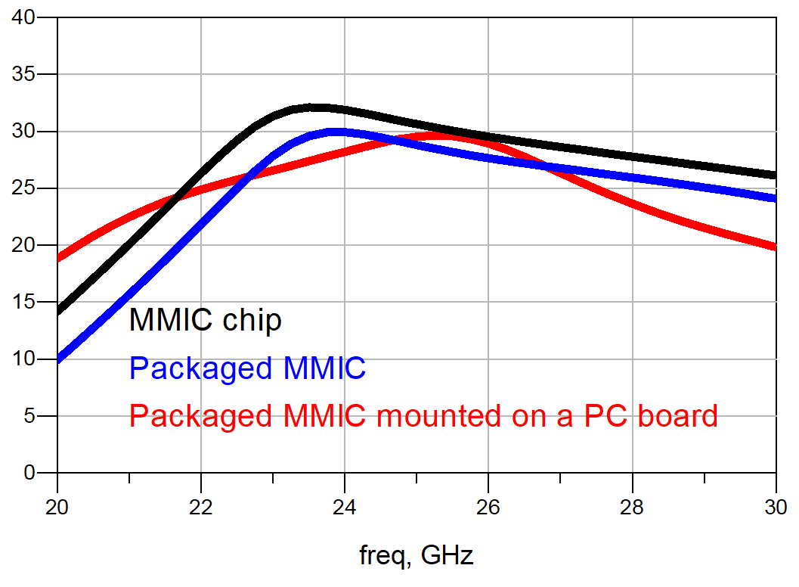
EM Simulation Results of MMIC / Packaged MMIC / Whole Module Mounted on PCB – RFPro Results
All designs are included in one single workspace
All simulations are performed in one single workspace
The whole project and solutions are fully integrated and there is no need to use any other tool
MMIC chip
Resonance peak shifted
Gain loss at the operating
freq. 28 GHz due to parasitic
Packaged MMIC
mm-Wave MMIC
Amplifier
Packaged MMIC
mounted on PCB
PCB Ground Plane
PCB Power Plane
DC Bias Lines
Notes:
All designs are included in one workspace
All simulations are performed in one workspace
The whole project and solutions are fully integrated and there is no need to use any other tool

Slide 30
Physical Integration and Simulation of 28 GHz 5G Beamformer Module
Integration and Assembly of Mobile-Phone Board
Physical Integration of a 28 GHz 5G Beamformer Module in ADS
https://youtu.be/VLQ4_QGHpro
8-Patch Antenna (Integrated on Board)
RF & DC interconnect lines
8 MMIC Phase Shifter / PA’s Modules (QFN)
YouTube video link
mm-Wave MMIC
Amplifier
RF Input
MMIC
1:8 Splitter (QFN)
PCB Ground Plane
PCB Power Plane
8 MMIC Amps
(flip chip in QFN)
DC Bias Lines
Notes:
Problem statement:
Putting all the multi-technology pieces together (RFICs, MMICs, 3D packaging, interconnects and routing) is not trivial especially when the resulting RF module structure must also be correctly simulated before prototyping.
Preparing the RF module assembly with proper assignment of ports, ground reference, material stack-ups, active/passive component partition, etc., can take longer than the actual simulation itself.
The solution:
Fortunately, with Smart Mount and RFPro, this process is now automated for RF circuit designers to invoke EM simulation as easily as circuit analysis.

Slide 31
Agenda Outline
Introduction: What is Heterogeneous Integration (HI), and what’s driving it?
Smart Mount: The backbone of HI Module Assembly
Examples: Multi-Technology and HI module Assembly
Co-simulation: RFPro and EM / Circuit Co-Simulation
Circuit Excitation: Introduction to Circuit Excitation and EM simulation with Near/Far Field plots
Summary
Demo: Putting everything together in a demo

Slide 32
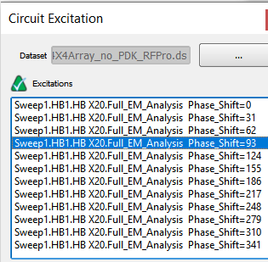
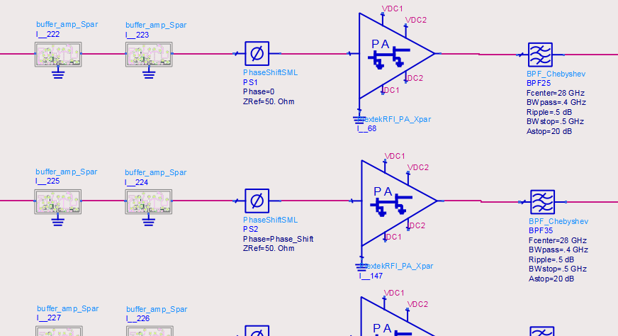
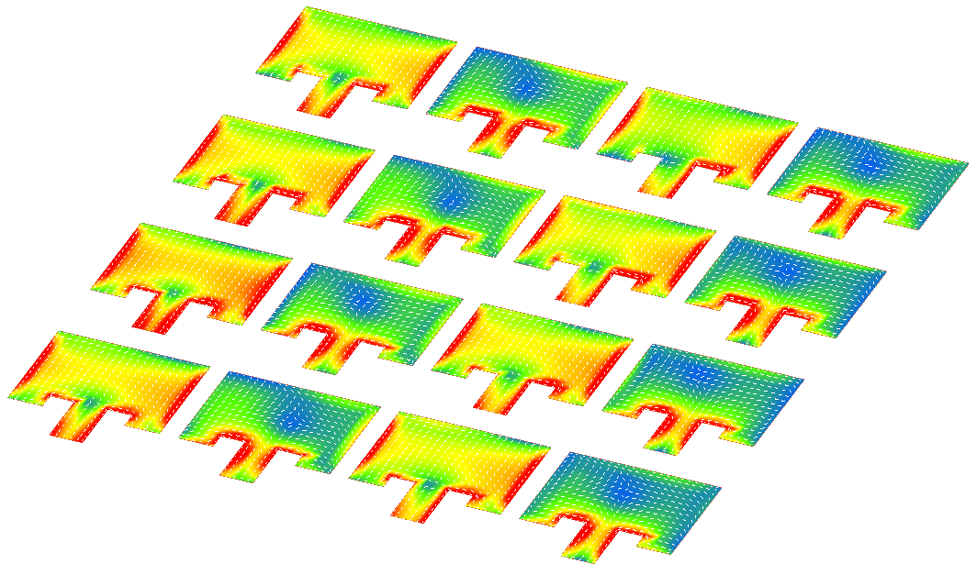
28 GHz Transmit Chain with Patch Antenna for 5G Application
Circuit excitation with EM/Circuit Co-simulation in ADS
Complete EM / Circuit Simulation and Analysis
Transceiver Components
Antenna and other physical structures
+
=
Circuit level designs; X-parameter models, EM models, etc.
Momentum Planar EM
Full 3D FEM Simulation
The output from the Circuit simulation drives/excites the Antenna ports
Captures the excitation from the T/R module and apply it to the Antenna(s)
Near-Field and Far-Field plots of the beam steered by swept phase-shifter circuit analysis
YouTube video:
5G Beam-Steering with EM-Circuit Excitation and Co-Simulation in ADS
Notes:
5G Beam-Steering Using Circuit-to-EM Excitation in ADS/RFPro
The short video shows how swept-phase excitation in a transmit chain is used to steer an antenna beam in RFPro.
The swept circuit-analysis output from the transmit chain is used to drive and excite the Antenna ports which results in a complete Circuit-to-EM simulation and analysis with RFPro.

Slide 33
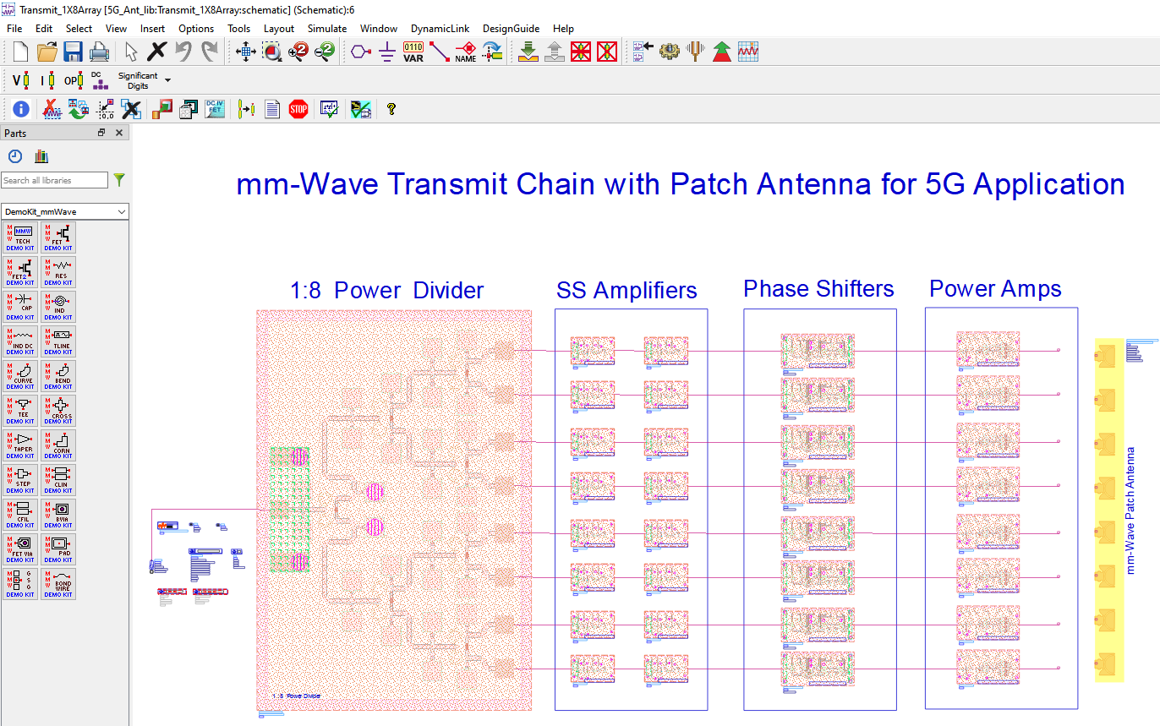
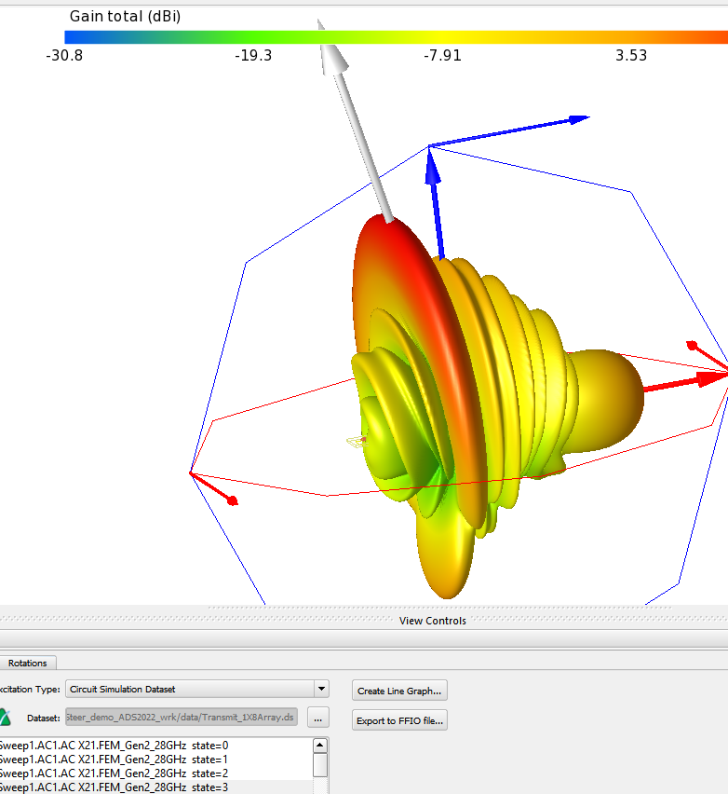
5G Beamforming with Integrated Antenna
Board is not included in the simulation
Perfectly matched MMICs
Perfect Antenna ½ Lambda spacing
Board interconnects and bias lines are not included here

Slide 34
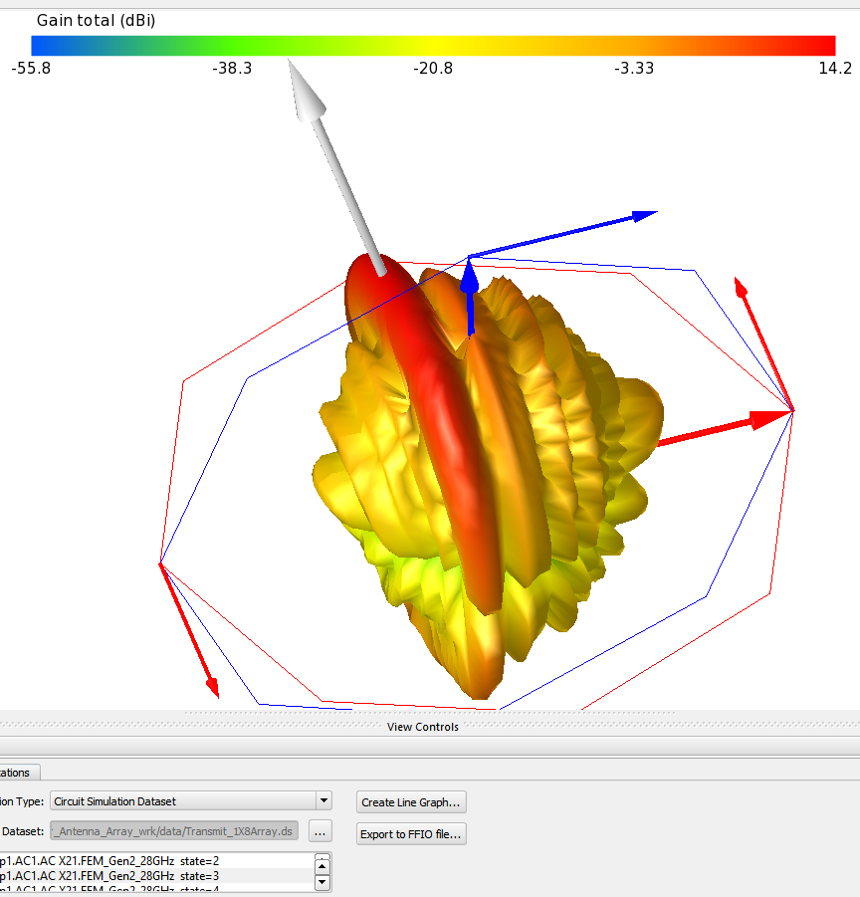
5G Beamforming with Integrated Antenna
The Integrated Antenna Pattern Results
Include the Board and Interconnect RF and Bias lines
Well matched MMICs
Antenna is now Integrated
Board interconnects and bias lines are now included here:
    Coupling and Crosstalk
    Isolation & leakage issues
    Mismatch between IC’s

Slide 35

Summary
Enabling Next Generation Heterogeneous Integrated Module Design in ADS
Problem statement:
Traditionally, putting all multi-technology pieces together (RFICs, MMICs, 3D packaging, interconnects and routing) is not trivial especially when the resulting RF module structure must also be correctly simulated before prototyping.
Traditionally, preparing the RF module assembly with proper assignment of ports, ground reference, material stack-ups, active/passive component partition, etc., can take longer than the actual simulation itself.
The Solution:
Fortunately, with Smart Mount and RFPro, the process of integrating sophisticated Heterogeneous modules in ADS while simulating and fixing the designs all in one database is very easy and fully automated.
RF circuit designers can assemble, integrate, and invoke EM simulation quickly and easily, all in one single tool and database.
ADS is a great platform for next generation Heterogeneous Design
Complex RF Module Assembly
Heterogenous Integration
Notes:
Problem statement:
Putting all the multi-technology pieces together (RFICs, MMICs, 3D packaging, interconnects and routing) is not trivial especially when the resulting RF module structure must also be correctly simulated before prototyping.
Preparing the RF module assembly with proper assignment of ports, ground reference, material stack-ups, active/passive component partition, etc., can take longer than the actual simulation itself.
The solution:
Fortunately, with Smart Mount and RFPro, this process is now automated for RF circuit designers to invoke EM simulation as easily as circuit analysis.
Enabling Next Generation Heterogeneous Integrated Module Design in ADS
The demand for higher functionality, smaller sizes, and higher frequency bands in RF and microwave design is driving the need for complex module integration. This paper discusses the challenges and solutions in designing high-frequency applications such as 5G and 6G, automotive radars, and wireless networking. Keysight's Advanced Design System (ADS) introduces new features in RFPro 3DEM simulation and Smart Mount assembly to address these challenges. These tools enhance simulation accuracy and simplify the integration of different technologies, enabling fast and accurate EM analysis. The paper highlights how Heterogeneous Integration, combined with these advancements, offers an efficient approach to meeting the stringent requirements of size, weight, power, and cost. The integration of circuit and 3D EM simulation in ADS facilitates first-pass design success, making it an ideal platform for next-generation heterogeneous integrated module design.

Slide 36
Agenda Outline
Introduction: What is Heterogeneous Integration (HI), and what’s driving it?
Smart Mount: The backbone of HI Module Assembly
Examples: Multi-Technology and HI module Assembly
Co-simulation: RFPro and EM / Circuit Co-Simulation
Circuit Excitation: Introduction to Circuit Excitation and EM simulation with Near/Far Field plots
Summary
Demo: Putting everything together in a demo

Slide 37
Demo Example
Heterogeneous Integrated Beamforming Module
DEMO

Slide 38
Assemble any set of technologies with Smart Mount
Notes:
Assembling technologies into one layout is challenging. One big issue is that the databases and the designs are coming from different sources, and they need to be stacked and assembled, while maintaining traceability. An assembly tool needs to be flexible – sometimes an IC metal should stack onto a board, other times it should embed into the board. Finally, assembly must be simple enough to fit into the circuit design process without a lot of tedious steps.
Smart Mount assembly in ADS addresses all these issues, making technology assembly as easy as instantiating a cell into layout. Its easy to use, there is no complex layer mapping, no substrate modification, and it also is configurable at the library level. At the same time, its quite powerful and versatile – And finally, its scalable: both in the sense that it works well for very large assemblies with lots of chips or stacked technology, and it also supports physical scaling as encountered in nm Silicon processes.

Slide 41
Appendix
Demo slides
Desktop LVS if time permits

Slide 42
Demo Slides

Slide 43



Heterogeneous Integrated Beamforming Module
Complete Module with Integrated Patch Antenna
Feeds point in the same direction with .5λ separation
Board interconnects, bias lines on the interposer board, cross talk, isolation, and coupling, all result in distorted output beam and other and need to be corrected prior to prototyping.

Slide 44



3DHI Beamforming with Integrated Antenna
Power Splitter
W=15 um
W=30 um
W=100 um

Slide 45

3DHI Beamforming with Integrated Antenna
Alternative Power Splitting – MMIC
W=15 um
W=40 um
W=140 um

Slide 46



3DHI Beamforming with Integrated Antenna
MMIC Power Splitter
W=15 um
W=40 um
W=140 um

Slide 47

3DHI Beamforming with Integrated Antenna
MMIC Power Splitter
W=15 um
W=40 um
W=140 um

Slide 48
3DHI Beamforming with Integrated Antenna
MMIC Power Splitter
W=15 um
W=40 um
W=140 um

Slide 49


Heterogeneous Integrated Beamforming Module
Design Challenges in this demo
The whole module was quickly put together to demonstrate the easiness of integration and simulation capabilities
Original MMICs were slightly altered to make them fit, resulting in detune and mismatch issues
Antenna has its own design challenges.
  Need to fit a good antenna on the Interposer board.
Board interconnects, bias lines on the interposer board, cross talks, isolation, and coupling, all result in distorted output beam and other issues.

Slide 50



3DHI Beamforming with Integrated Antenna
Guided Antenna: Feeds oriented in the same direction (less than .5λ)

Slide 51
Heterogeneous Integrated Beamforming Module
Whole Module includes an Integrated Patch Antenna
Notes:
3DHI Beamforming with Integrated Antenna
Antenna Design Tips
Ensure that the antenna feeds are oriented in the same direction to achieve a constructive radiation pattern.
Use a higher impedance line to feed the antenna. This will minimize radiation from the microstrip line and provide a better match with the via.
The electrical length of all feedlines should be the same.
The antenna element spacing (center-to-center) should be 0.5 λg​ (guided wavelength).
Tuning > Reduce horizontal length dimension to shift to higher frequency.
Beam Steering will be more visible if all antenna elements are placed in one line adjacent to each other.

Slide 52
Verification with Desktop LVS

Slide 53



5G Beamforming with Integrated Antenna
Desktop LVS

Slide 54


5G Beamforming with Integrated Antenna
Desktop LVS

Slide 55




5G Beamforming with Integrated Antenna
Desktop LVS

