Slide 1
SESSION NAME
Date & Time of Session

Slide 2
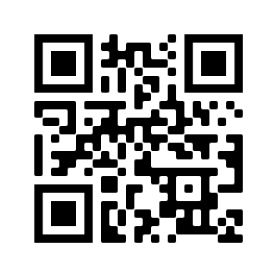
This is an interactive session.
To participate, log onto your mobile device web browser
SAME.CNF.io
Or scan the QR code
Find the Session.
The Presenter will unlock the poll(s) during the presentation.
Please complete the brief Evaluation Survey at the end of the session.

Slide 4
SESSION NAME
Moderator: Add Moderator Name and Org
Speakers:
Add Speaker Name, Title and Org
Add Speaker Name, Title and Org
Add Speaker Name, Title and Org

Slide 5
SPEAKER Name, Credentials
Replace White BOX to the left with your photo. Then Add some fun facts about yourself here such as
Sports Teams
Vacation Spots
Did you Know I…
Hobbies

Slide 6
Use this slide for a new content section

Slide 8
Name, Email
Name, Email
Name, Email

Slide 9
THANK YOU
Please take a few minutes to complete a short survey about this session. Your feedback will help us improve future programming for SBC.

Slide 10
Add Poll Questions Here
1.
2.
3.
4.
5.

Slide 11
VIDEO
ENTER TITLE OF VIDEO
ROLL VIDEO…

