Slide 1
SESSION NAME

Slide 2
Session Name
Moderator: Add Moderator Name and Org
Speakers:
Add Speaker Name, Title and Org
Add Speaker Name, Title and Org
Add Speaker Name, Title and Org

Slide 3
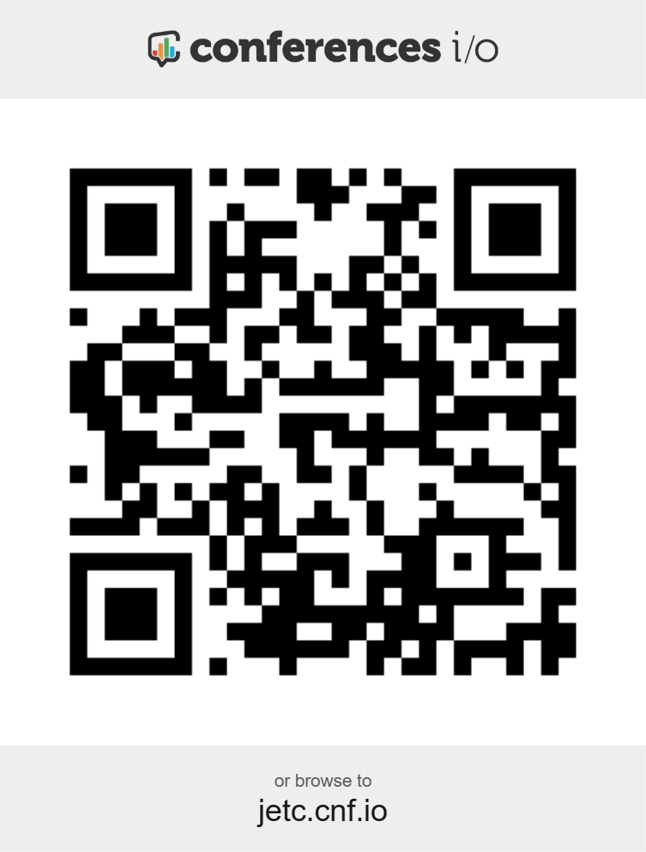
This is an interactive session. To participate, use your mobile device: jetc.cnf.io Or scan the QR Code
Find the session.
If this session has polls, the presenter will unlock them during the presentation.
Complete a brief Evaluation Survey at the end of the session.

Slide 4
HOUSEKEEPING ITEMS
Take Note of Exits
Silence Your Mobile Devices
Presentations and Audio Recordings will be available in the Attendee Service Center until September 1, 2025
Download your PDH record in the Attendee Service Center before September 1, 2025

Slide 5
Thank You to our Education Session Sponsors

Slide 6
Fun Facts
MODERATOR
Name Organization Job Title
Sports Teams
Vacation Spots
Did you Know I…
Hobbies

Slide 7
Fun Facts
SPEAKER
Name Organization Job Title
Sports Teams
Vacation Spots
Did you Know I…
Hobbies

Slide 8
Use this slide for a new content section

Slide 9
Enter Poll Question Here
Answer 1
Answer 2
Answer 3
Answer 4
Answer 5

Slide 10
Q&A
Name, Email
Name, Email
Name, Email

Slide 11
THANK YOU
Please take a few minutes to complete a short survey about this session. Your feedback will help us improve future programming for JETC.

Slide 13
VIDEO
ENTER TITLE OF VIDEO
ROLL VIDEO…

