Slide 1


Enabling Next Generation EM Simulation with ADS RFPro 2025
Presented by:

Slide 2
Abstract
As RF and microwave designs continue to increase in complexity, engineers require tools that streamline workflows and enhance simulation accuracy.
ADS 2025 introduces significant advancements in RFPro, enabling more efficient design exploration and validation.
This presentation highlights key updates to the Generation 2 Momentum and FEM solvers.
New Calibration Types that extend accuracy at high frequencies, substrate sweep capabilities for rapid material trade-offs, re-use of simulation results to save time, modal port solvers, enhanced visualization of mesh and fields, FEM interior meshing, near and far field computations.
Explore how these new capabilities simplify the design process, reduce iteration cycles, and improve confidence in achieving performance targets.

Slide 3
Agenda
RFPro Vision
  Designers Focus on Design
  One Platform … One Flow
  Next Generation EM
Case Studies with measurement correlation
  Nokia 90G Phased Array
  Menlo Micro MEMS assembly
  Keysight 50G PCB Signal Analyzer
What’s New in RFPro for ADS2025
  7 key new features
Realizing the 1THz Vision

Slide 4

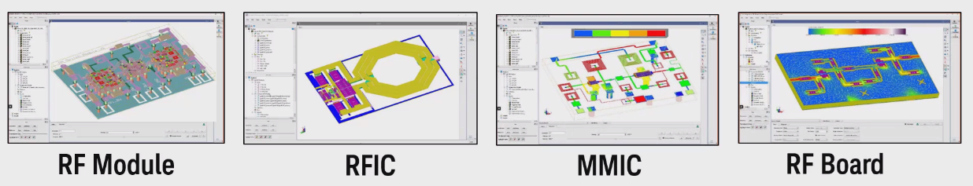
RFPro Vision: EM for every RF circuit designer
Allows users to focus on design rather than setting up EM
Main customer requests for the EM flow
Integration
  Interactive 3D view
  Design flow to handle simplistic structures to complete designs to full RF Modules
  Same user interface integrated into multiple design flows from standalone ADS to Cadence Virtuoso, Synopsys Custom Compiler, and Siemens Tanner
Ease of Use
  Same environment for FEM and Momentum
  Usable by EM novices with advanced settings for experts
  Intelligent defaults and better automated defeaturing (via merging/hatched planes…)
Use Manufacturing Layout
  No Cookie cutting
  No exporting
  No removing active devices and placing pins & ports
  No reconnecting schematics to s-parameter files
RFPro
Notes:
Higher frequencies are a big challenge in the industry today. The thing that happens when you go up in frequency is that the small interconnects start to really matter in the design. So these must transform from being parasitics, which you want to minimize and manage, to being critical elements in the design. In other words, at high frequencies, a solder ball is just as important as a capacitor on your IC. So, the EM tools need to change too. They need to go from being verification tools to design tools. In other words, instead of combining everything together and running a giant full product EM simulation, you need to do EM on just one interconnect – but that interconnect may run through several technologies. That’s not easy to pull off.
RFPro enables circuit design engineers who are not experts in EM theory to run fast and accurate analysis as part of their design.
The next few slides will illustrate how RFPro enables circuit designers to access EM technology.

Slide 5
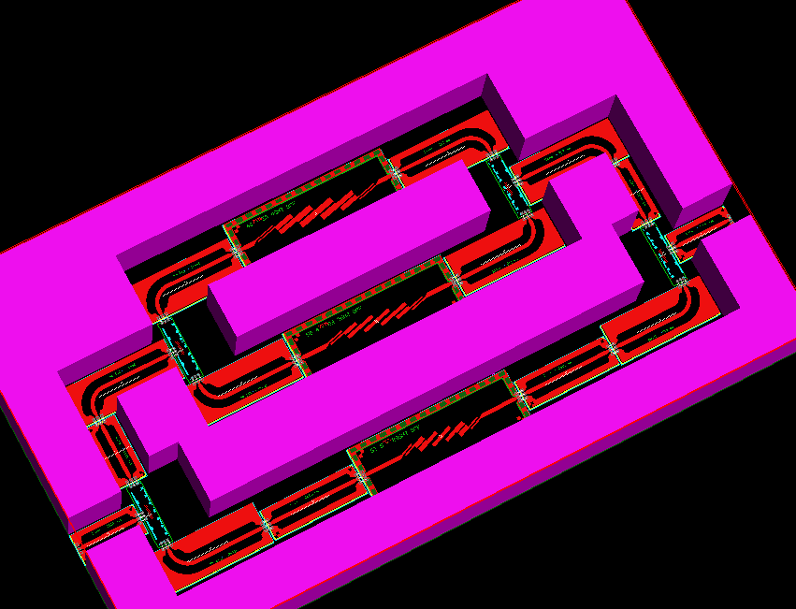
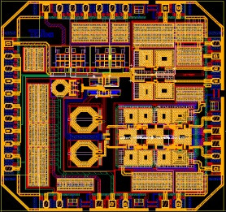
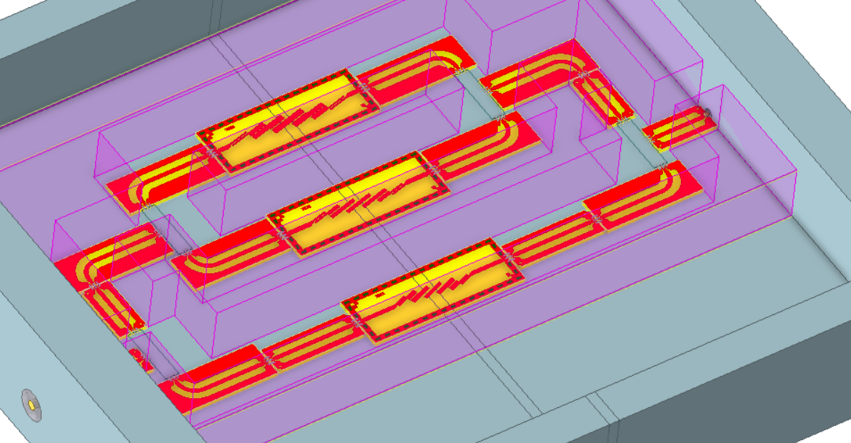
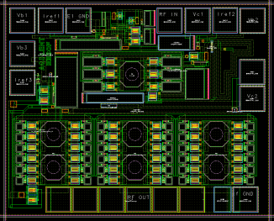
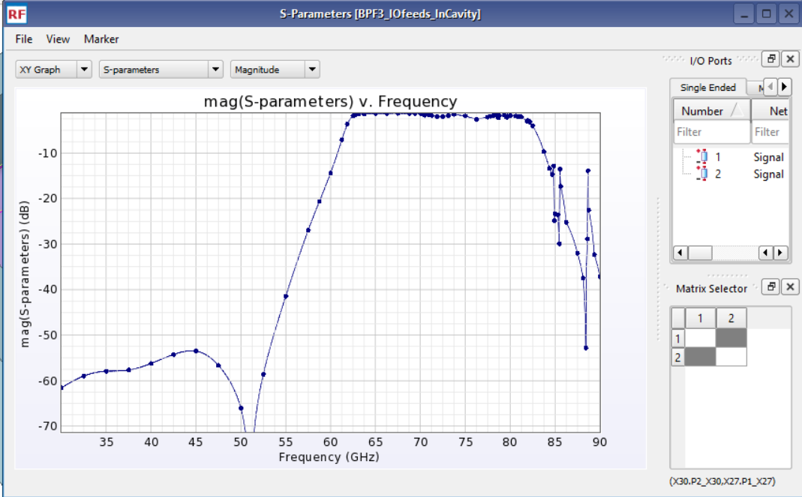
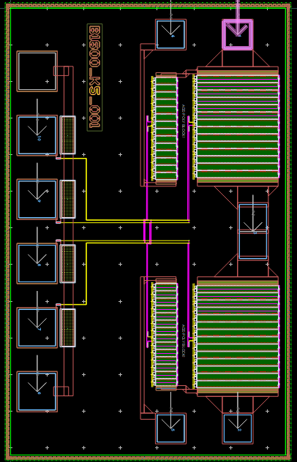
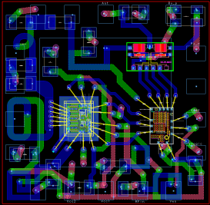
RFPro Vision: One Platform for Integration, Assembly, and EM
  EM design flow for simple structures, transitions, IC, package, board, 3D components, up to complete MCM assemblies
  EM design flow that fully integrates into existing design flows
  Multi-technology assembly and simulation which scales with design complexity
  Ability to EM simulate pieces of complex multi-technology design without cutting
  nor modifying the original layout
Silicon RFIC
Interoperable, OA based Layouts
2D/3D Layout
GaAs/GaN/MMIC
Smart Mount Technology
Assembly
EM Sim
(RFPro)
Native IC designs
Silicon IC
Pkg or board
Imported Layouts
EM Co-simulation
Notes:
Assembling technologies into one layout is challenging. One big issue is that the databases and the designs are coming from different sources, and they need to be stacked and assembled, while maintaining traceability. An assembly tool needs to be flexible – sometimes an IC metal should stack onto a board, other times it should embed into the board. Finally, assembly must be simple enough to fit into the circuit design process without a lot of tedious steps.

Slide 6
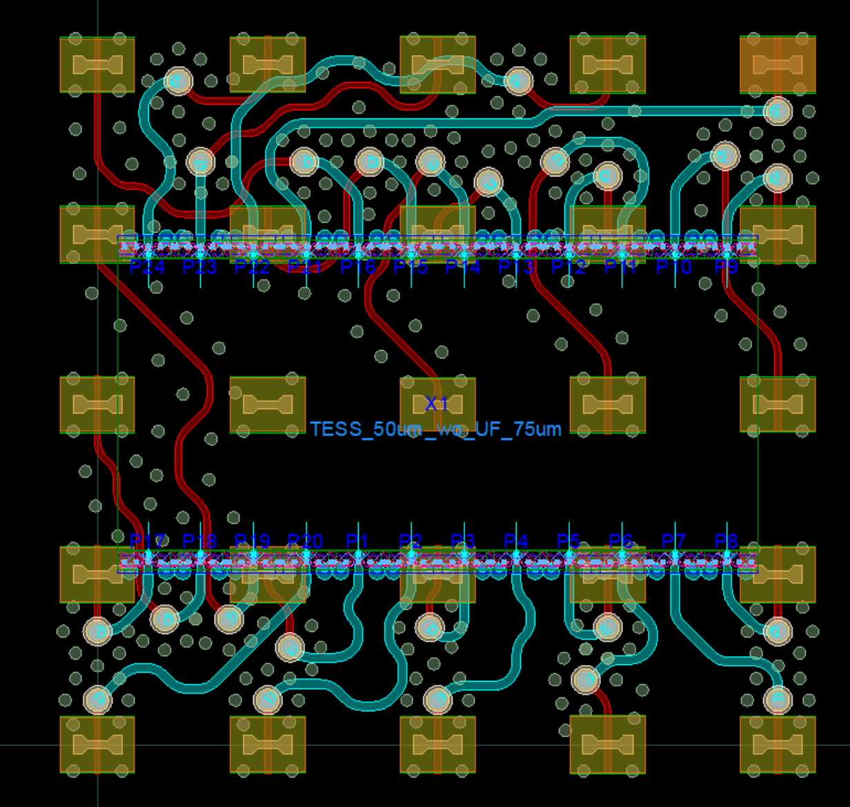
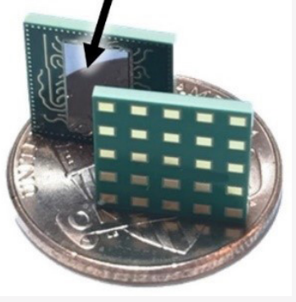
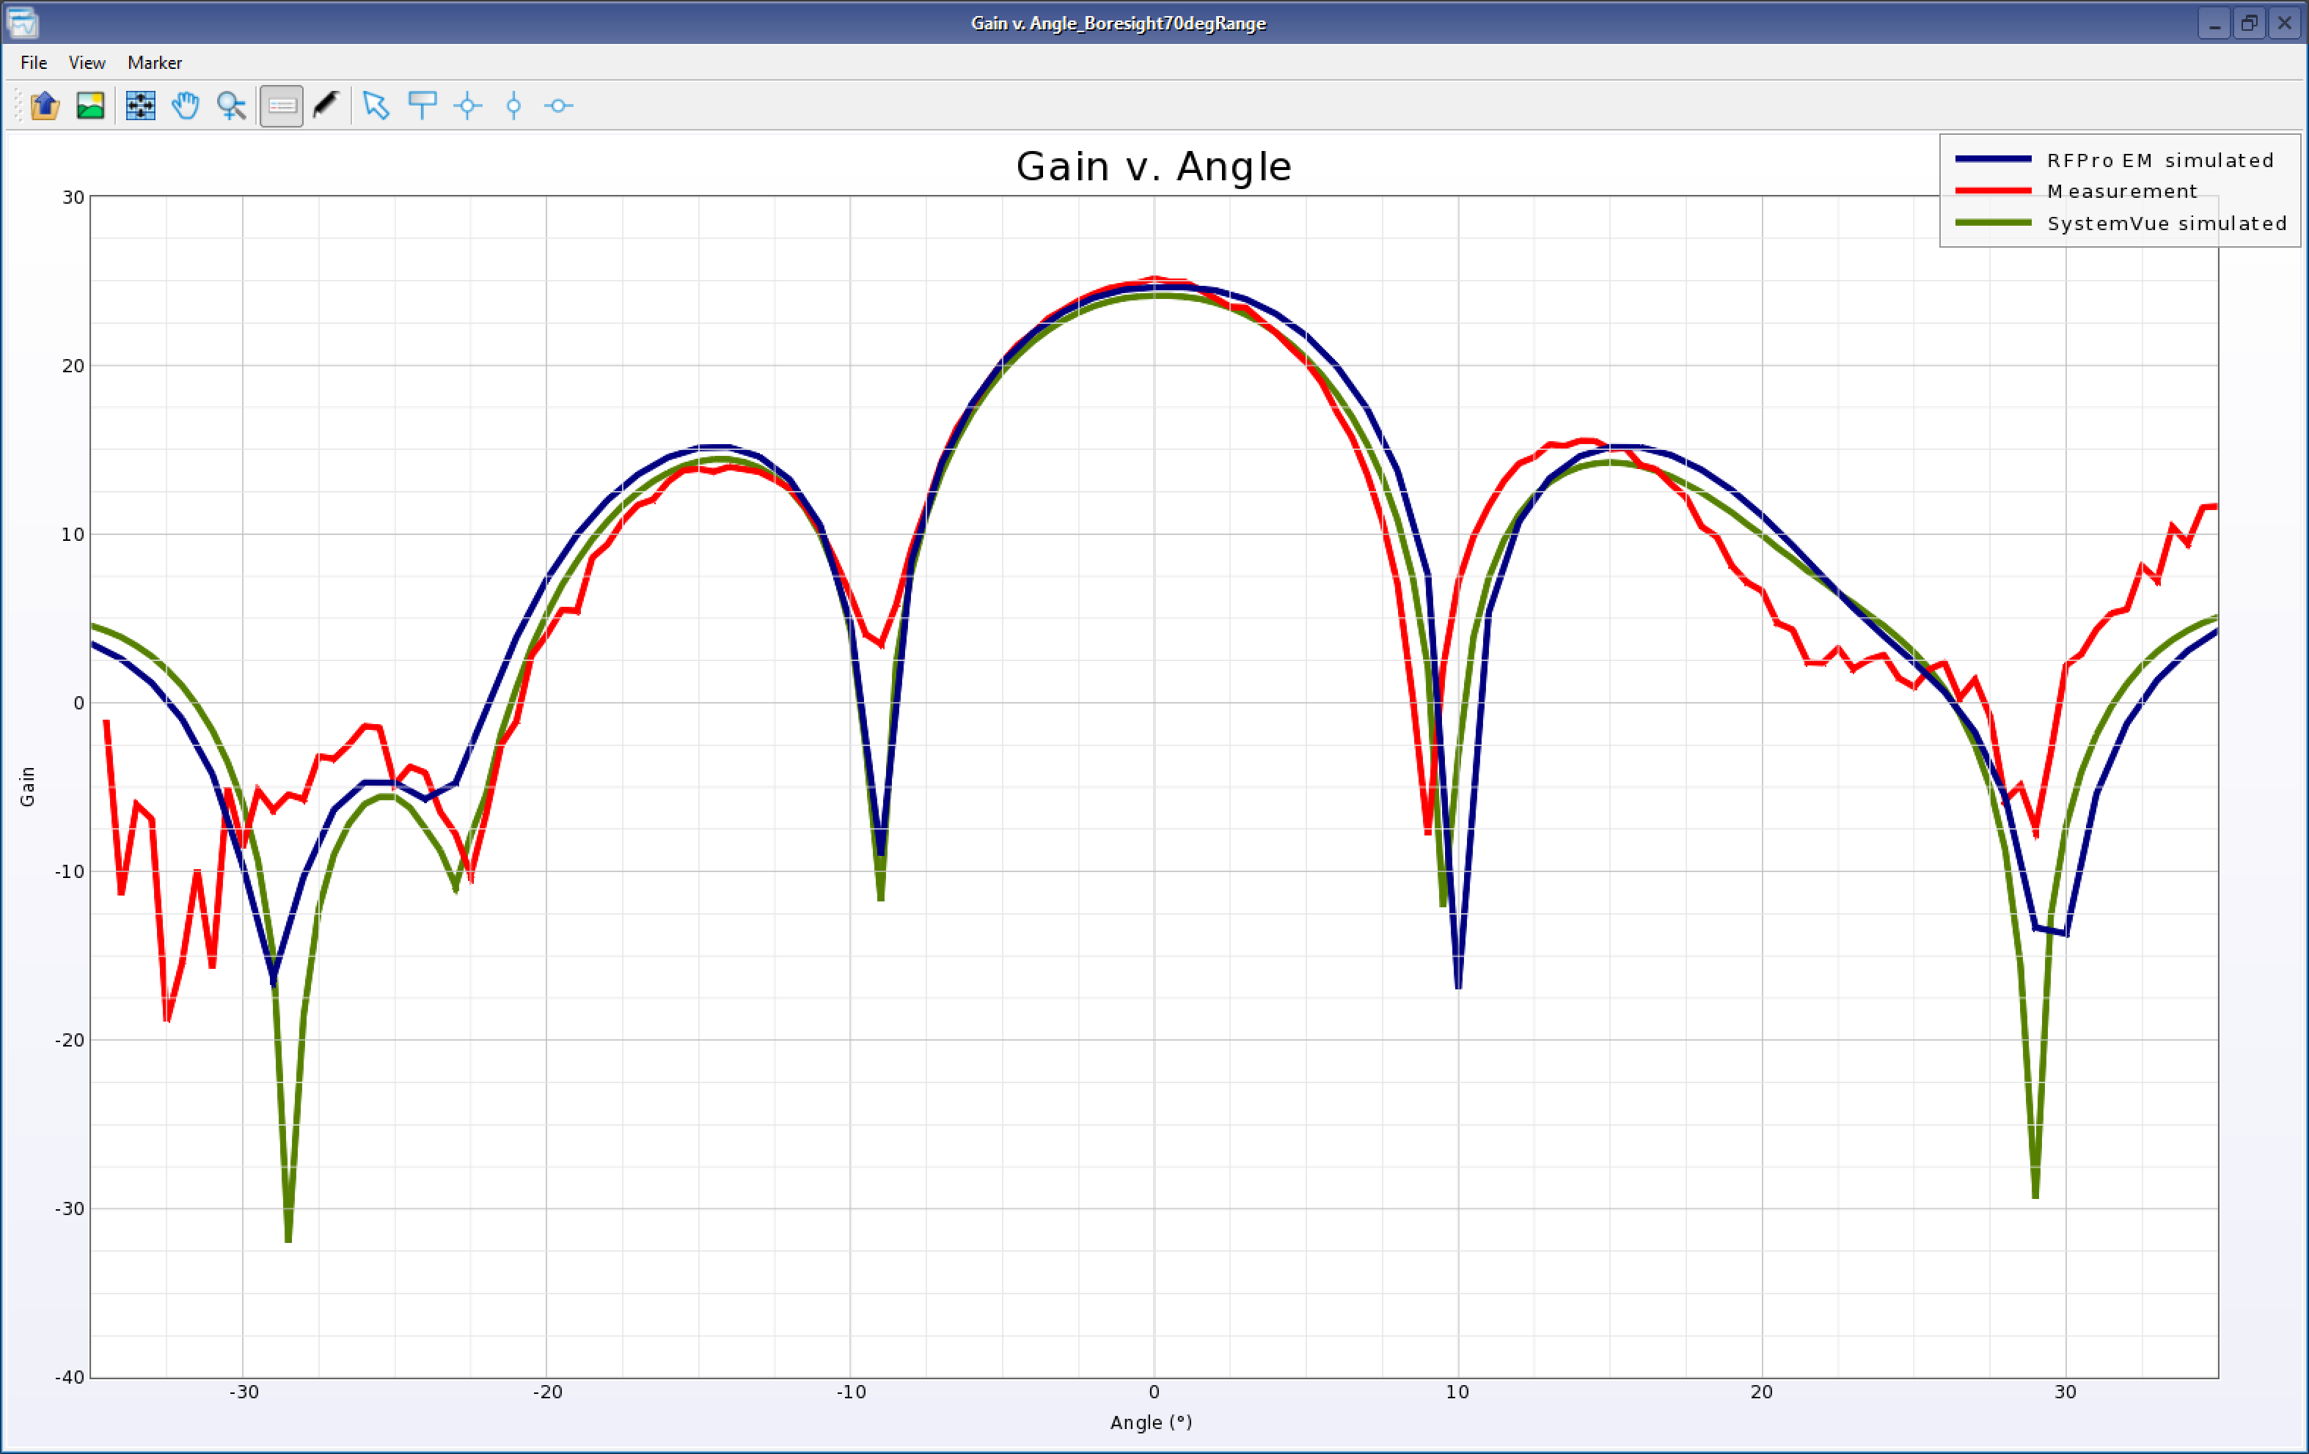
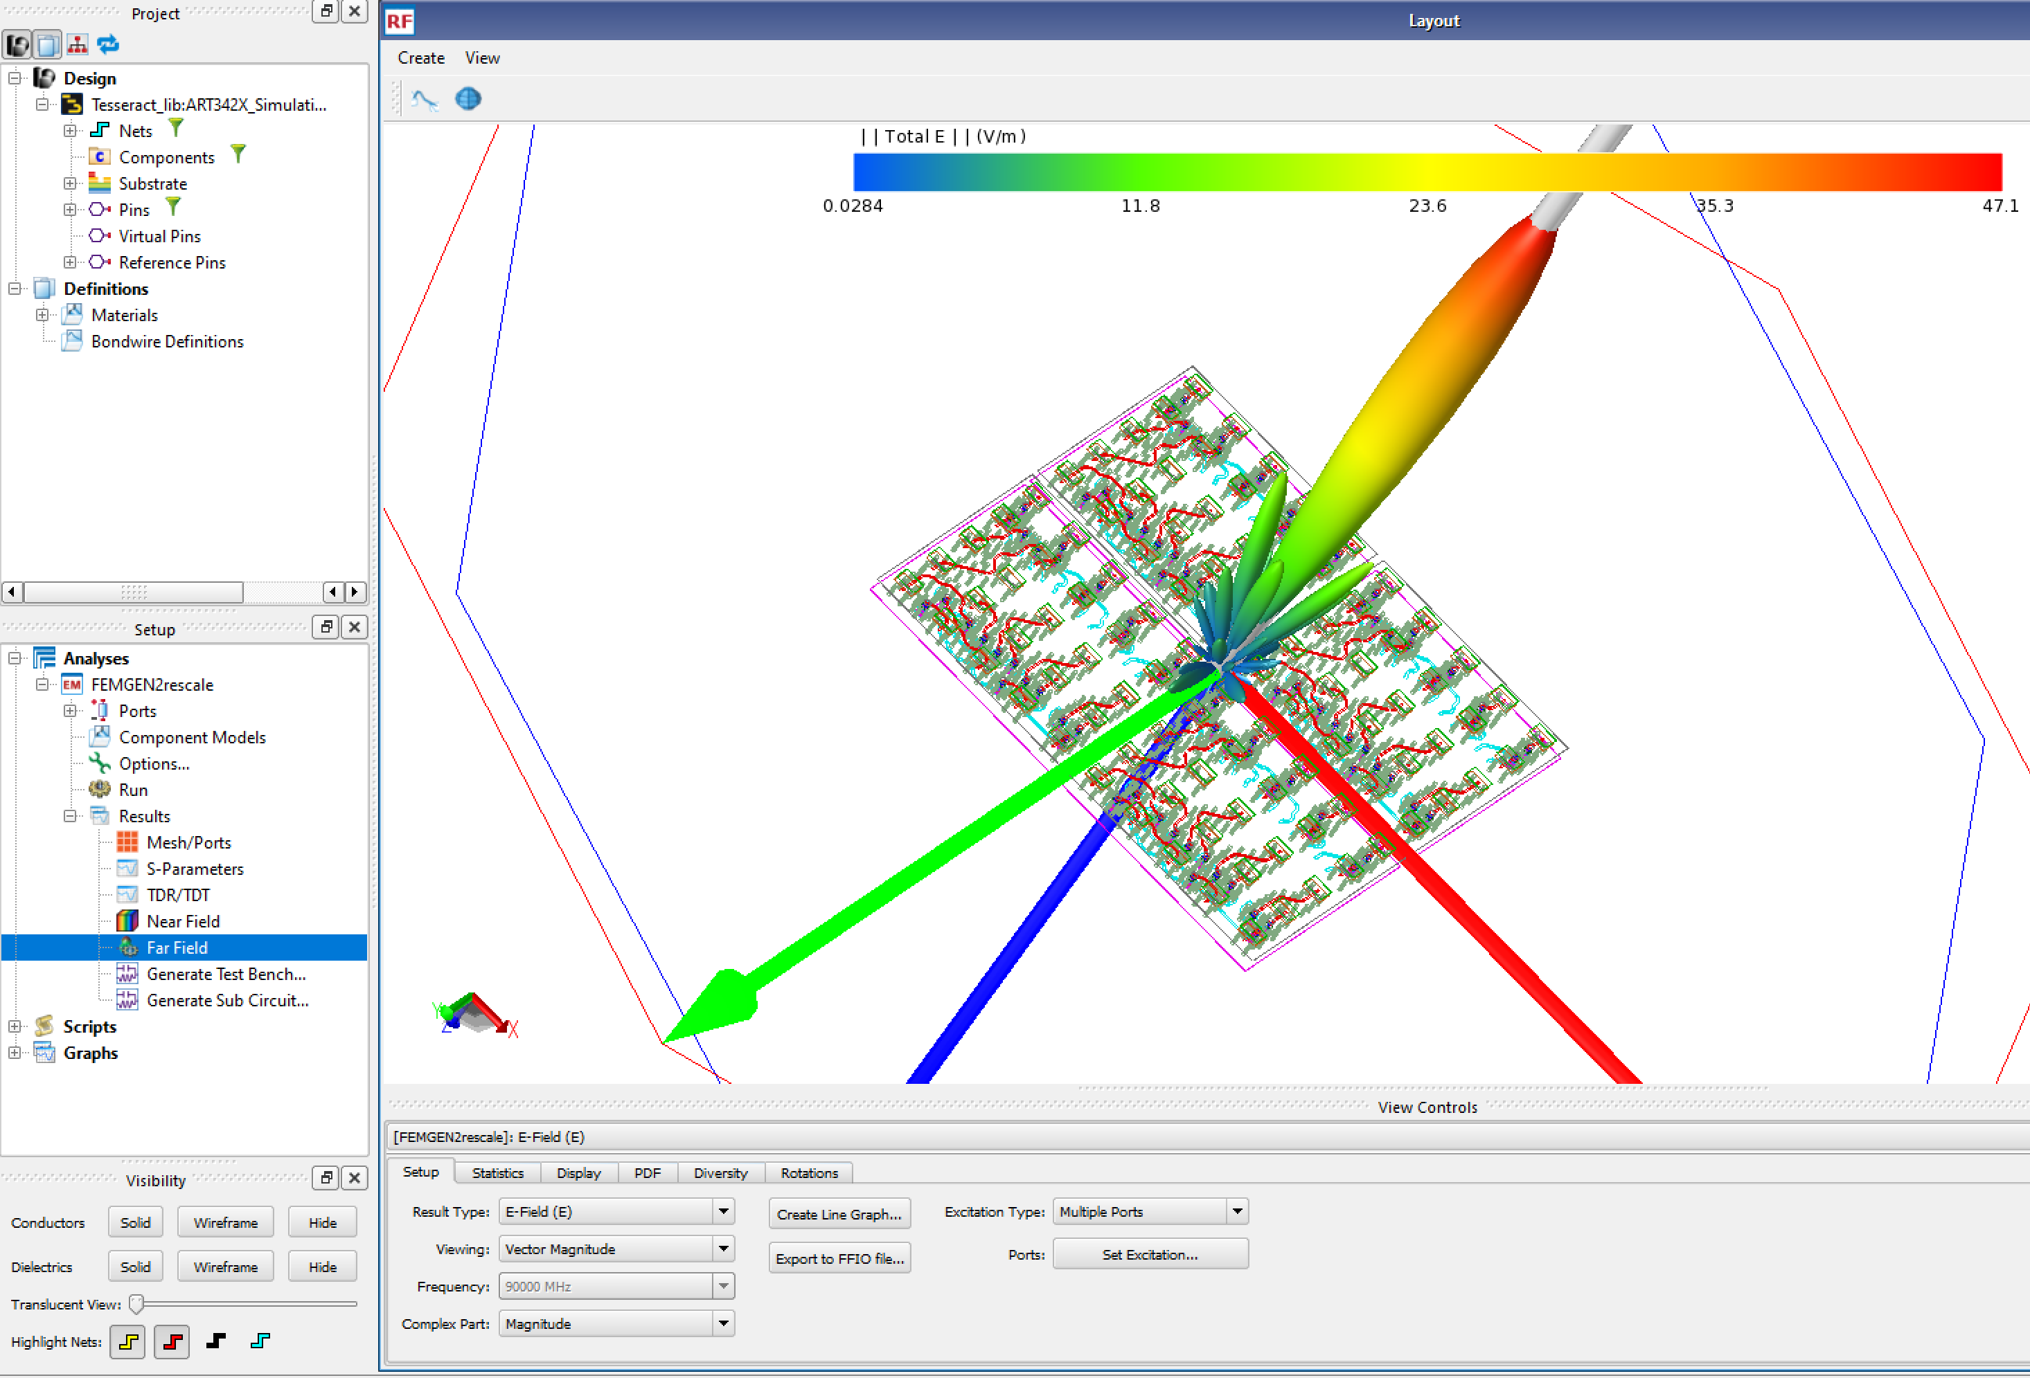
RFPro Vision: Nokia Bell Labs 90GHz W band Phased Array
SiGe Chip Smart Mount to 24 Element Array ‘Tile’
Measurement VS RFPro FEM Simulation VS SystemVue Phased Array Simulation
RFPro FEM Simulation of 2x2 Tile Array
Notes:
Case study link on top right of slide is live. This design contains a Smart Mount mounted SiGe BICMOS IHP chip onto a glass antenna interposer. A single ‘tile’ is simulated from the output of IC PA through the chip-interposer interface to the array elements. This data is passed into SystemVue to create a 2x2 tile array. A large EM simulation is also done of the 2x2 array. Measured VS SystemVue VS Large 4 tile EM simulation for boresight at 90G is shown.

Slide 7
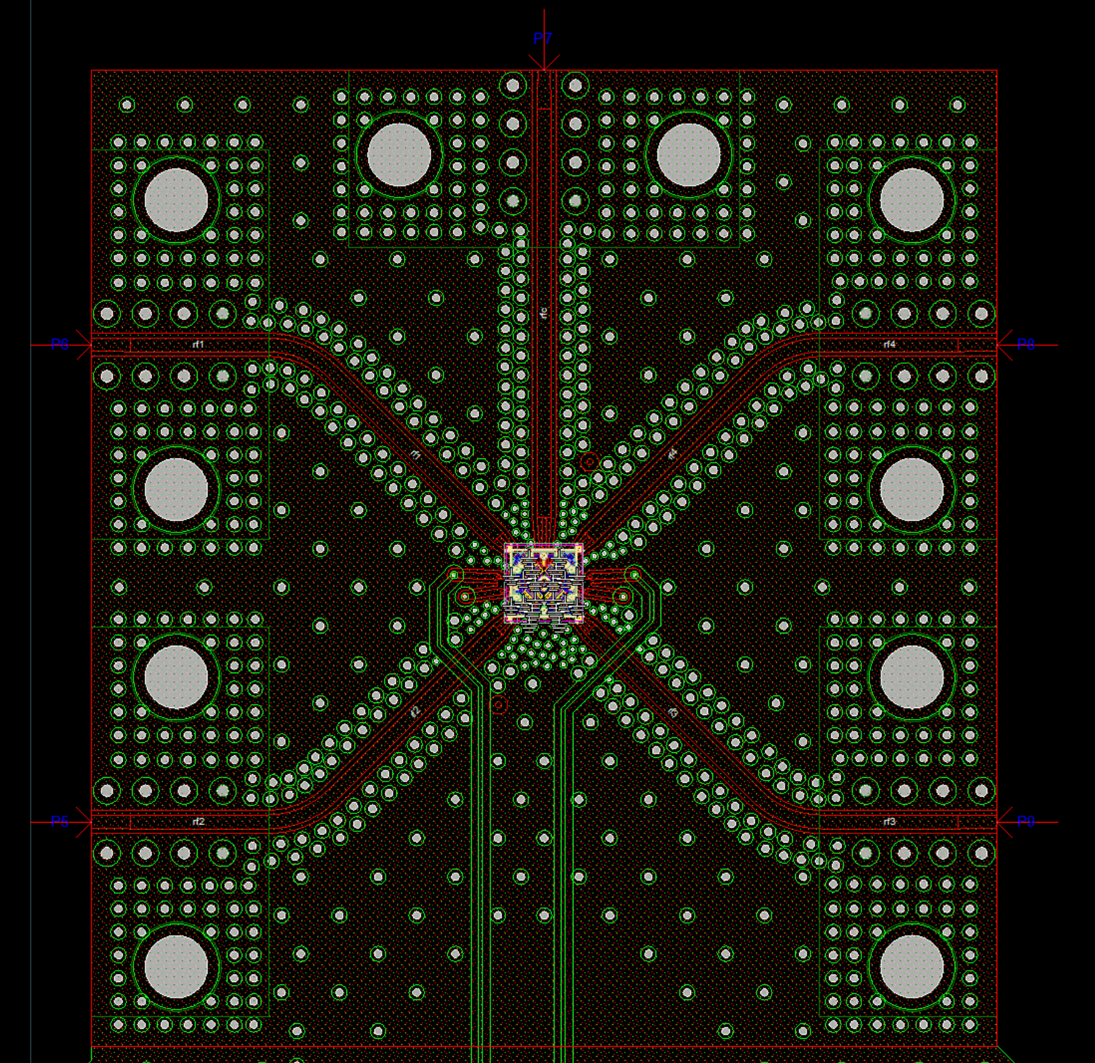
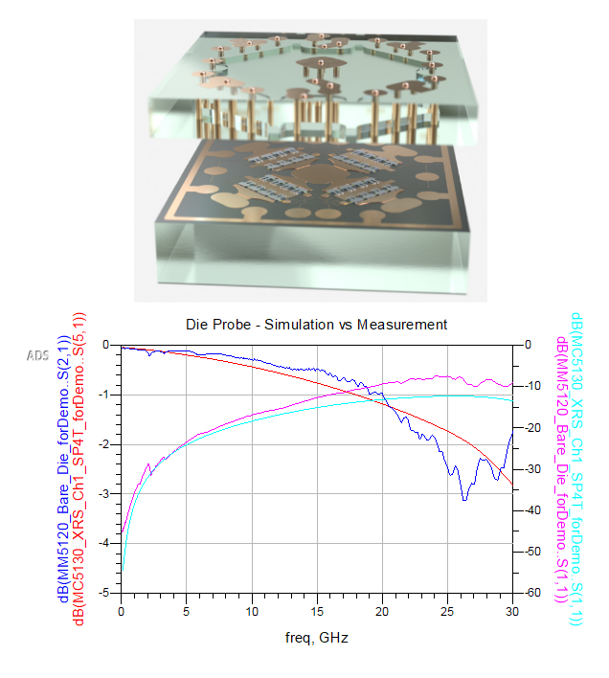
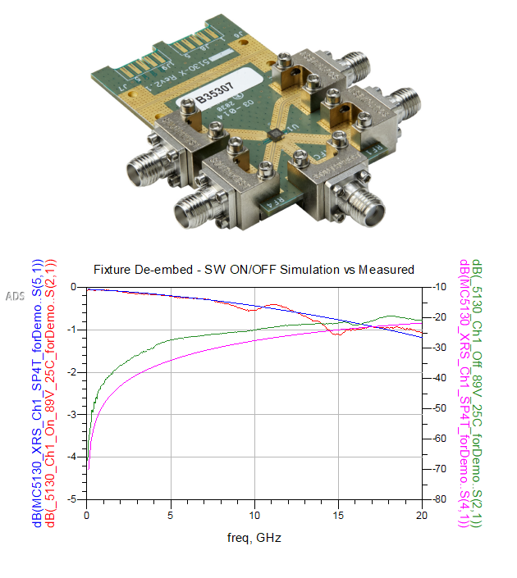
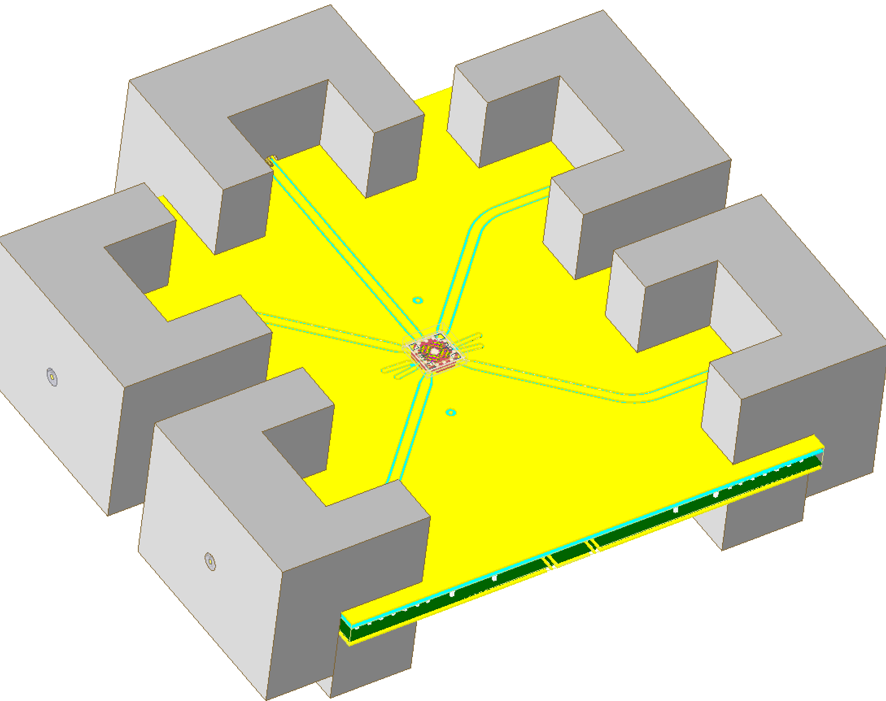
RFPro Vision: Menlo Microwave MM5130 SP4T DC-26G Switch
Chip Smart Mount to Test PCB
RFPro FEM Simulation with 3D Connectors
Notes:
Case study link on top right of slide is live. Simulation of MEMS switch mounted to parent PCB with 3D Component Parameterized Southwest connectors. Measured VS Simulated of die probed chip to 30G, Connector to connector Measured (de-embedded back to chip leads) VS Simulated to 20G.

Slide 8
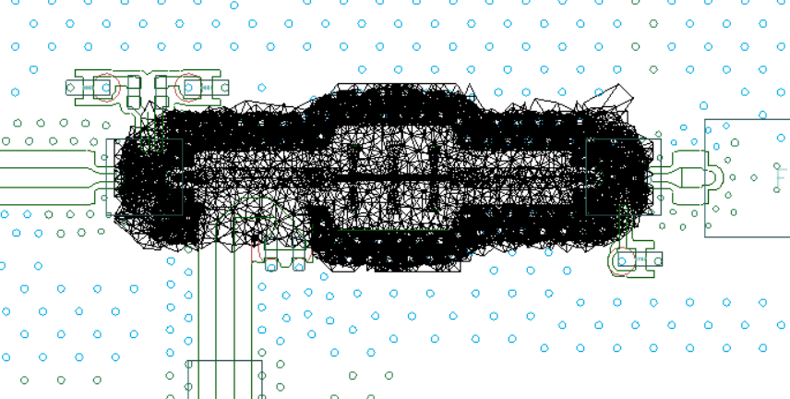
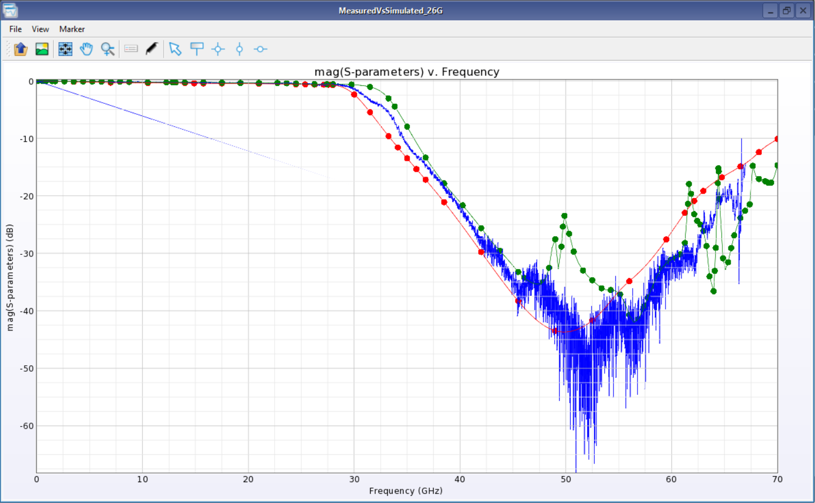
RFPro Vision: Keysight Labs N9042B 50GHz Down Converter PCB
Printed Microwave LPF MDO Analysis – No Cookie Cut!
Measured
Momentum GEN2
FEM GEN2
8 x 4 inch
16 metallization layers
~ 250 000 vias
~ 1000 Surface Mounted Components
Notes:
First of three simulation done on this signal analyzer PCB. Simple MOM/FEM MDO extraction of LPF. Can also discuss Process Variation capability as it relates to filter performance over etch/dielectric tolerances.

Slide 9
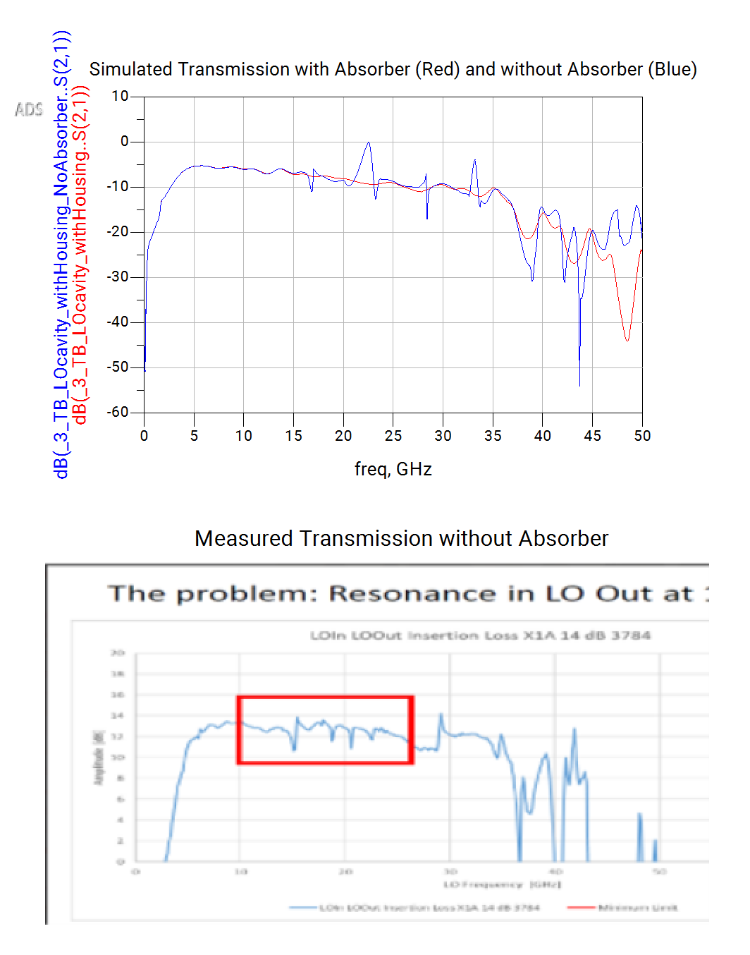
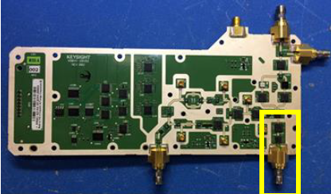
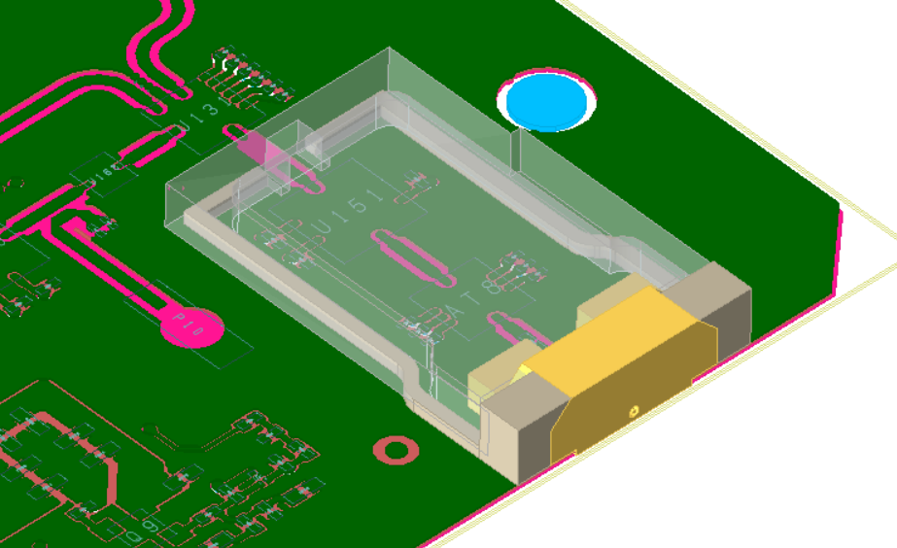
RFPro Vision: Keysight Labs N9042B 50GHz Down Converter PCB
LO Output EMPro 3D Shield Connector
Notes:
Second simulation showing 3D Shield cavity effects. Housing is placed on PCB and simulated with and without absorbing material.

Slide 10
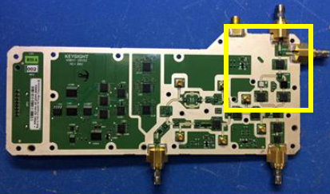
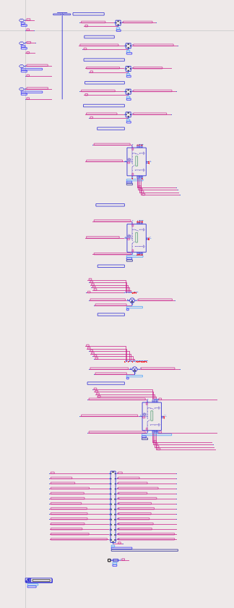
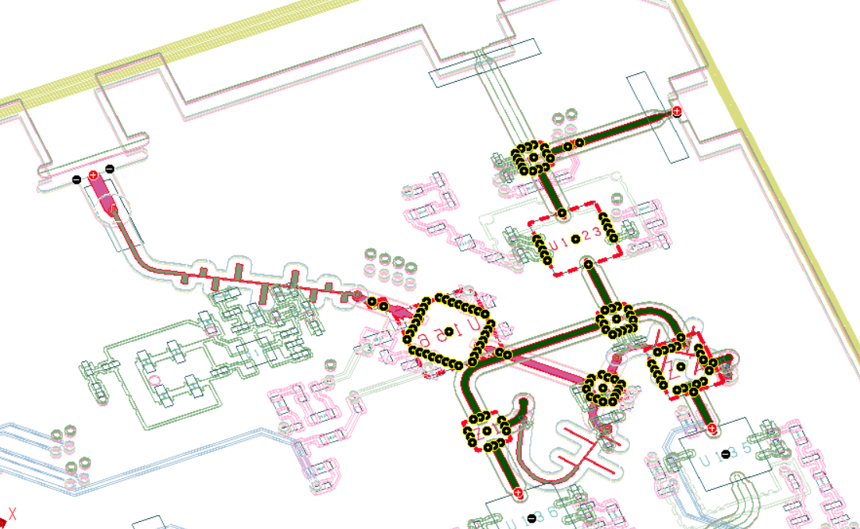
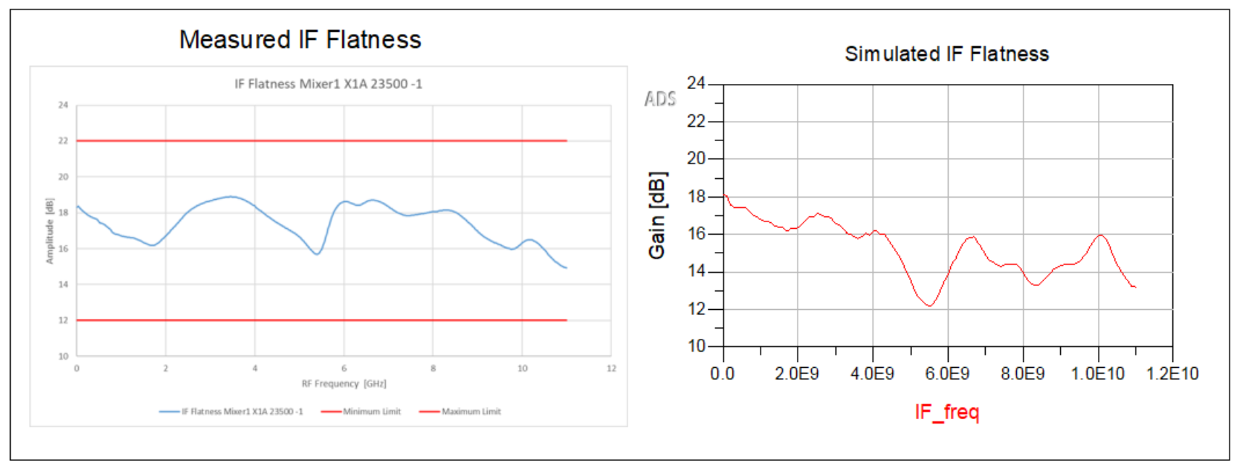
RFPRo Vision: Keysight Labs N9042B 50GHz Down Converter PCB
Full Band 50GHz RFin to IFout Downconverter
Notes:
Final simulation showing complex converter path with all components automatically re-wired.

Slide 11
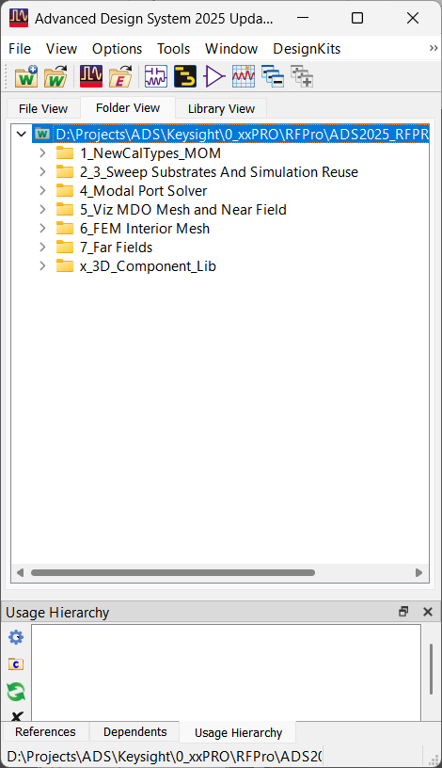
ADS RFPro 2025 updates
One page summary
Workspace Collateral: ADS2025_RFPRo_WhatsNew_v1.1_wrk
Note: Each example folder has ‘readme’ documentation
1
New calibration types extend to high frequencies
2
Sweep substrates
3
Re-use simulation results
4
Modal port solver
5
Visualize mesh and field for MDO simulations
6
FEM interior mesh
7
Far Fields can be computed without Near Field
Notes:
A lot of new updates are introduced in the 2025 release. They cover some usability updates like the requested MDO mesh visualization of the FEM internal meshing but also some algorithmic improvements like the new calibration types

Slide 12
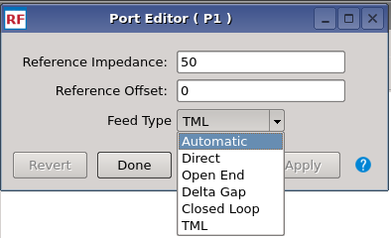
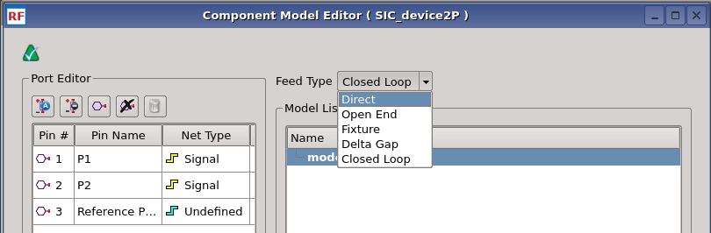
ADS RFPro 2025 updates (1) New Calibration Types Extend to High Frequency
Customer value:
  more accurate HF calibration
  easier to use, less confusion
NEW Closed Loop Feed Type for Component ports and IO ports (horizontal & vertical)
Extended Delta Gap to vertical N-port Components ports and IO ports
Renamed SMD to Closed Loop (SMD was Closed Loop for horizontal 1-port components)
Renamed None to Direct
Renamed TML0 to Open End

Slide 13
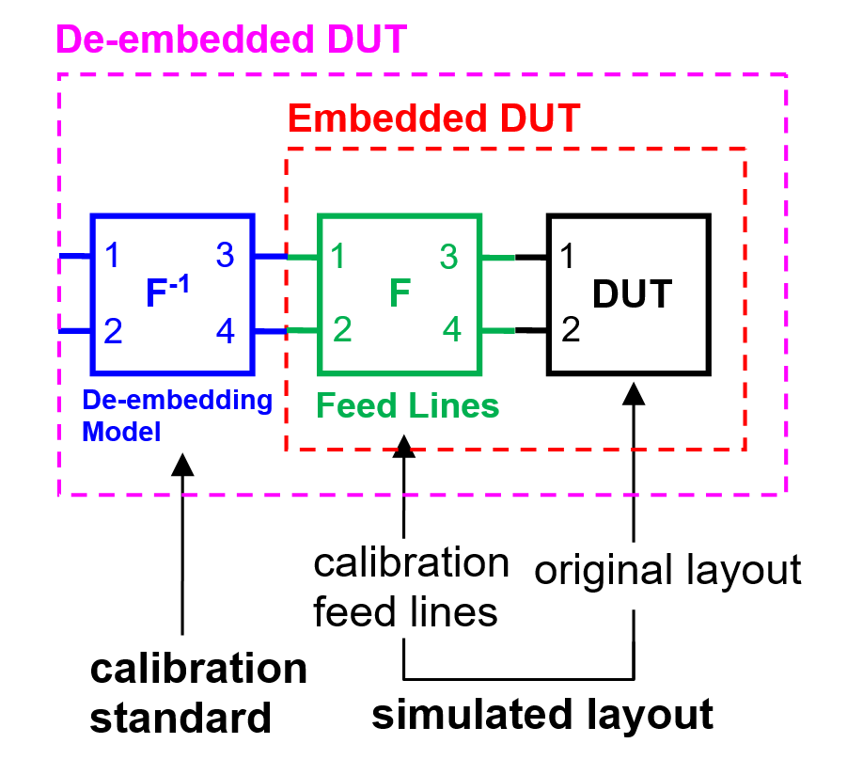
Calibration Process & Terminology
ADS RFPro 2025 updates (1) New Calibration Types Extend to High Frequency
General port calibration process
DUT - Design Under Test
original layout of the design with ports
calibration feed lines
extend the layout of the DUT → Embedded DUT
make the ports physical at HF → Mitigate the HF radiation
but add coupling to the DUT
calibration standard
defines the De-embedding model
removes coupling from the embedded DUT → De-embedded DUT

Slide 14
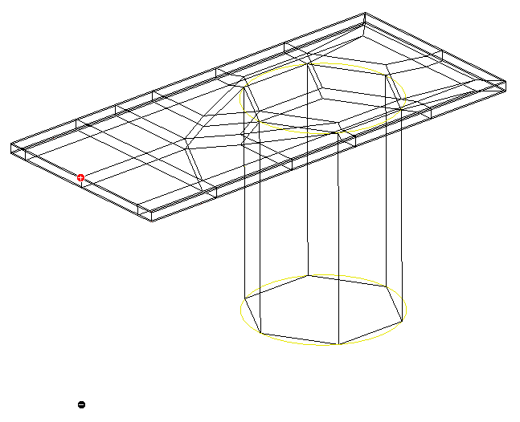
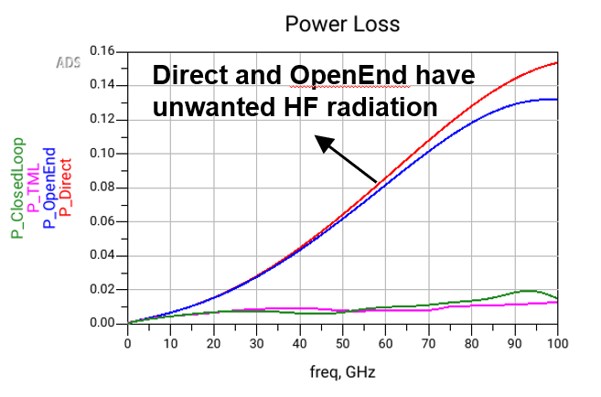
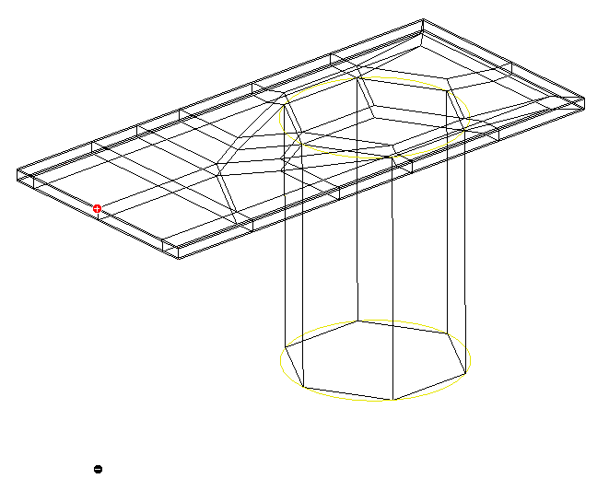
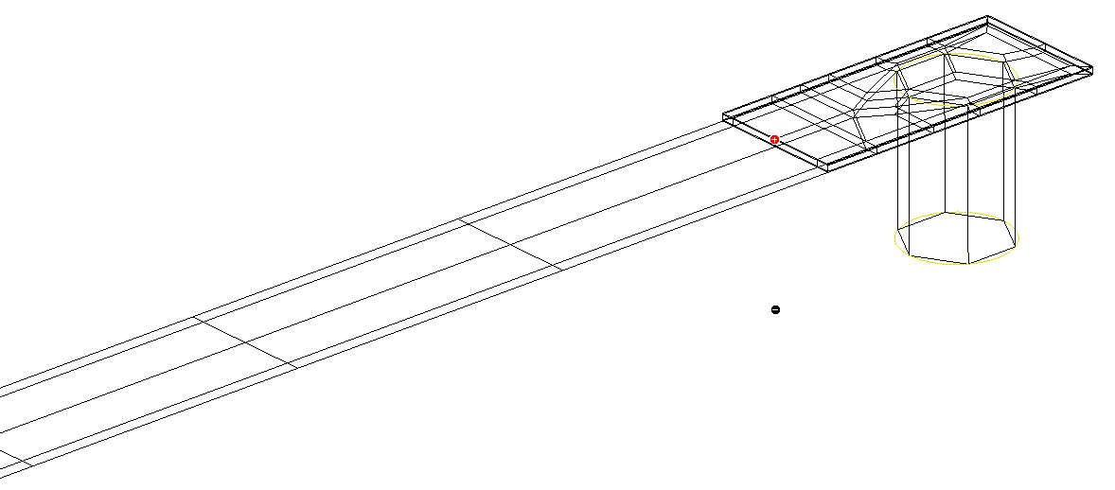
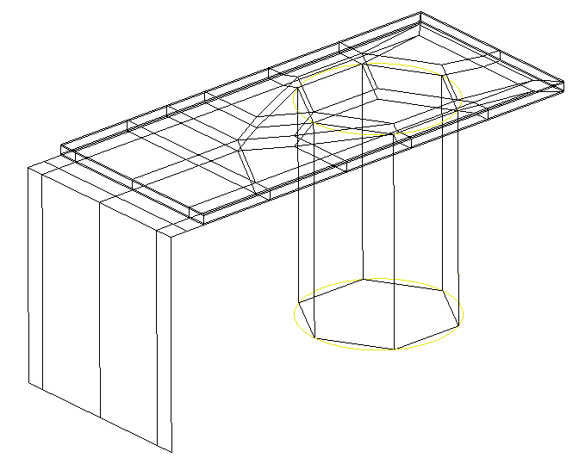
RFPro 2025 solver updates
ADS RFPro 2025 updates (1) New Calibration Types Extend to High Frequency
Calibration = Direct
Calibration = Open End
Calibration = TML
Calibration = Closed Loop
Notes:
Here’s a more visual representation of the calibration types. Open End is simple to explain as there’s no connection to the ground of the structure. For the closed loop, the process add a connection to the ground. Of course, this is an extra line that can also couple so it should be used with proper knowledge. Yet, for HF behavior, having a ground connection helps avoiding radiation and yield to more accurate results as depicted on the graph. This is very useful when TML cannot be used.

Slide 15
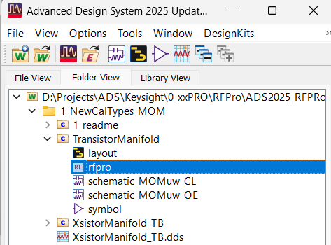
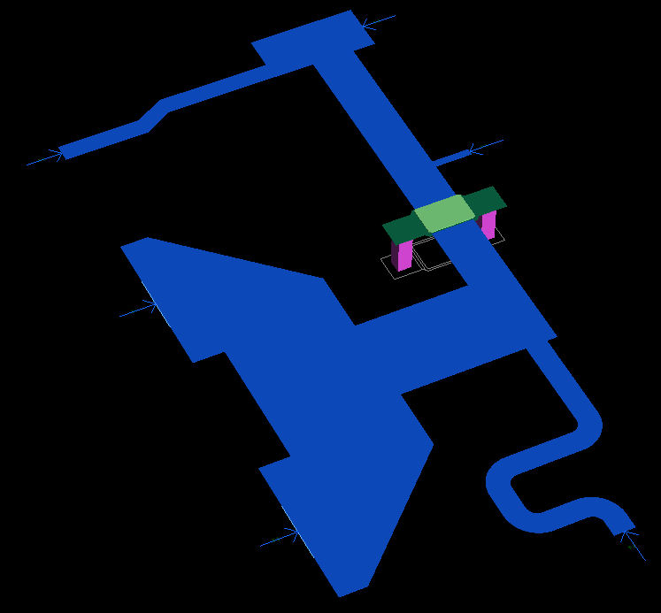
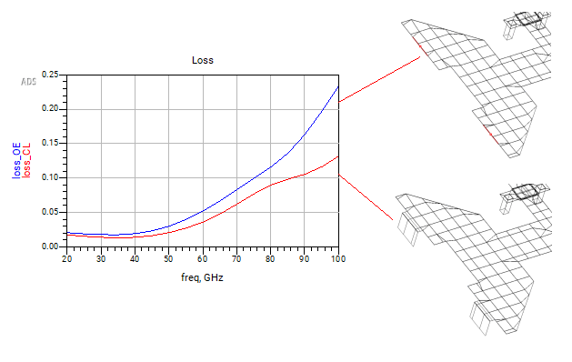
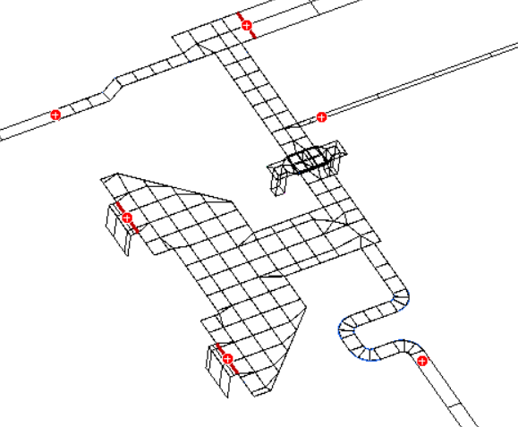
Demo – Transistor Manifold
ADS RFPro 2025 updates (1) New Calibration Types Extend to High Frequency
CLOSED LOOP.
New for ADS2025. Whether a top-level port or component port. Physical feed lines are embedded that provide a path for current to flow, thereby reducing radiation.
But, unlike the case of the Delta Gap port, this added feed is de-embedded out.
This port fully calibrates out 'open end' radiation and capacitive fringing without the need to have 1/2 wavelength of space in the layout.
Notes:
Two potential demos. Demo from ‘What’s New’ highlights mitigation of Power Loss to 100G. I like the demo on the next slides from workspace ‘ADS2025_TL_Calibration_v1_wrk’ where a section of TL is removed and different port feeds for FEM and MOM are applied. This is compared to ‘golden’ simulation of a thru TL with no gap. Clear winner is MOM Closed Loop and FEM Direct calibrations.

Slide 16
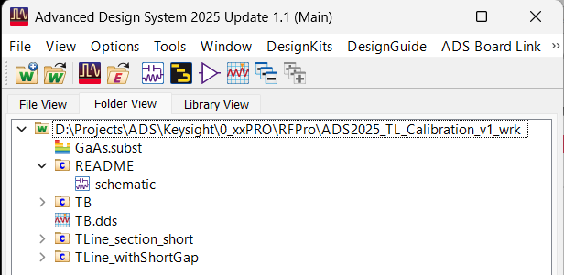
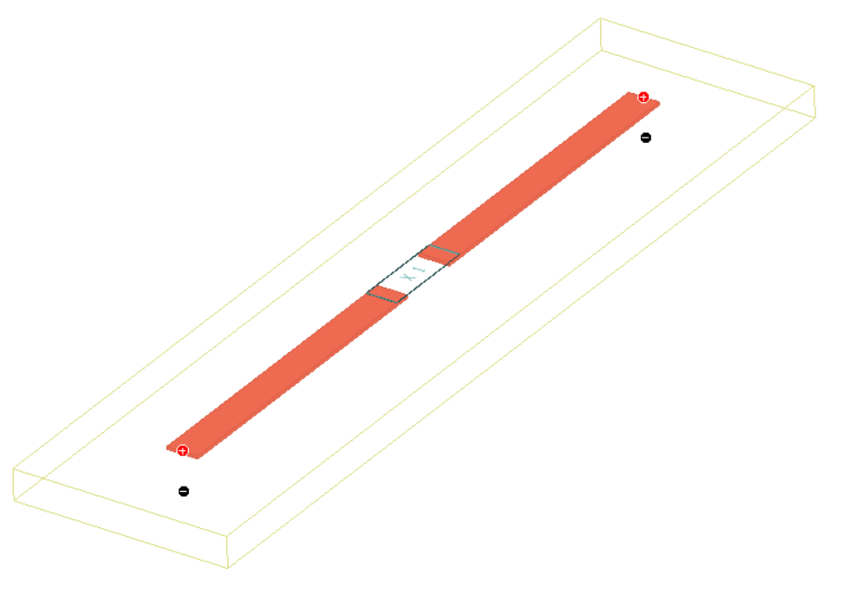
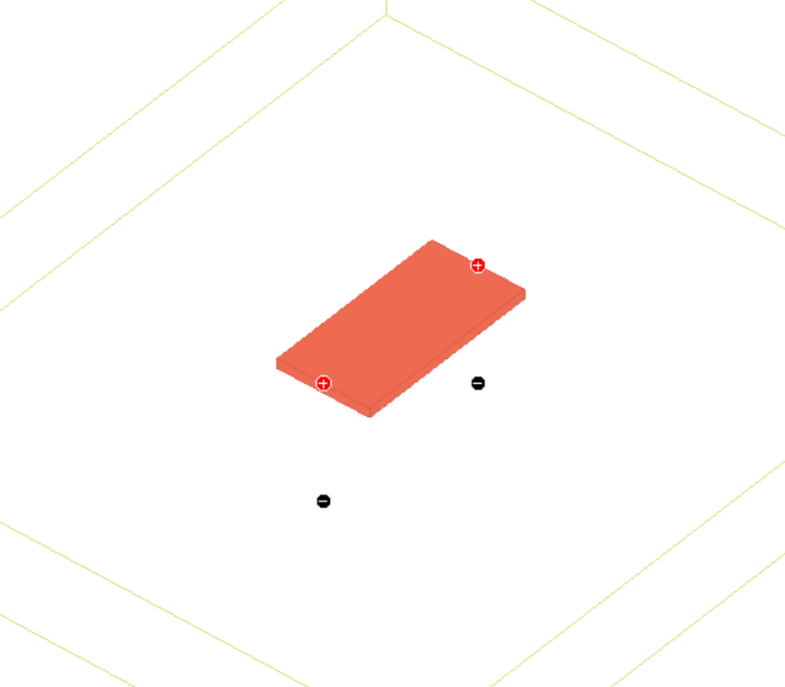
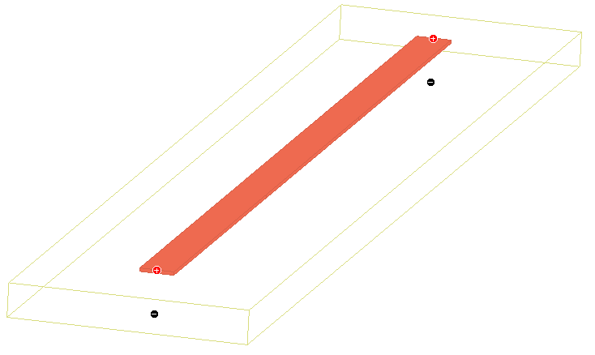
ADS RFPro 2025 updates (1) New Calibration Types Extend to High Frequency
Demo – Transmission Line with gap filled with a Line section – Momentum MW
How perfect is a calibration?
Transmission line with gap
TML
Transmission line section
Transmission line (reference)
TML
L = 2.2 mm
W = 100 um
H = 100 um
GaAs ε_{r} = 12.9
Component ports
TML
→ Direct
→ Open End
→ Fixture
→ Delta Gap
→ Closed Loop
TML
TML
TML

Slide 17
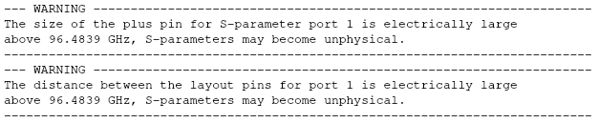
ADS RFPro 2025 updates (1) New Calibration Types Extend to High Frequency
Demo – Transmission Line with gap filled with a Line section – Momentum MW
Reference (no Gap)
Closed Loop
Direct
Open End
Fixture
DeltaGap
Frequency sweep: 0 – 100 GHz
How perfect is a calibration?
Design electrically large
Ports electrically large

Slide 18
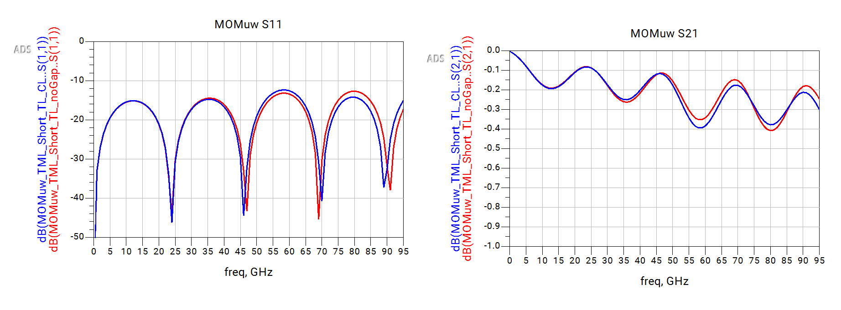
ADS RFPro 2025 updates (1) New Calibration Types Extend to High Frequency
Demo – Transmission Line with gap filled with a Line section – Momentum MW
How perfect is a calibration?
Reference
Closed Loop
Closed Loop outperforms
at higher frequencies

Slide 19
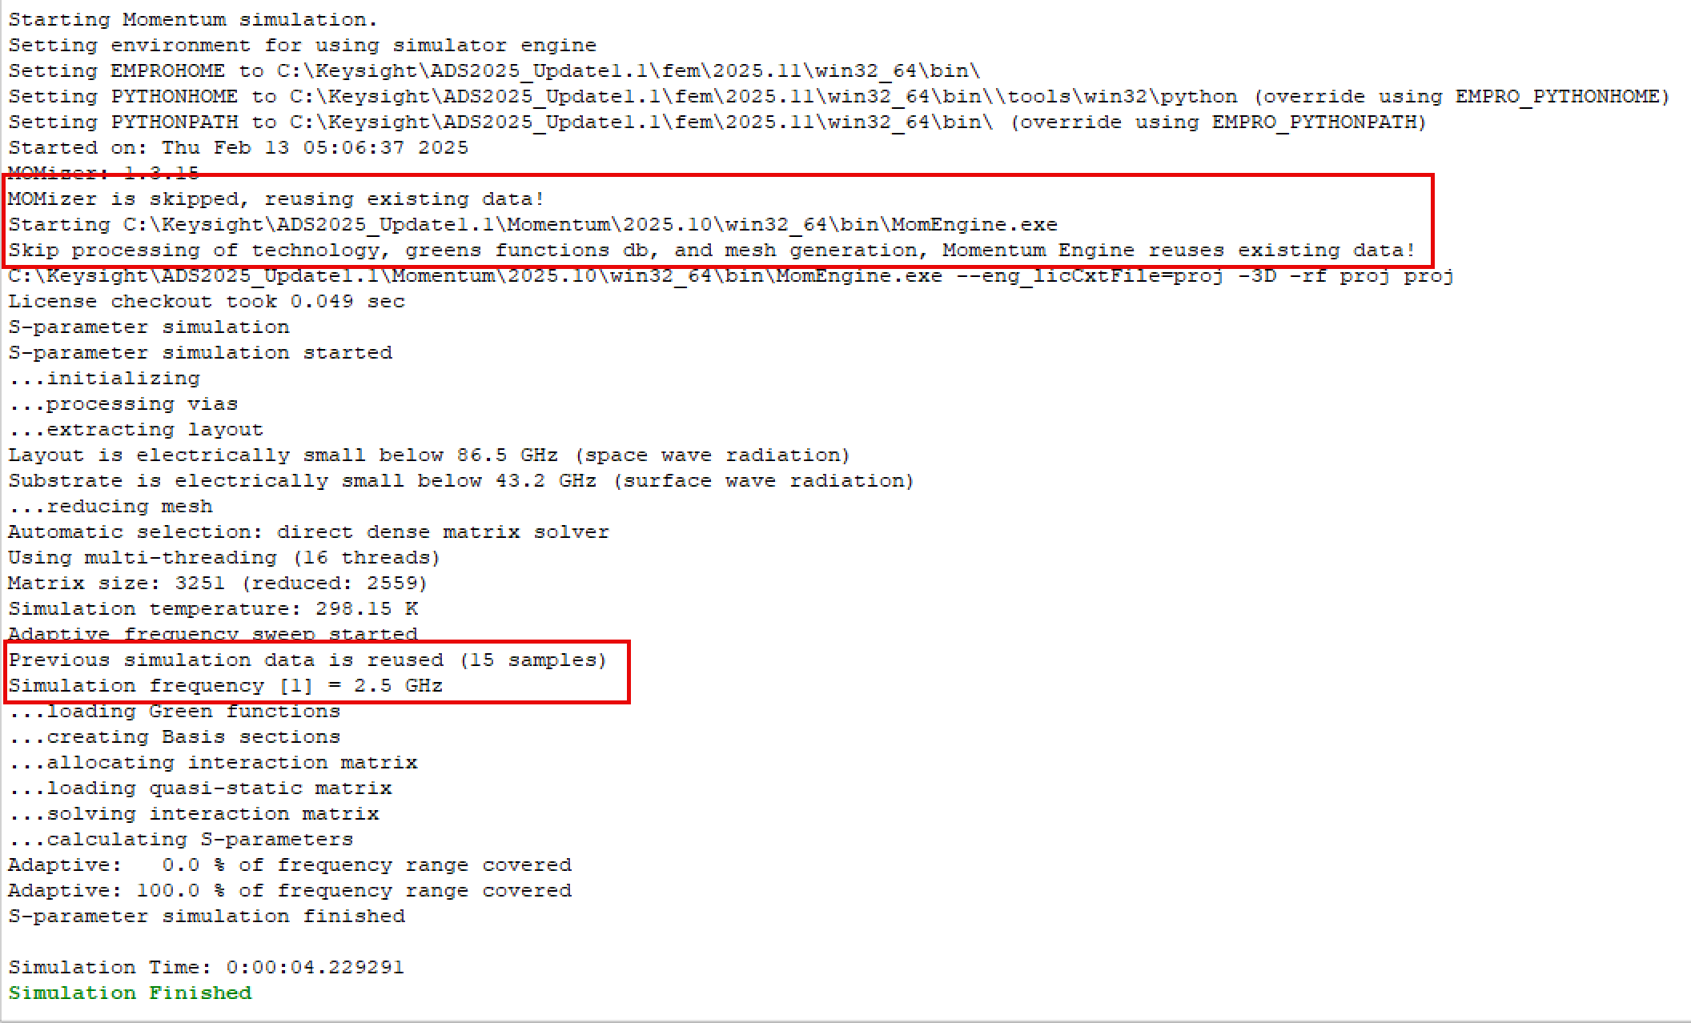
ADS RFPro 2025 updates (3) Simulation Re-use
Demo – Simple MMIC Filter. Designers may want to redo a simulation where changes do no affect mesh.
RFPro automatically detects what can be re-used (mesh, substrate calculation).

Slide 20
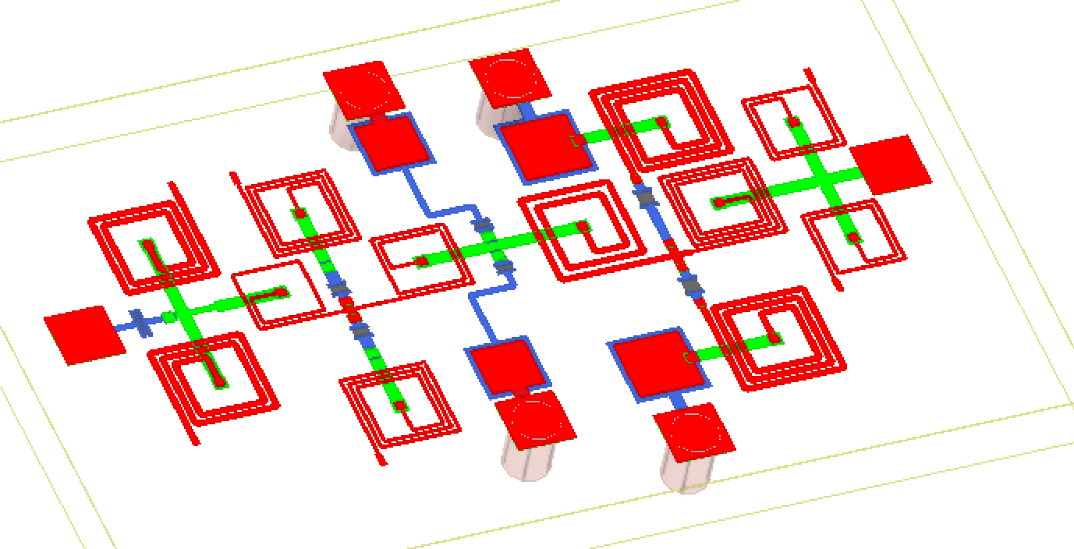
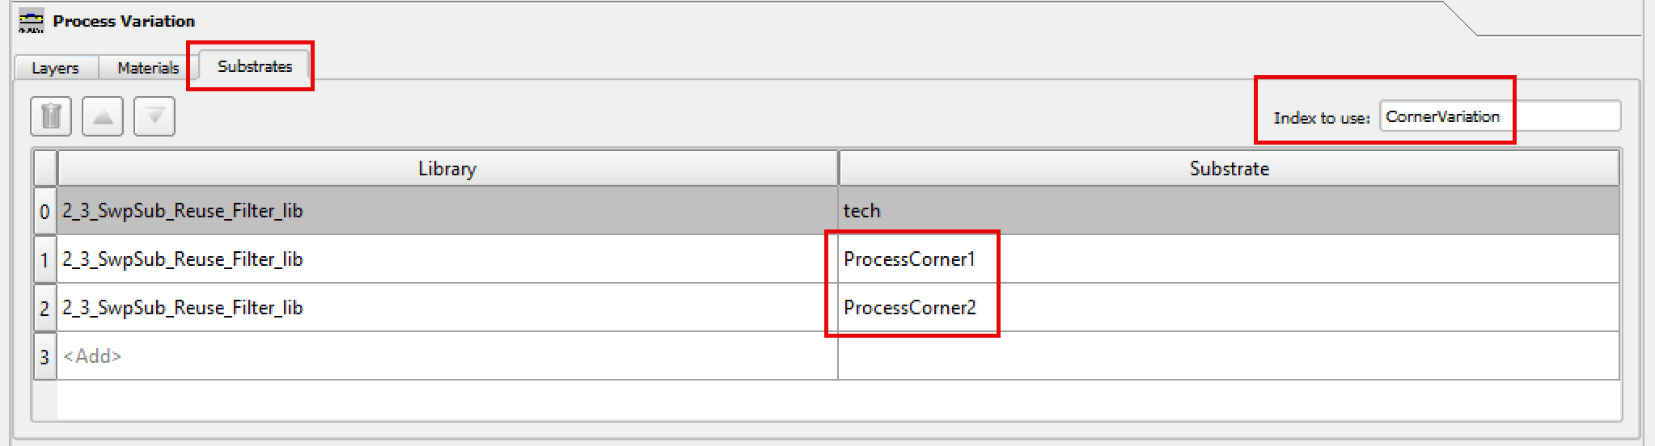
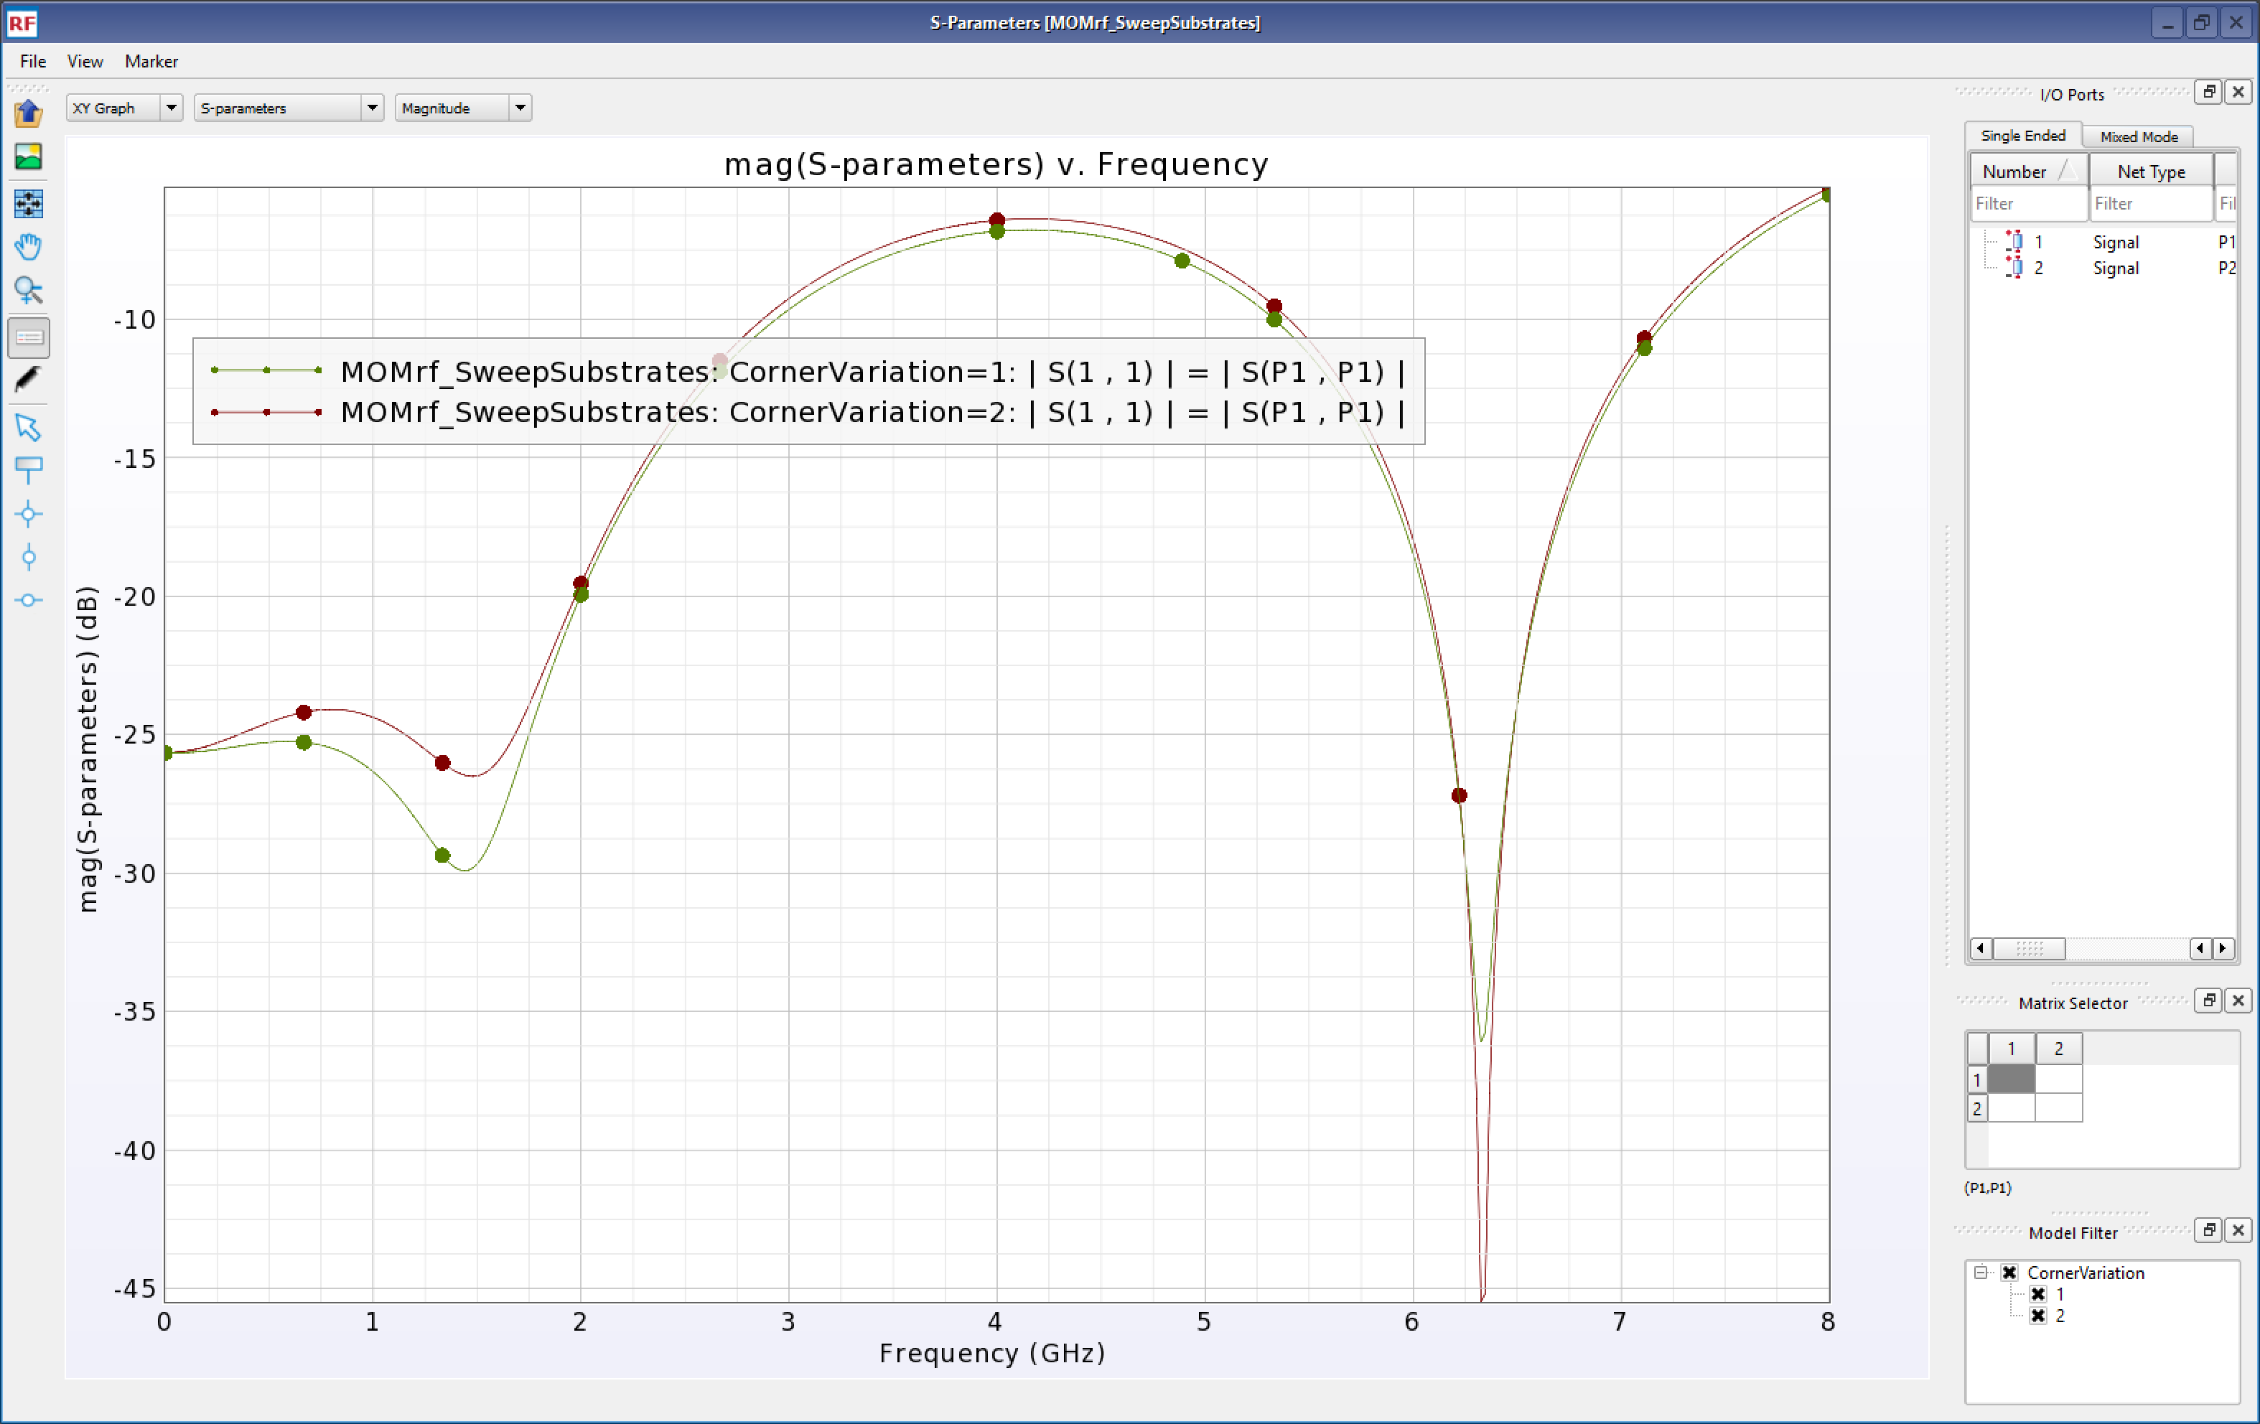
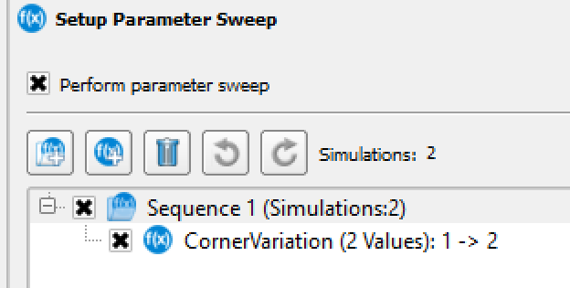
ADS RFPro 2025 updates (3) Sweep Substrates
Demo – Simple MMIC Filter. Designers may want to choose a specific substrate to simulate or sweep through ‘process corner’ substrates.

Slide 21
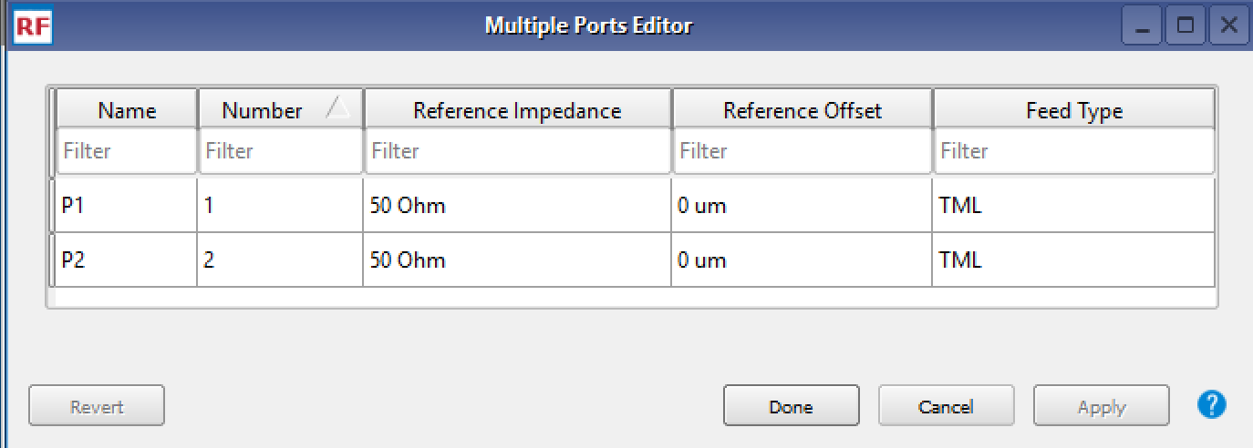





ADS RFPro 2025 updates (4) TML Reference Offsets - FEM Modal Port Solver
Demo – Strip line with Top/Btm Infinite Covers. Two salient points
(1) MOM and FEM ‘TML’ Feed Type supports ‘Reference Offset’
(2) FEM Modal Waveguide Port can Solve multi-conductor structures.
Notes:
To test or extract a model for a device, the device is often mounted on a test board with connectors at the PCB boundary. To exclude the effect of the transmission lines on the test board, making the connection between the DUT and the connectors, a port reference offset is applied. Another use case is to reduce the port parasitic coupling with the DUT. The port lines are extended away from the DUT and a reference offset is used to compensate for that.
The EM simulators in RFPro now support a reference offset when the port feed type is TML.
Momentum simulates a line of the corresponding length behind the scenes and uses the resulting model to shift the reference plane.
FEM invokes a port solver to provide the characteristic impedance and propagation factor of the waveguide mode what allows to shift the reference plane.
A common waveguide excitation challenge is to excite the wanted mode in a multi-conductor structure. The number of modes that can propagate from DC equals the number conductors minus one. For example, in a stripline structure with 3 conductors (line, top and bottom reference), 2 modes can propagate at all frequencies. Besides illustrating how to specify a port reference offset, the demo highlights a couple of the caveats when defining a waveguide port excitation. For example, it highlights an important difference in how the waveguide rectangular boundary is being treated differently by both port solvers.

Slide 22





ADS RFPro 2025 updates (5) ‘Mesh Domain Optimization’ Viz – Near Field
Demo – Keysight Education PCB. Two circuits are analyzed with MDO. (1) Switched Filter Bank, (2) Amp
(1) Switched Filter Bank
Behavioral
EM
EM
Behavioral
(2) Amp with non-reciprocal embedded .s2p Amp model
Notes:
PCB Application. Demo 1 is a MDO extraction of a Switch Filter Bank with various topology filters, Discrete, LTCC, SAW. MDO cookie cut is displayed as well as a EM co-simulation Test Bench. Change the state of the filter bank with the ‘SW_state’ variable. Switch between behavioral and EM extracted. ‘SW_state=3’ shown above, RED is EM, Blue is Behavioral. Note performance degradation when EM is performed.
‘Amp_NearField’ simulation MDO extracts a simple amplifier chain. Amp U401 is modeled with an embedded non-reciprocal .s2p file. Note Near Field current gain and S21, S12 results.
If you want to go deeper. This simulation runs fast. The Amp is not well grounded. Change the Amp to use the center gnd pad as the port reference. Note change in performance and significant change in current VIZ. Good lesson around choosing proper return path.

Slide 23




ADS RFPro 2025 updates (6) FEM Interior Mesh
Demo – Thin Film mmW BPF
Thick 30um Gold is deposited on top of 50nm TiW, of dis-similar conductivity
Thin 50nm TiW ‘cond’ metal is set to Internal mesh
Notes:
FEM simulators, by default, only mesh the outer surfaces of conductors. A surface impedance calculation is performed to estimate loss.
In the case of dis-similar stacked metal conductors (i.e. a 'sandwich' stack) such as thin film plating, loss may not be calculated correctly.
The internal interface between the conductors is not meshed.
To solve this, RFPro can now mesh Inside of metals, the metal interface will be meshed and loss will calculate correctly, no surface impedance estimation.
Options --> Simulator --> Advanced Options (Gear Wrench) --> Physical Model --> 'Thick conductor model' and/or 'Via conductor model'.

Slide 24


ADS RFPro 2025 updates (7) Far Field Computation
Demo – Encrypted Johanson Antenna mounted on an evaluation PCB
Notes:
Far Fields can now be computed without near fields. Additionally, Far Fields can be computed for Encrypted Components. In this example an encrypted EMPro 3D model for a dual band antenna is mounted on a PCB.
Fields are computed.

Slide 25


ADS RFPro Bonus thought – Realizing THz Design
Increasing Frequency means no simplification of physical structures to maintain accuracy.
For example:
Vias must be modeled as fabricated, no longer orthogonal holes.
Substrates can no longer be considered planar. Conformal nitride layers or stacked metal layers must be simulated ‘as-built’
Conformal Substrate with ‘as-built’ metal stack
EMPro 3D Component Implemented in Foundry PDK
Notes:
Frequencies keep increasing, yes we’ve heard that, but what does this practically mean for EM simulation? Not making simplifications. Conformal substrates, metal stacks, non-orthogonal vias must all be simulated as fabricated.
It’s all about the flow. This example uses PDK vias elements that use a EMPro 3D component model, derived layers to create conformal nitride layers and a metal stack that maintains fabrication ‘stepped’ layers.

Slide 26
Summary
No matter what your application area, PCB, IC, Module, ADS IS the platform to Integrate and EM simulate your designs
ADS RFPro 2025 implements 7 new key enablement features.
  New Calibration Standards
  Substrate Sweeps
  Simulation re-use
  Modal Ports
  Mesh Domain Optimization Mesh and Fields
  FEM Interior Mesh
  Far Field Computation
No matter your design complexity (1 THz!) ADS has the capability

