Slide 1
Sound, Science & Spirituality Presents…
Karmic Relief
Awaken to the Unawakened You!
Introduction

Slide 2
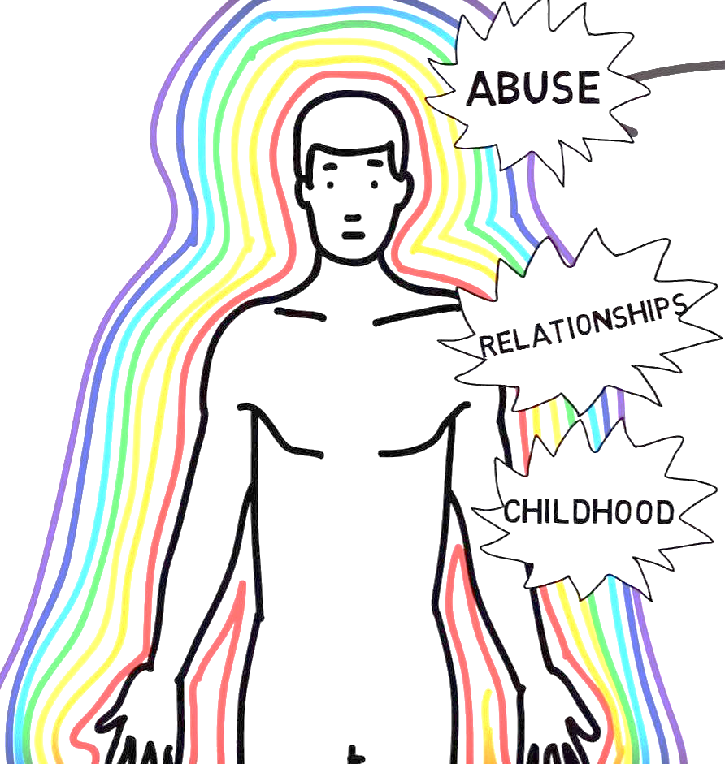
What is the Pain Body?
The pain-body is the collective manifestation of all the pain, misery, and sorrow a person has ever gone through their entire life, and all the things they inherited from their culture and family history as well.

Slide 3
Events of our past can leave an energetic imprint…
Discordant frequencies can also become lodged in the crystalline structure of our tissue…
Discordant frequencies can create areas of non-coherence that leads to obstructions…
The breakdown of healthy frequency information can lead to weakened immunity…

Slide 4
pain body has become certain patterns of life
Does the voice in your head have a life of its own?
Do you find yourself reenacting the past over and over again?
Are you looking for a different way to handle life’s challenging situations?

Slide 5
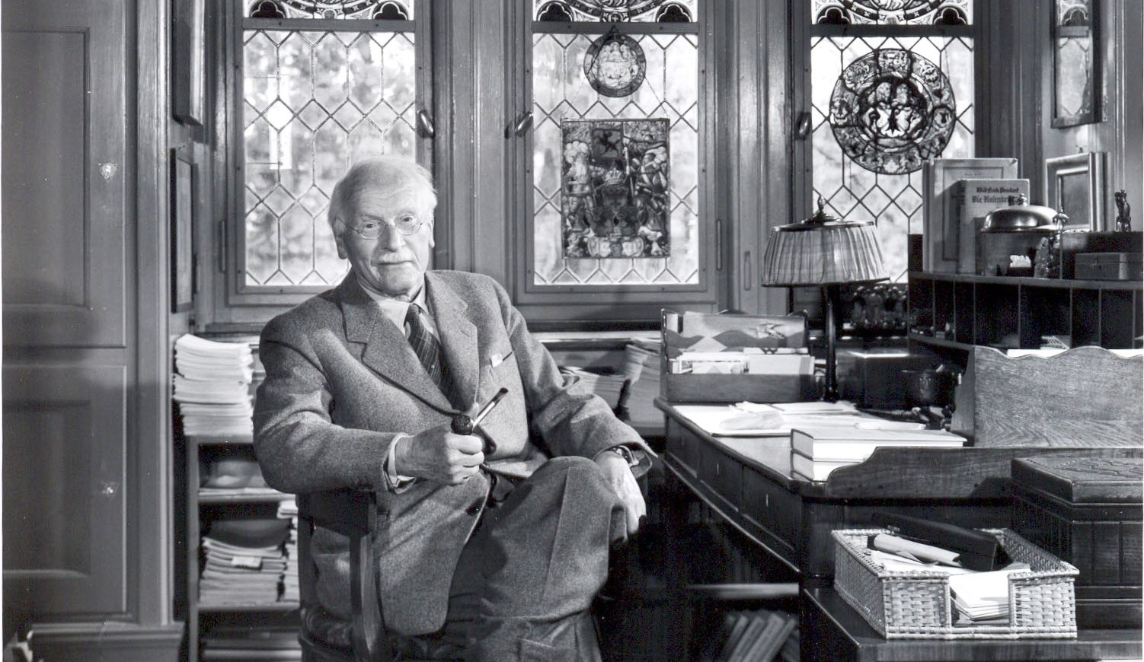
“The psychological rule is that if an inner situation is not made conscious, it will happen outside as fate.”
~ Carl Jung

Slide 6
“The pain-body wants to survive, just like every other entity in existence, and it can only survive if it gets you to unconsciously identify with it. It can then rise up, take you over, “become you,” and live through you. It needs to get its “food” through you. It will feed on any experience that resonates with its own kind of energy, anything that creates further pain in whatever form: anger, destructiveness, hatred, grief, emotional drama, violence, and even illness. So the pain-body, when it has taken you over, will create a situation in your life that reflects back its own energy frequency for it to feed on. Pain can only feed on pain. Pain cannot feed on joy. It finds it quite indigestible.”
~Eckhart Tolle

Slide 7
Your Pain Body is attracted to this class because it is ready to be released!
Week 1: What is your pain body and how was it made?
Week 2: How the Pain Body renews itself into patterns of our life.
Week 3: Awakening to your inner purpose.
Week 4: Our nations pain body.
Week 5: Thoughts, feelings and emotions.
Week 6: Break Free – Karmic Relief!

Slide 8
Karmic Relief; with David Hulse
Awaken to the UNawakened You!
6-week class begins Wednesday, April 5th – 7PM
Energy Exchange: $15 per class or $60 for entire series

